Slide 2
Class :One
Subject: English
Unit –four: Let’s Count
Lesson- One : Counting Cats (four line)
Nigar Sultana
Assistant teacher
Piarpur Govt. Primary School,
Faridpur Sadar, Faridpur.
Nigar.dipty@gmail.com
)

Slide 3
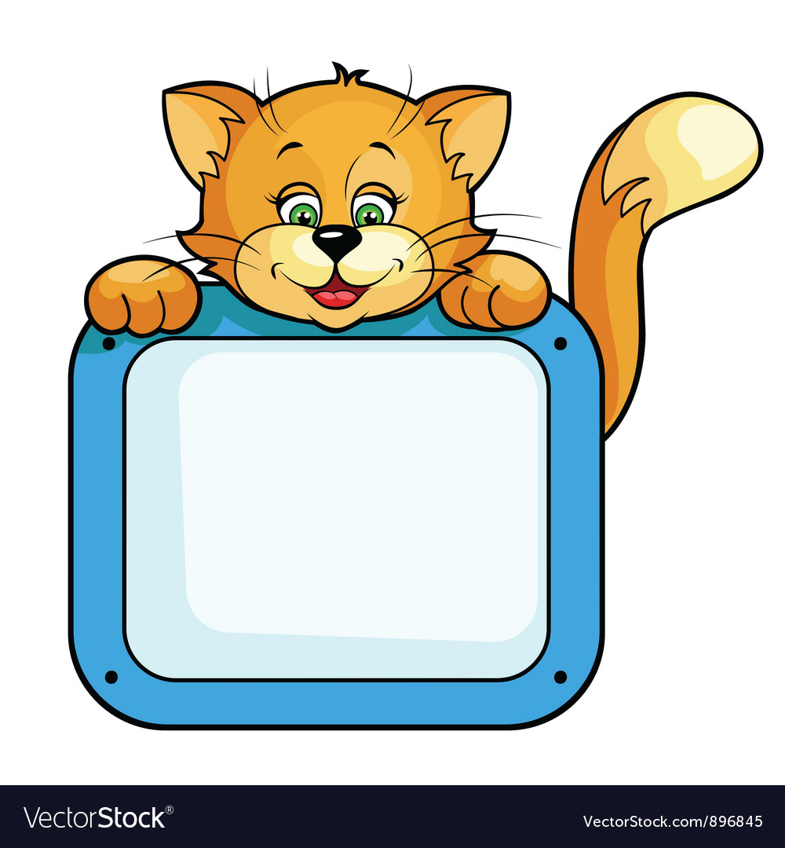
Learning Outcomes: By the end of the lesson students
will be able to
. listen the rhymes attentively.
. recite the rhymes with correct
pronunciation stress and
intonation.

Slide 5
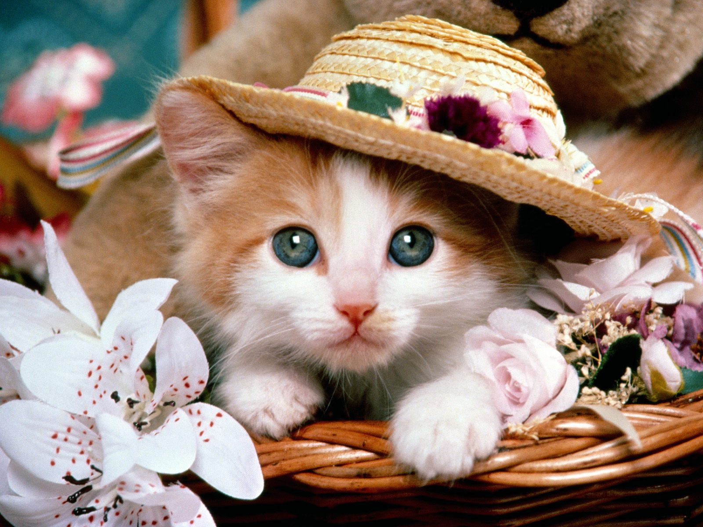
What is this ?
This is cat.

Slide 6
Today’s Lesson:
Counting Cats (four line)

Slide 7
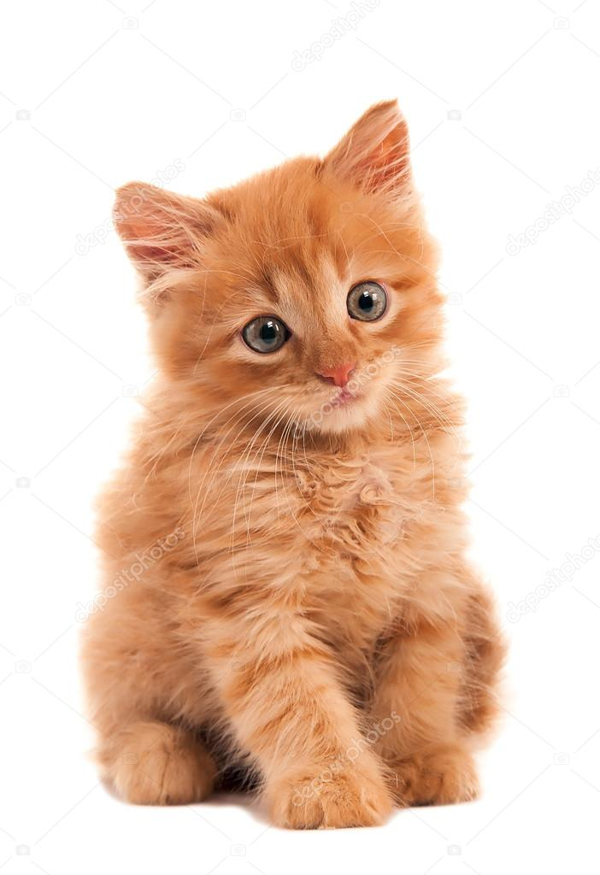
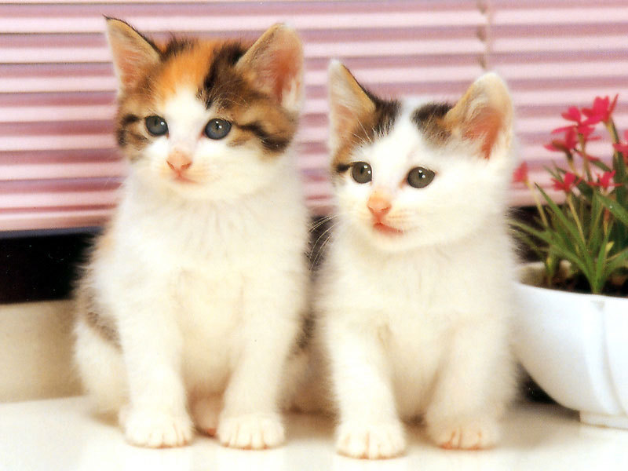
1 cat,
2 cats

Slide 8
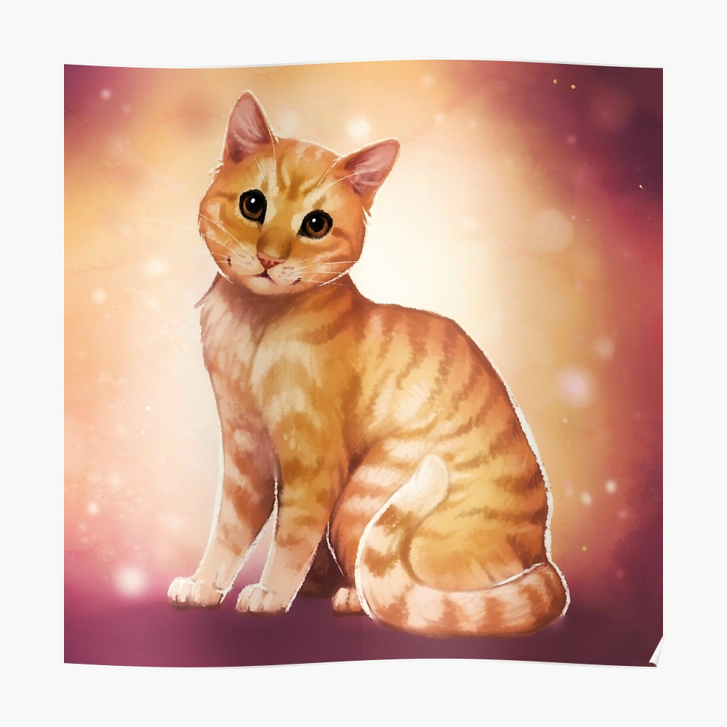
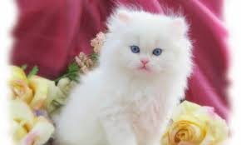
Brown cat,
White cat.

Slide 9
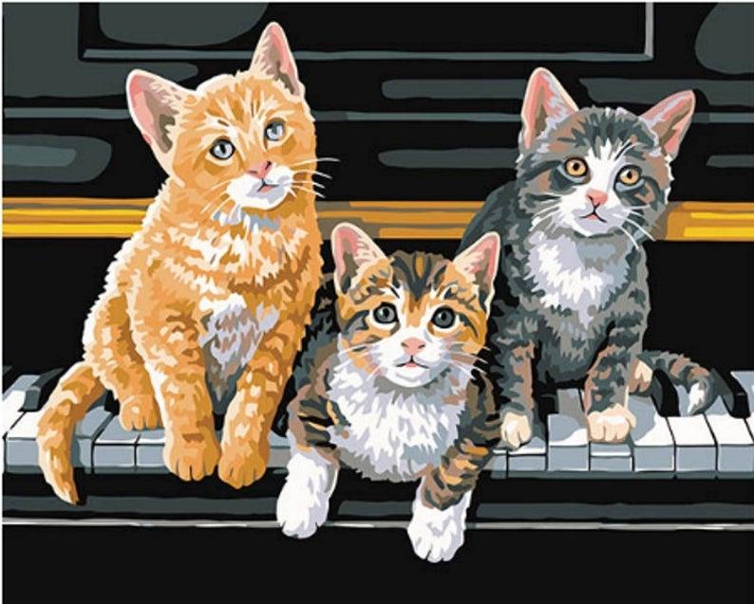
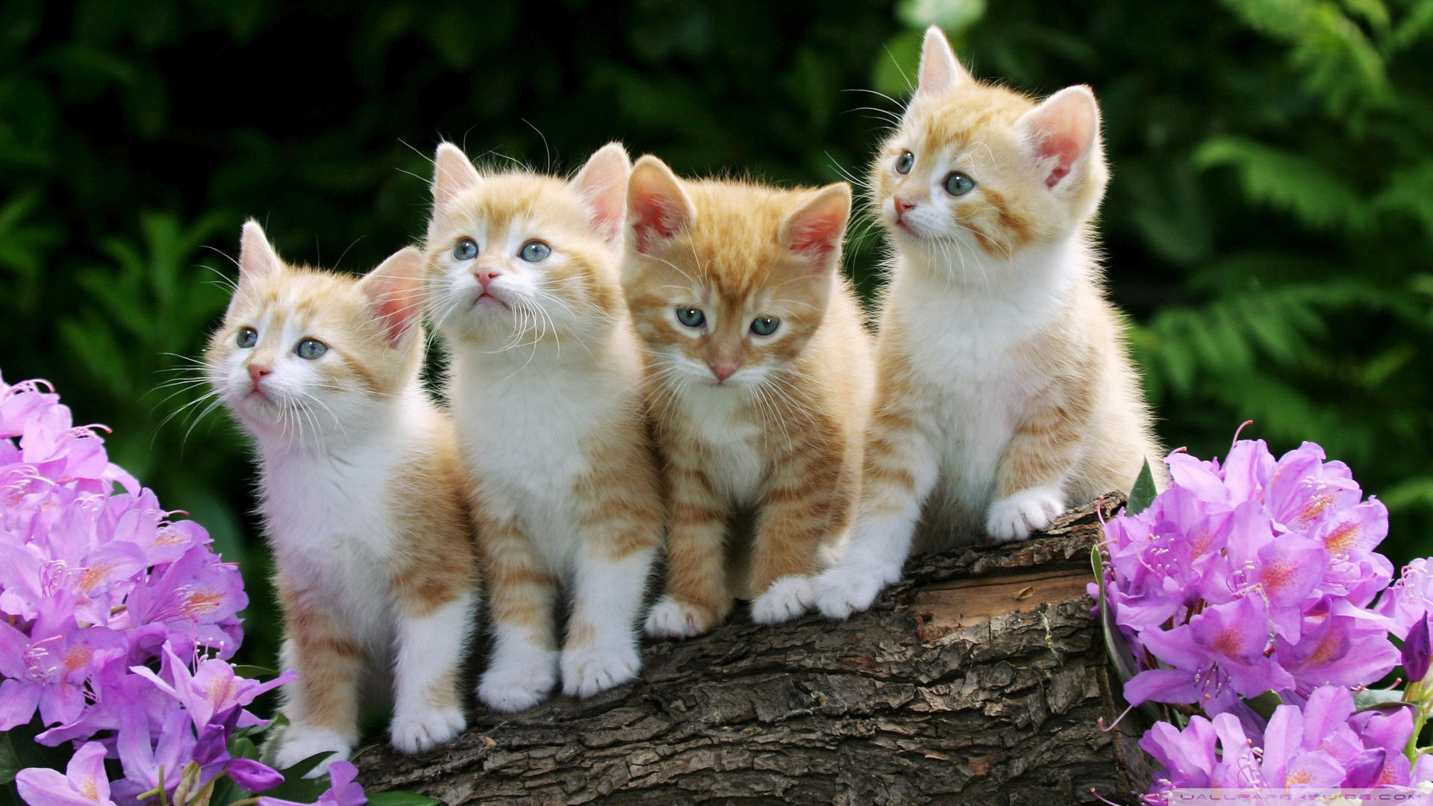
3 cats,
4 cats.

Slide 10
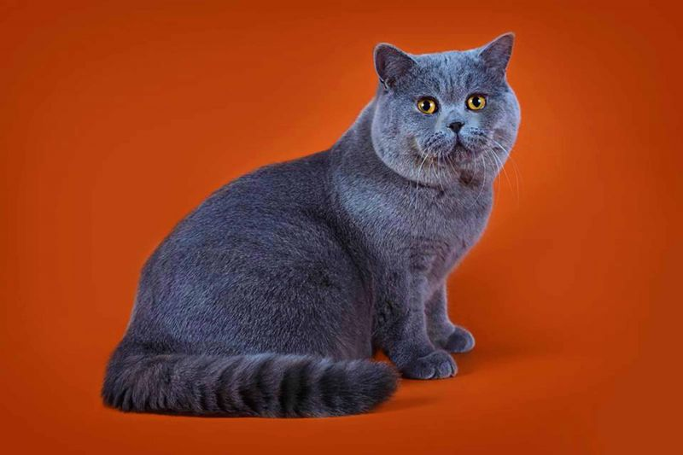
Black cat,
red cat.

Slide 12
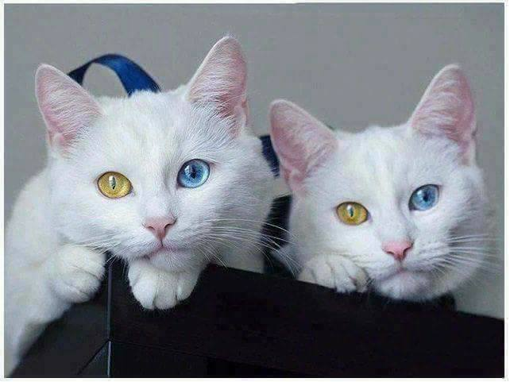
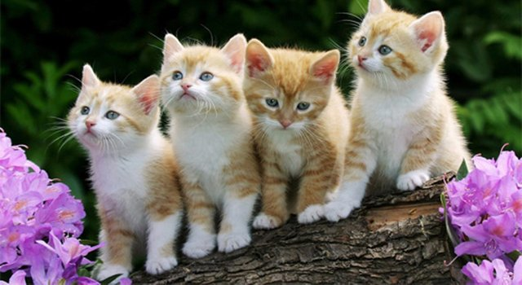
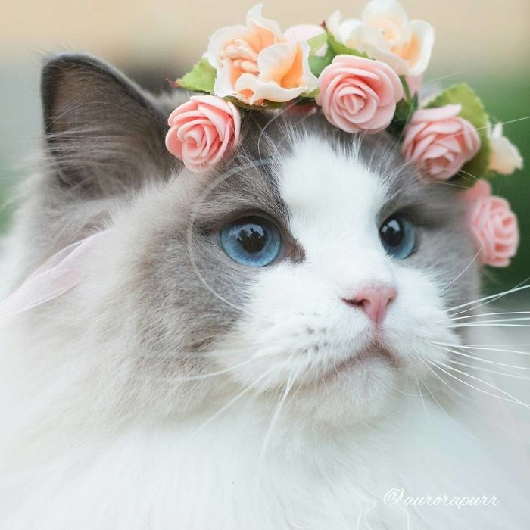
Macthing
1
2
4

Slide 13
Brown cat
Red cat
White cat

