Slide 2
Welcome

Slide 3
Identity
Class- Eight
MD. NOOR E ALAM SIDDIKI
Asstt. Teacher
NAGESWARI KERAMOTIA M.L HIGH SCHOOL.
Mobile- 01716962418
Email- nooralam.na35@gmail.com
Title- Sentence

Slide 4
Look at the following sentences
I will eat chocolate today.
I will not eat chocolate today.
There is some meat in the fridge.
There is no meat in the fridge.
He has found some gold.
He has not found some gold.
Are there any children here?
Aren't there any children here?
What differences have you identified between the two types of sentences?
One is Affirmative and other is Negative

Slide 5
Today’s title is…
Affirmative
to
Negative

Slide 6
After studied the lesson, students will be able to…
Tell about affirmative and Negative sentence.
Transform from affirmative to Negative.

Slide 7
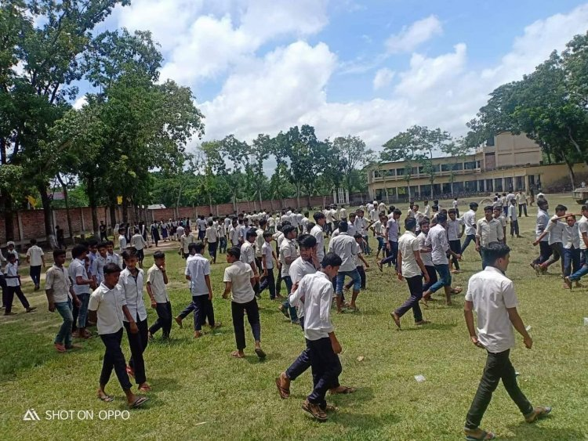
They are students.
They are not students.
They go to school by boat.
They do not go to school by boat.

Slide 8
Auxiliary verb
They are students.
They are not students.
are
To make an affirmative sentence in to Negative, you have to put ‘not’ after the auxiliary verb .
They go to school by boat.
go
Principal verb
They do not go to school by boat.
If there is no auxiliary verb in sentence, we have to place ‘do not/ does not/ did not’ after the subject.

Slide 9
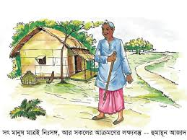
Look at the following sentences
He is a good boy.
He is an honest man.
He is not a bad boy.
He is not a dishonest man.
In transformation we must not change the meaning of a sentence. For this we have to put ‘ not ’ after the auxiliary verb & opposite word of adjective/ verb/ adverb.

Slide 10
Look at the following sentences.
1. He is an honest man.
He isn’t a dishonest man.
2. Mr. Rahim is a solvent man.
Mr. Rahim isn’t insolvent man.
3. We always remember our freedom fighters.
We never forget our freedom fighters.

Slide 11
Group work
Transform the following sentences into negative.
1. Mr. Rahim is industrious.
2. He is able to help you.
3. He loves to work hard.
4. We should remember our freedom fighters.
5. The rose is beautiful flower.
6. They were poor.
7. They are glad to get it.

Slide 12
Match your answer.
1. Mr. Rahim isn’t indolent.
2. He isn’t unable to help you.
3. He doesn’t hate to work hard.
4. We shouldn’t forget our freedom fighters.
5. The rose isn’t ugly flower.
6. They weren’t rich.
7. They aren’t sad to get it.

Slide 13
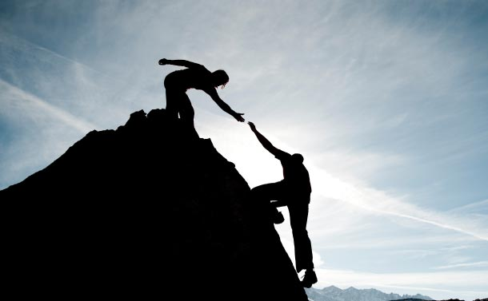
He must help you.
He can not but help you.
He can not help helping you.
If ‘Must/ have to/ has to’ exist in an affirmative sentence, we have to replace can not but/ can not help + ing verb instead of those words.

Slide 14
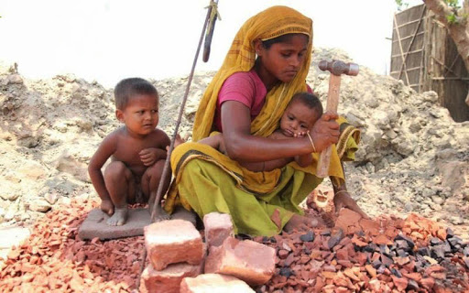
Every mother loves her child.
There is no mother but loves her child.
If an affirmative sentence starts with Every, then we have to follow the following structure.
There is no + noun +but + ex

Slide 15
Every rose has thorns.
There is no rose without thorns.
When ‘has’ is used as verb in a sentence which starts with every, you have to use the following structure.
There is no + noun+ without+ ex

Slide 16
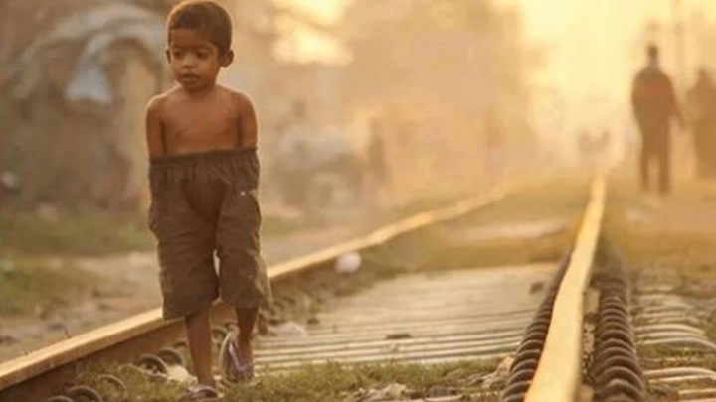
The boy is too poor to buy warm clothes.
The boy is so poor that he can not buy warm clothes.
When too…..to lies in an affirmative sentence, we have to use so…..that instead of too….to. After that subject + can not/ could not + ex has to be used.

Slide 17
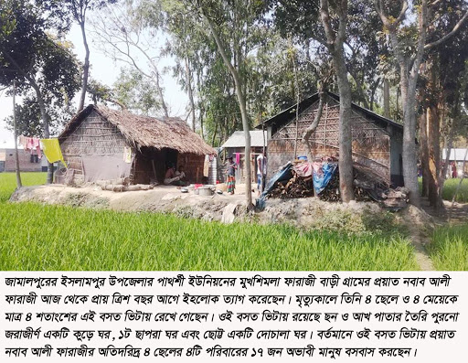
Only Allah can help us.
I have only homestead.
None but Allah can help us.
I have nothing but homestead.
If only/alone lies in an affirmative sentence, we have to use None but (person)/ nothing but( object)/ not more than/ not less than ( age/ serial) instead of only/alone.

Slide 18
As soon as he came, it began to rain.
No sooner had he come than it began to rain.
If an affirmative sentence starts with as soon as,
we have to use No sooner had instead of as soon as.
We have to use past participle verb .
We must use than at the place of comma.

Slide 19
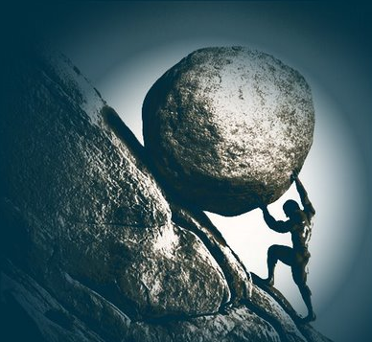
By working hard, you can succeed in life.
Without working hard, you can not succeed in life.
If an affirmative sentence starts with by+gerund, you have to use without+gerund and use not after the A.V in second part.

Slide 20
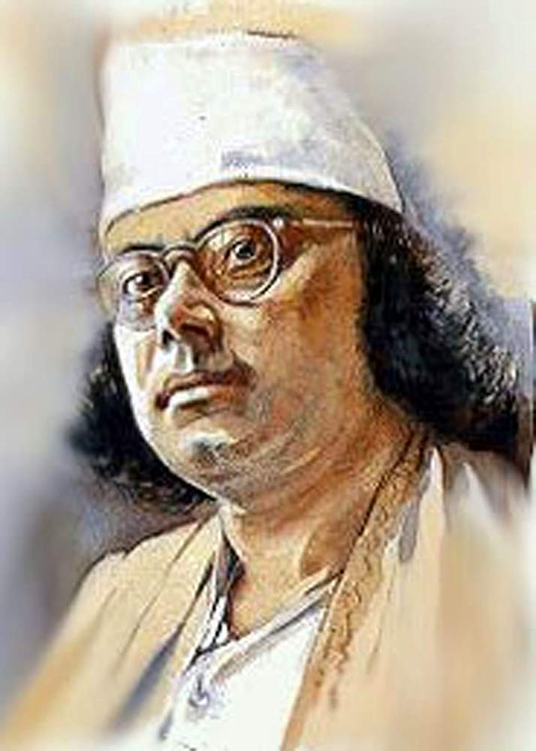
Kazi Nazrul Islam is both poet and novelist.
Kazi Nazrul Islam is not only poet but also novelist.
If ‘both…..and’ lies in a sentence, you have to use ‘not only…..but also’ instead of that.

Slide 21
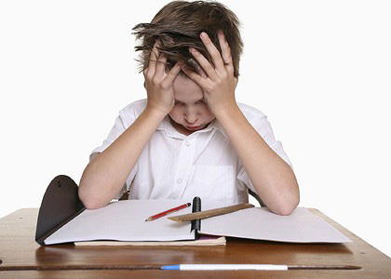
Individual work
Time- 10 minutes
Transform the following sentence into negative.
1. Only the brave deserve the fair.
2. Every cloud has silver lining.
3. As soon as the train arrived, he got into the train.
4. You must follow the rules of health.
5. He was very active.
6. He tried his best to solve the problem.
7. They are sincere to their work.
8. We should remember our freedom fighters.
9. He has to work hard to shine in life.
10. By reading more, you can learn more.

Slide 22
Match your answer.
1. None but the brave deserve the fair.
2. There is no cloud without silver lining.
3. No sooner had the train arrived than he got into the train.
4. You can not but follow the rules of health.
5. He wasn’t inactive at all.
6. He left no stone unturned to solve the problem.
7. They aren’t insincere to their work.
8. We shouldn’t forget our freedom fighters.
9. He can not but work hard to shine in life.
10. Without reading more, you can’t learn more.

Slide 23
