Slide 1
Introduction to Business

Slide 2
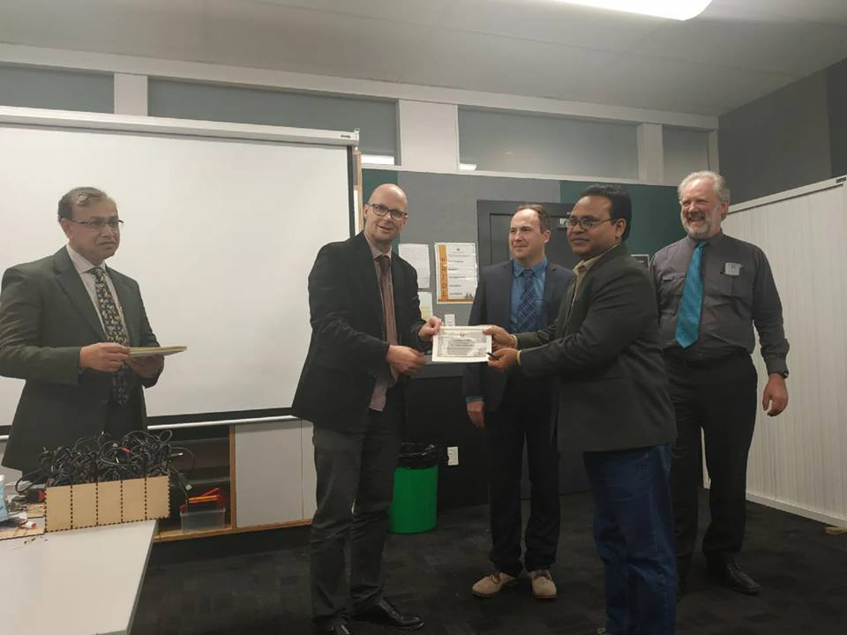
2/16/2020
Khandoker Mufakkher Hossain/ 01911689503
2

Slide 3
Characteristics of
Sole proprietorship
Prepared By-
Khandoker Mufakkher Hossain

Slide 4
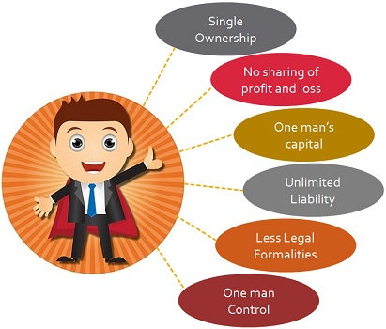

Slide 5
Some characteristics of sol proprietorship
Easy formation
Single ownership
No sharing of profit or Loss
Limited capital
Control
Unlimited liability
Limited area of operation
Fredom in selection of trade
Secrecy
Personal relations

Slide 6
Single Ownership: It is a type of business unit, in which a single person owns the entire business, i.e. all the assets and property belongs to the proprietor. Accordingly, he bears all the risk associated with the enterprise. Hence, the business ends up at his will or on his demise.

Slide 7
2. No sharing of Profit and Loss: Whatever income generated from the sole proprietorship business, it belongs to the sole proprietor only. Consequently, he alone bears all the losses incurred by the firm. There is no sharing of the business profits and losses.

Slide 8
3. One man’s capital: The capital required to start the business or to continue operations, is arranged and brought to the business by the sole proprietor only, either from his personal resources or by borrowing, i.e. from the bank, financial institutions, friends, relatives, etc.

Slide 9
4. Unlimited Liability: This is one of the major con of sole proprietorship business, i.e. the liabilities are unlimited.
In the event of loss, the personal assets of the proprietor along with the business assets can be utilised to discharge the dues of business.

Slide 10
6. Less Legal Formalities: The legal requirements for formation, operation and closure of a sole tradership business is almost nil, even it does not need registration. Although for the purpose of business, it can be registered with local self-government, and obtain a certificate of registration..

Slide 11
One man Control: As only one person is in charge of all the activities, he has full fledged control over it. Thus, the sole proprietor takes all the decision and execute it, in the manner he wants.
There is no legal distinction between the proprietor and business; they are one and the same thing in the eyes of the law. Sole proprietor uses his own skills, intelligence and expertise to operate the business

Slide 12
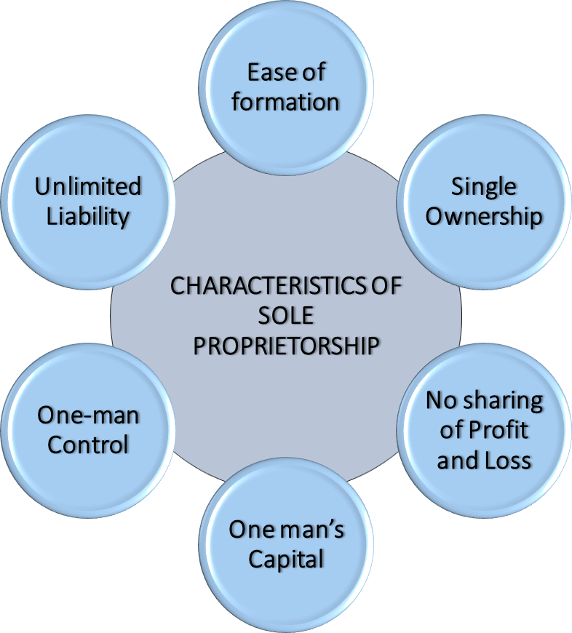

Slide 16
বাড়ির কাজ
আজকের ক্লাসে আলোচনা হয় নাই এডোবি ইলাস্ট্রেটর এর এমন ০৫টি TOOL সম্পর্কে লিখে আনবে ।

