Slide 1
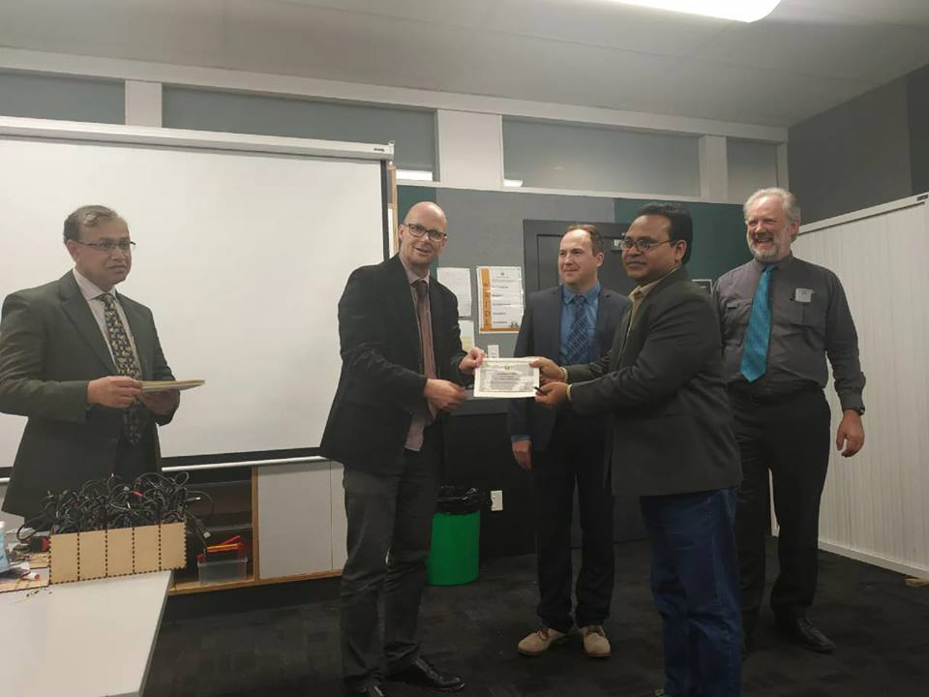
পরিচিতি
2/16/2020
Khandoker Mufakkher Hossain/ 01911689503
1

Slide 3
The advantages of sole trader business are the following:

Slide 4
Advantages-
Easy formation
Direct motivations
Quick decision and prompt action
Better Control
Maintainance of Business Secrecy
Personal relations
Flexibility in Operations

Slide 5
Encourages self-employment
Incetives for hard work
Minimum government regulations
Tax advantages
Better Control of business Functions
Social desirability
Benefits of hereditary goodwill

Slide 6
1. Easy to form: It is very easy and simple to form and organize a sole trader’s business. There are no legal formalities.
2. Simple to manage: It is a small organization. It can be managed easily by the owner himself.
3. Profit incentive: Sole trader enjoys all the profits for himself; This profit motive is an incentive to work hard.
4. Quick decisions: Since he is the sole organizer, he can take quick decisions. He can act promptly according to the changes in the market.

Slide 7
5. Contact with customers: He is the owner and manager of the concern. He will be in a position to study the tastes and needs of customers personally since he establishes good contacts with them.
6. Business secrets: He can maintain the business secrets for himself. Maintenance of secrecy is an important matter in any type of business organization.
7. Smooth running: As he is the sole proprietor there will not be differences of opinions or disputes. It helps smooth running of the concern.
8. Efficiency and economy: The organization is a small one. He can have close supervision. He can reduce the costs of the management and all sorts of waste. Business can be run efficiently.

Slide 8
9. Flexibility: Changes in the business can be adopted at any time. Flexibility is facilitated by small investment. It can be shifted from place to place very easily.
10. Family training: He takes the help from the members of his family in maintaining business. His children get training in the business activities.
11. Self employment: Small scale units can be easily started. Nationalized banks are also helping in this direction.

Slide 9
12. Social advantages: It provides opportunities to a number of individuals. Many can become entrepreneurs with limited resources.
13. Tax advantages: Income tax is imposed on the personal income of the sole trader, but not on the profits of the concern. Hence it is advantageous.

Slide 10
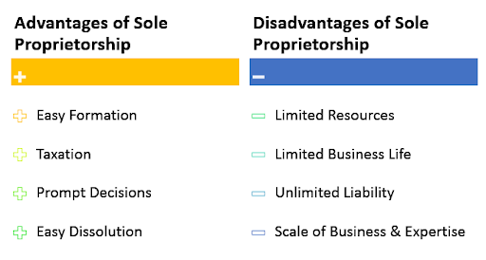

Slide 11
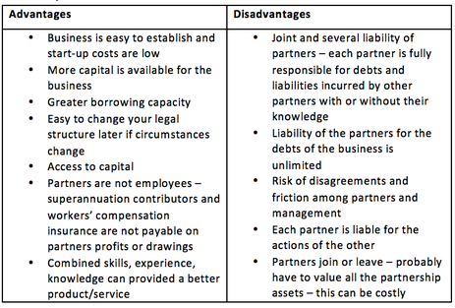

Slide 15
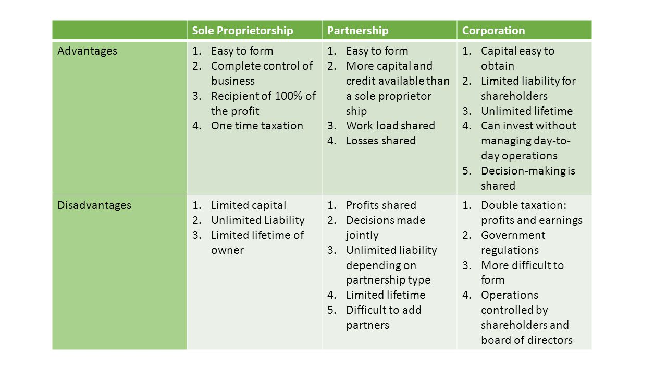

Slide 16
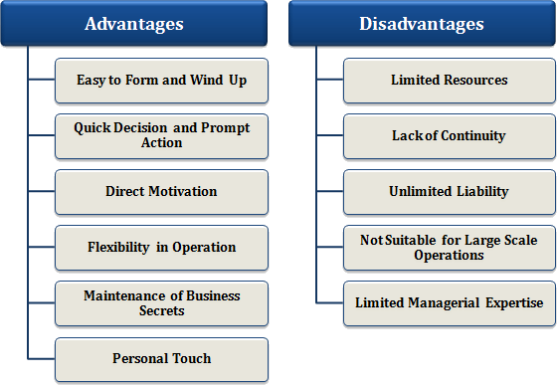

Slide 17
বাড়ির কাজ
আজকের ক্লাসে আলোচনা হয় নাই এডোবি ইলাস্ট্রেটর এর এমন ০৫টি TOOL সম্পর্কে লিখে আনবে ।

