Slide 1
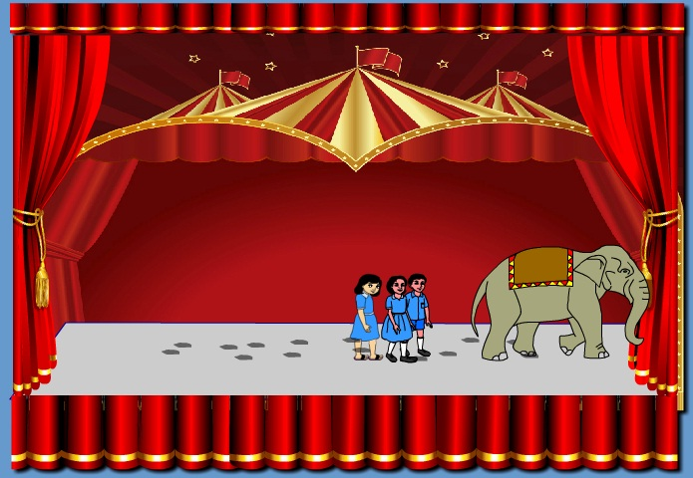
Welcome Students.

Slide 2
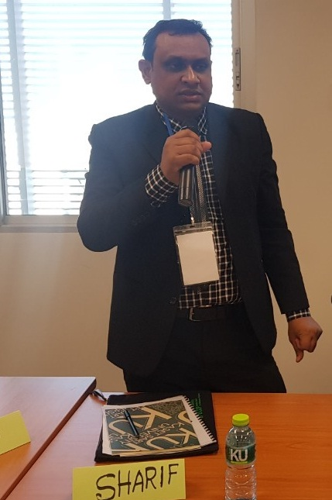
Introduction
Sharif Miah
Assistant Teacher
Paikara M.U. High School
Kalihati , Tangail
Mobile : 01719460514
Email : sharifsgbd@gmail.com
Class-VI
Subject: English 1st Paper
Lesson : Seven
Notes:
Introduction of the teacher and the class.

Slide 3
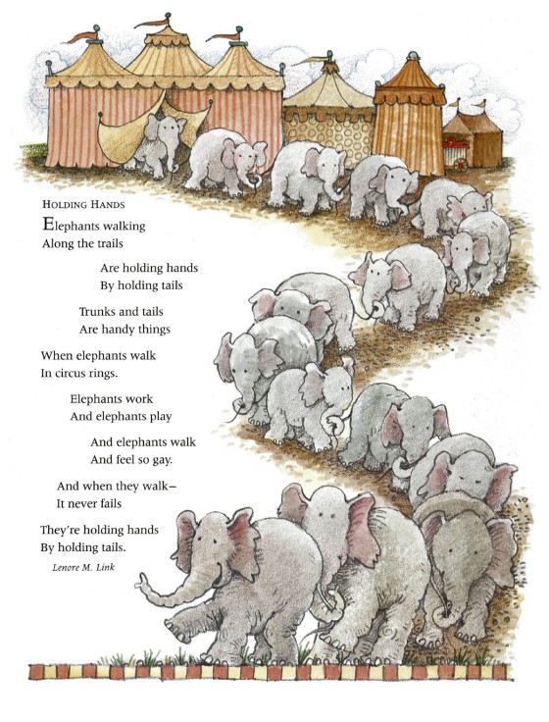
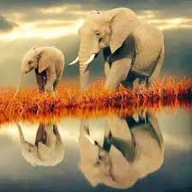
What do you see in the picture?
Elephant
Notes:
Showing the picture teacher can ask the question to the whole class. SS can raise their hands. Teacher can ask 2/3 students randomly.

Slide 4
Today our topic
Holding Hands
Class : Six
Lesson : Seven

Slide 5
LEARNING OUTCOMES OF THE LESSON
Recognize word and stress on words in sentence .
Recognize intonation sentences .
Understand and enjoy stories and poem.

Slide 6
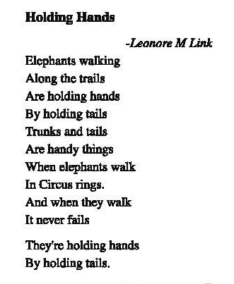
We read out the lesson

Slide 8
Understand Word Meaning

Slide 9
Trail

Slide 10
tail

Slide 11
Trunk

Slide 12
Walk

Slide 13
Ring

Slide 14
Pairs work
Recite the poem in pairs

Slide 15
Single work
Recite the poem individually

Slide 16
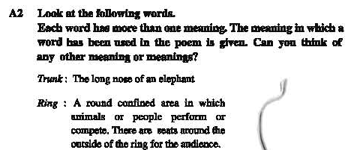
Home Work

