Slide 1
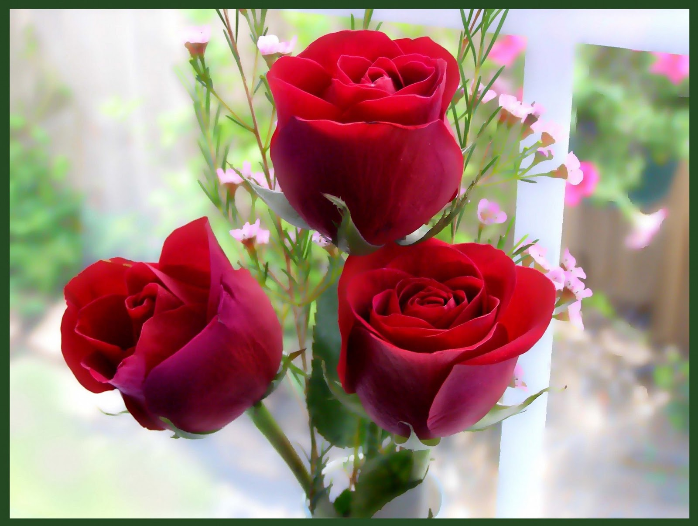
Welcome everybody…

Slide 2
Nurul Aziz
Assistant Teacher
Krishnakumari City Corporation Girls’ High School,
Nandankanan, Chittagong
E mail : naziz13.na@gmail.com
Mobile : 01843773924
English Grammar and Composition
Class VI
Time : 45 Minutes
Date : 16/02/2020

Slide 3
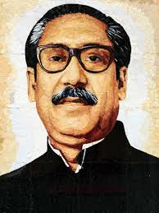
Do you know the man and things below? First tell the names and then their parts of speech.
Yes, we know.
They are nouns…
Bangabondhu Sheikh Mujibur Rahman
Flag
Apple

Slide 4
Our today’s lesson is..
Parts of Speech (Noun)
Unit : 1
Lesson : 1
Page : 1

Slide 5
Objectives of the lesson
After the end of the lesson students will be able to…
Enrich vocabulary
Identify nouns along with its kinds
Use nouns correctly in English Grammar

Slide 6
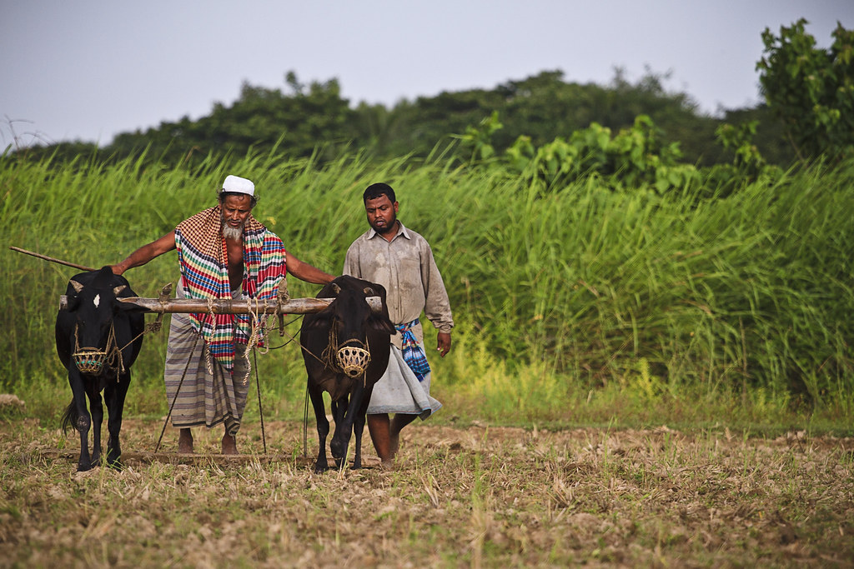
What is Noun? A noun is a word that names a person, a place, a thing or an idea. So it’s a naming word..
Farmer
Grass
Karim
Bull
field
Work
leveler

Slide 7
Classifications of Noun…
Noun
Material
Proper
Common
Collective
Abstract
Compound

Slide 8
1. They live in___
2. Mark is a college___
3. ____ is the key to success.
4. Our___ won the match yesterday.
5. Children should not use____
6. ____is a precious metal.
Pair Work
Fill in the blank in each sentence with nouns from the box. There are more nouns than necessary.
Smartphone, student, perseverance, Chattogram, gold, team, book, pencil, table
Chattogram.
student.
Perseverance
team
smartphone.
Gold

Slide 9
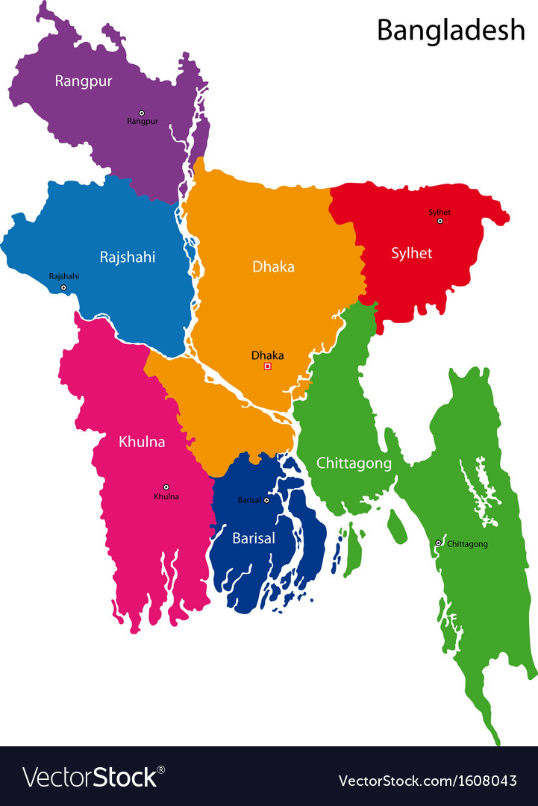
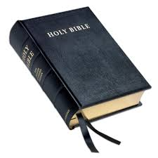
Proper Noun : A Proper Noun is a special name , that names a particular person, place or thing. It always begins with a capital letter. For example…
Sakib Al Hasan
Bangladesh
The Holy Bible

Slide 10
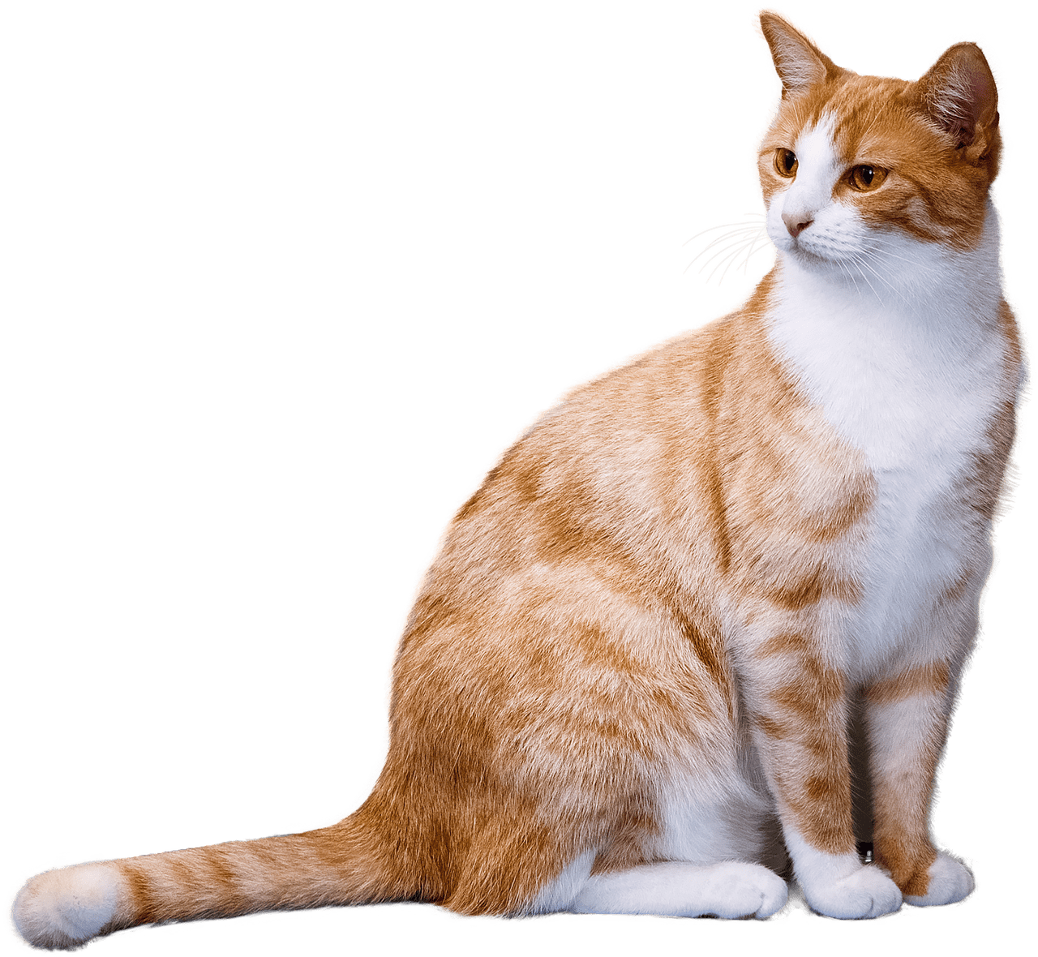
Common Noun : A Common Noun names a general person, name, place, or idea. It does not refer to something specific. For example….
House
Boy
Cat

Slide 11
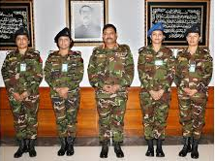
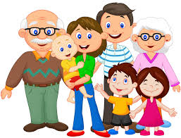
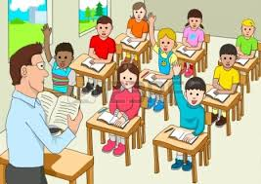
Collective Noun : A noun which is the name of a group or collection of the same kind of person, animals or things is called a collective noun. For example…
Army
Family
Team
Class

Slide 12
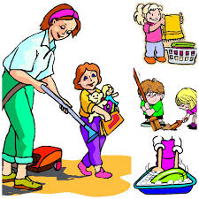
Abstract Noun : Abstract Nouns are nouns that you can not see, hear, touch, smell, or taste. They are ideas, qualities and feelings that can not be seen or touched. For example….
Justice
freedom
Responsibility

Slide 13
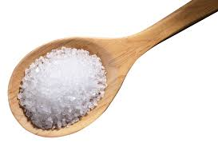
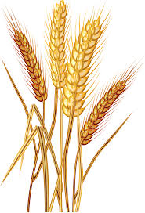
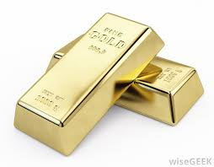
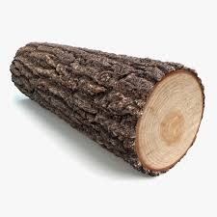
Material Noun : Material noun is a substance, a material or an ingredient we can see and touch which is used for making things. This is usually an uncountable noun and it becomes a common noun if there is an article before it. For example…
sugar
wheat
gold
wood

Slide 14
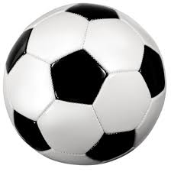
Compound Noun : A Compound Noun is a noun formed by combining two or more words. For example….
School boy
Orange Juice
Football

Slide 15
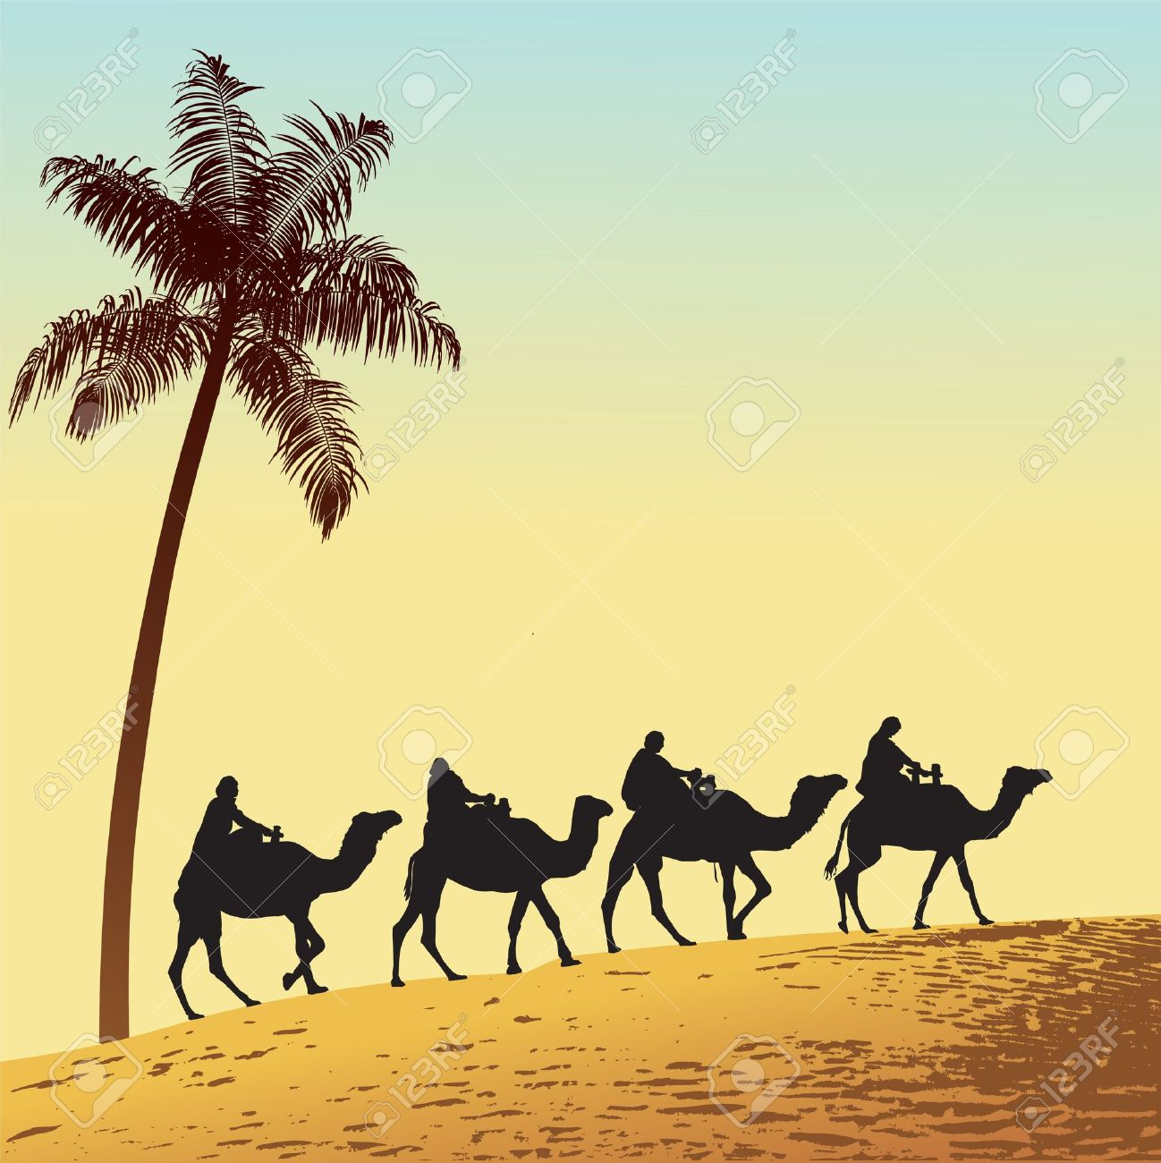
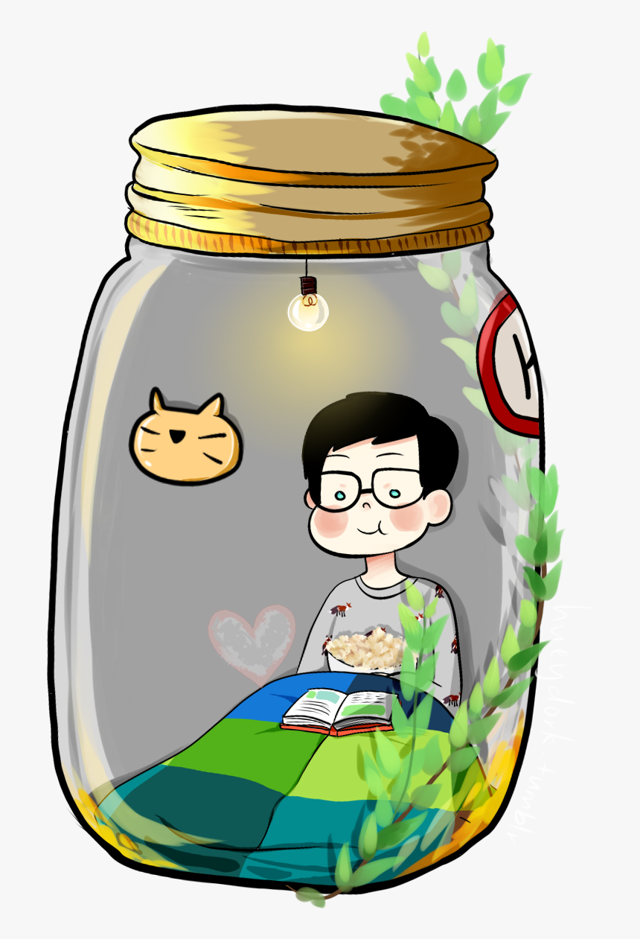
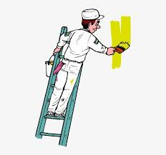
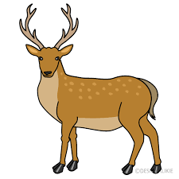
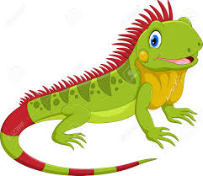
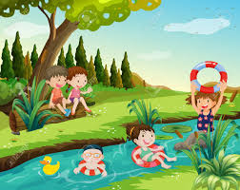
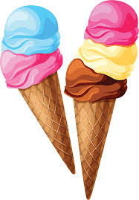
Group Work
Put the following nouns into their categories.
Desert
Jar
Painter
Deer
Ice-cream
Postman
Iguana
River
People
Things
places
animals
Painter
Ice-cream
River
Iguana
Postman
Jar
Desert
Deer
Notes:
Dear respectable teachers I have used Trigger for different class works here.. You are requested to use it while giving task...

Slide 16
Evaluation
Choose the best answer from the alternatives
1.Use a _____to clean your teeth.
b) toothbrush.
c) hairbrush
a) Lint brush
2. The house where bees live is called a _____.
a) beehome
b) beehive
c) beerhouse
3. Which one is a common noun?
a) Karim
a) country
a) honesty
4. Which one is an abstract noun?
a) freedom
a) class
a) city
5. Which one is a collective noun?
a) football
a) team
a) Sakib

Slide 17
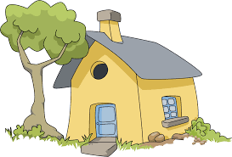
Home Work
Write down five nouns from each category.

Slide 18
Thank you all for happy learning….

