Slide 2
Teacher’s identity
Chumki Das
Assistant teacher
Gonabelai Govt.Primary School
Vekatmary, Rampal, Bagherhat
E-mail: chumkidas2002@gmail.com
Cell phone Number-01718829182
Class-5
Subject-English
Unite-7
Lesson 1-2

Slide 3
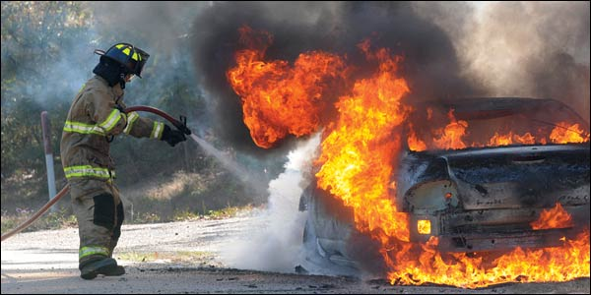
What can you see here?

Slide 4
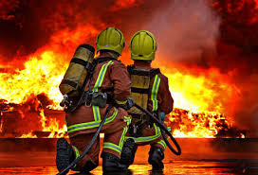
What are they called?

Slide 5
So our today’s Lesson is
A Firefighter
Lesson unit: Raju is a firefighter…..department

Slide 6
Learning outcomes:
Able to know new words.
Able to read with correct pronunciation.

Slide 7
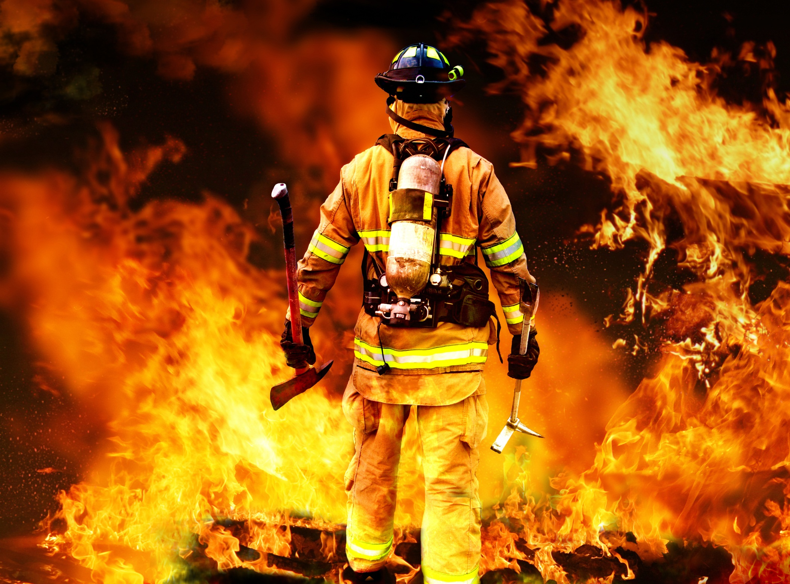

Slide 8
A Firefighter

Slide 9
Panicked
He got panicked
Put out
He is putting out the fires
Prevent
Prevent fires.

Slide 10
Raju is a firefighter.

Slide 11
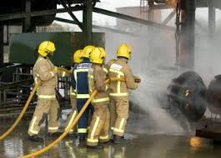
Long time ago, when Raju was in class 5, there was a fire in his school building.

Slide 12
But soon a fire brigade came and put out the fire. Raju could not forget that for many years.

Slide 13
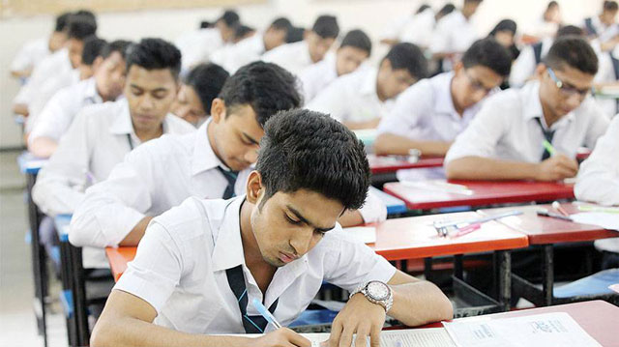
Raju
After finishing HSC, he joined a volunteer fire department.

Slide 14
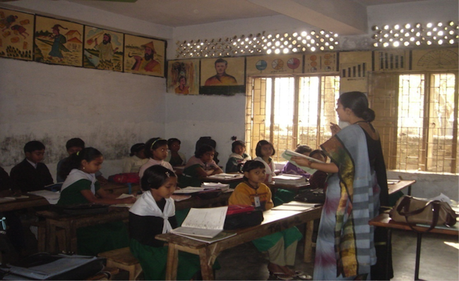
Now Open your book at page 36.

Slide 15
Read the Text in groups.

Slide 16
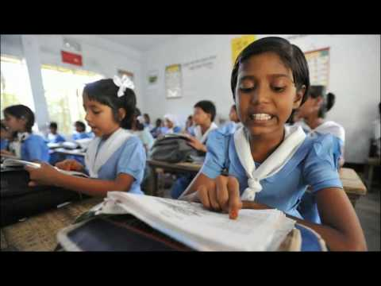
Read the text individually.

Slide 17
Checking learning: 1. Make two sentences with the word fire.
2. Read the text.

