Slide 1
WELCOME

Slide 2
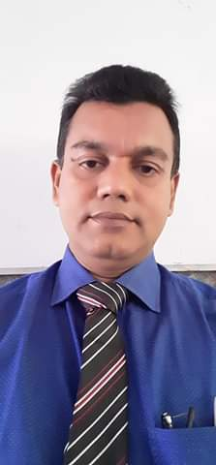
INTRODUCTION
Nurul Amin Azad ASSISTANT TEACHER ( ENGLISH)
Jahangirpur T. Amin Govt. Pilot sHigh School
Madan, Netrakona
Mobile no. 01718431636
E-mail: nuruasif@gmail.com
Lesson
ENGLISH GRAMMAR.
Class : Six ,Unit:2 Lesson:8
Time: 50 minutes.
Date: 17/ 02/ 2020

Slide 3
Read the following conversation and notice the time reference of the verb forms in underlined sentences.
Asif: I have no money in my pocket. What shall I do now ?
Jarif: Don’t worry. I shall lend you some .
Asif: Will you please give me it right now?
Jarif: Here you are.
Asif: Thank you. I will repay you the loan tomorrow.
Jarif: That will be fine.
Thanks a lot
Guess what time are the underlined sentences referring to ?
Future Indefinite Tense

Slide 4
So Today we will discuss
On simple future Tense

Slide 5
Learning objectives
After completing the lesson the students will be able to
Define simple future tense
Write dialogue
Write a few sentences in the future tense

Slide 6
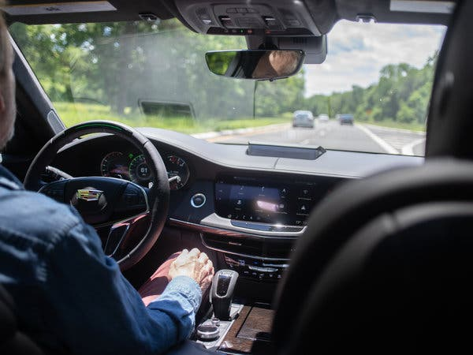
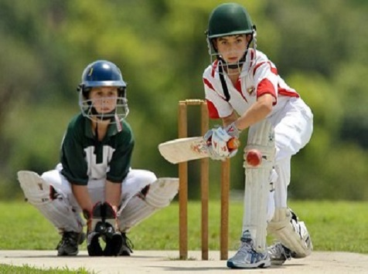
Definition
The future indefinite tense denotes an action that will happen in future.
I will drive the car.
They will play cricket in the afternoon.
He will have shower tomorrow

Slide 7
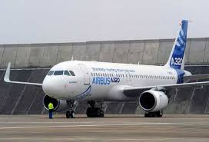
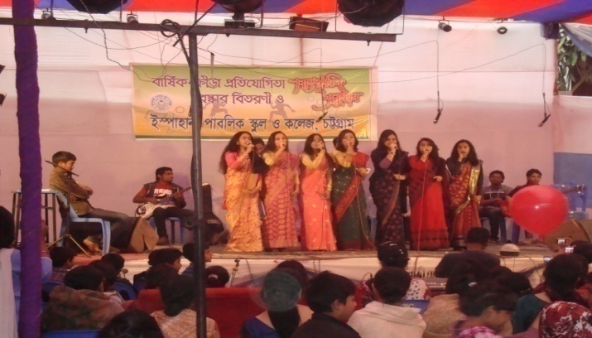
STRUCTURE
Sub + Shall/will+ verb + object.
The flight will leave Dhaka Shahjalal International Airport at 11.00 p.m.
We shall go to Thailand tomorrow.
We will take part in a function there.

Slide 8
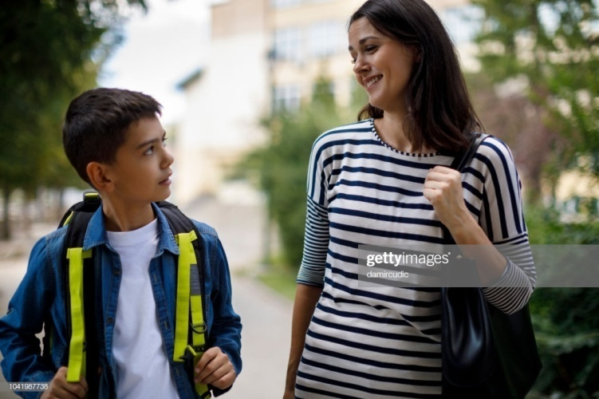
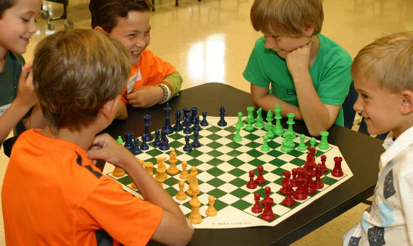
INTERROGATIVE
Shall/will + sub + verb + obj + ext + ?
Will you go home tomorrow?
Shall we help her ?
Will they play chess?

Slide 9
INTERRO-NeGATIVE
Shall/will + sub + not + verb + object ?
Will he not go home?
Shall we not inform him the news?
Will they not join the meeting?
Will not Mona E-mail me?

Slide 10
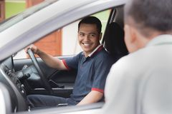
Interrogative with wh
question
WH + shall/will + sub + verb + object + Ext + ?
Why will you go to Dhaka ?
How shall/will I help you ?
Where will you meet me tomorrow?

Slide 11
Be + going to
Now read the sentences below and notice how we can use
be going to + base form of verb to talk about the future .
I am going to revise the essay letter.
She is going to take driving lessons from tomorrow.
They are going to submit the report soon.
We are going to buy something in the market.
She is not going to wait for the gift.

Slide 12
Group work
Group: A
Complete the following sentence using the future simple tense.
Will you sleep now?
________________.
A. When will you sleep then?
B. __________________.
Will you write an e-mail?
___________________.

Slide 13
Group :b
Complete the sentences using ‘am going to’ .
Learn – play – spend – study - practice
I am ______ study for JSC exam seriously.
I am _________ to use the computer.
I am __________ more time with my grandfather.
I am _________ speaking English regularly.

Slide 14
Evaluation
Complete the sentences .Put the verbs in brackets into
The simple future tense.
1.I ………my holydays with my parents this year. ( spend).
2.We ………at my parents house in khulna. (stay).
3.My father …………… at the station to receive me. (be).
4. I ………… some warm clothes. (need).
5.I ………. Some presents for my parents. (take).
6, It ……… a great time with my parents. (be).

Slide 15
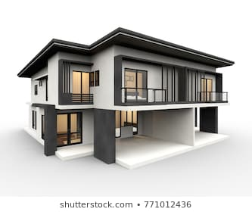
Home task
Write a few sentences in the future simple tense describing Your plan for the coming winter Vacation.

Slide 16
THANKS TO ALL

