Slide 1
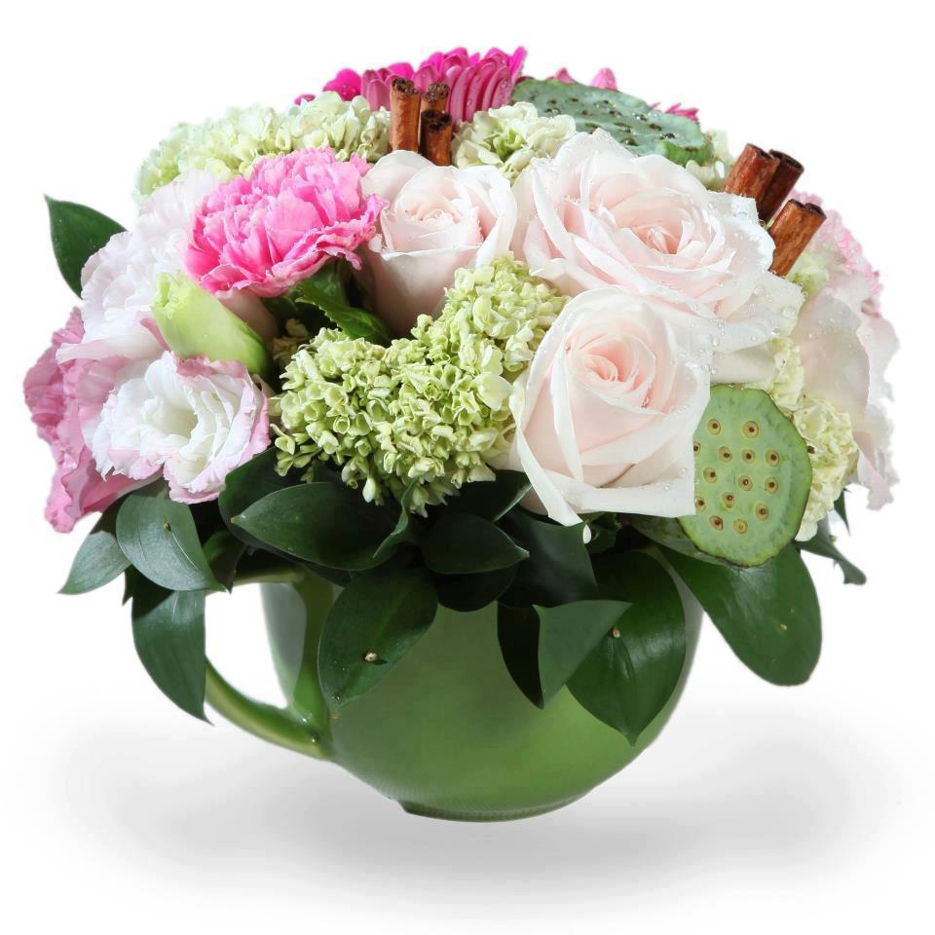

Slide 2
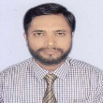
IDENTITY
MD. MONSUR AHMED (M.A- B.Ed) ASSISTANT TEACHER (ICT) CHANDPUR NURIA HIGH SCHOOL PURAN BAZAR, CHANDPUR. MOB: 01673341343 E-mail: monsuratc@gmail.com
ENGLISH 1st paper
CLASS : SIX, LESSON – 10

Slide 3
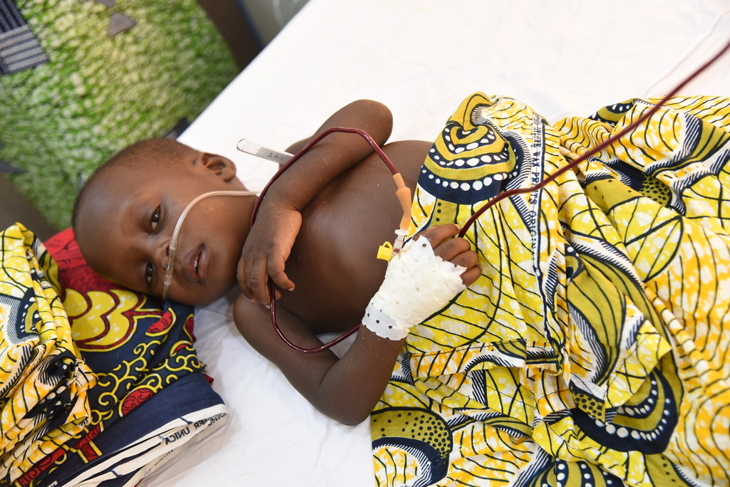
Look at the pictures
S: I went to a doctor for my remedies.
S: Yes, recently I have had a cholera.
T: What did you do when you have had cholera?
T: Have you had any health problems recently ?
Notes:
Teacher can ask the students to talk this condition in pairs.

Slide 4
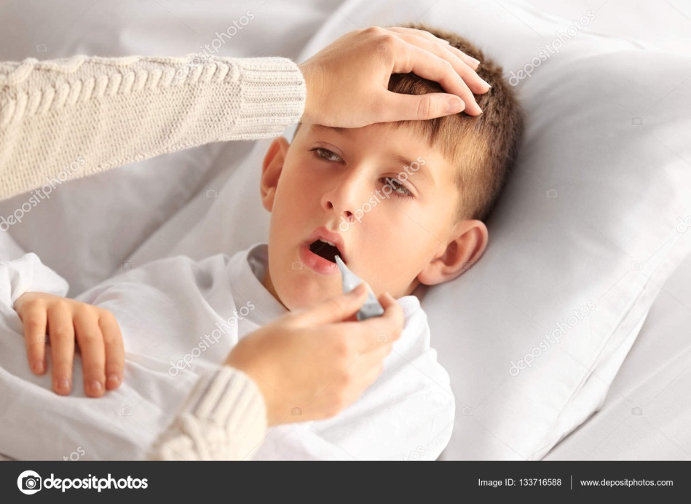
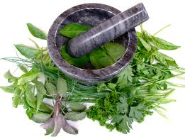
LESSON DECLARATION
So today we`ll discuss about
Remedies:
modern and traditional.

Slide 5
Learning outcomes
By the end of the lesson, students will be able to----
read and understand texts through silent reading.
infer meaning from context
Listen for information.
ask and answer questions
Write answers to questions.

Slide 6
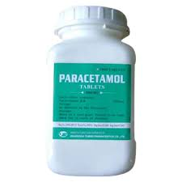
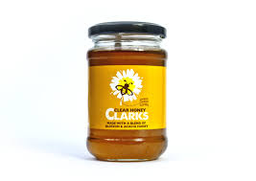
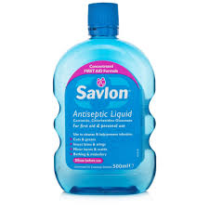
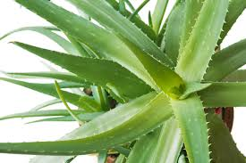
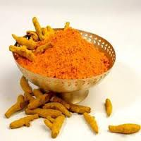
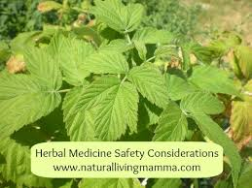
Look at the following pictures. Discuss with your partner what they are. Match them with their names given in the box.
Paracetamol,
Holy basil/Tulsi,
Antacid,
Honey,
Neem,
Savlon,
Turmeric,
Alovera.
Notes:
Teacher help the students.

Slide 7
Section - A
Read the text carefully then separate the Natural cures and Chemical cures. One example is shown
Natural cures | Chemicals
Honey | Savlon
Neem
Turmeric
Aloevera
Holy basil / tulsi
Paracetamol
Antacid
Burnol ointment
Notes:
Teacher can ask students to underline the clues.

Slide 8
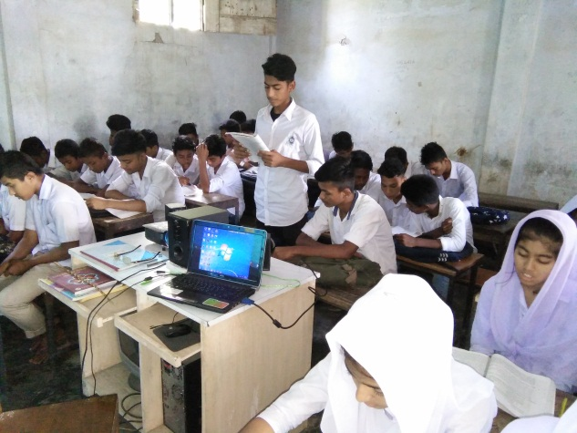
Loud reading
Notes:
Teacher can help the students. If they do wrong.

Slide 9
Some Vocabulary
Try to say the meaning of the following
words and make sentence.
Ancient = old
They are ancient people and used herbal medicines.

Slide 10
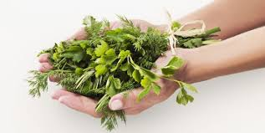
Try to say the word meaning and make sentence.
Natural Medicine = Herb
Herbel remedies are not new system.

Slide 11
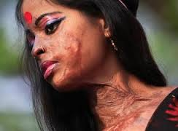
Try to say the word meaning and make sentence.
Burn = Injury
For burn herbal medicines are aleovera or honey.

Slide 12
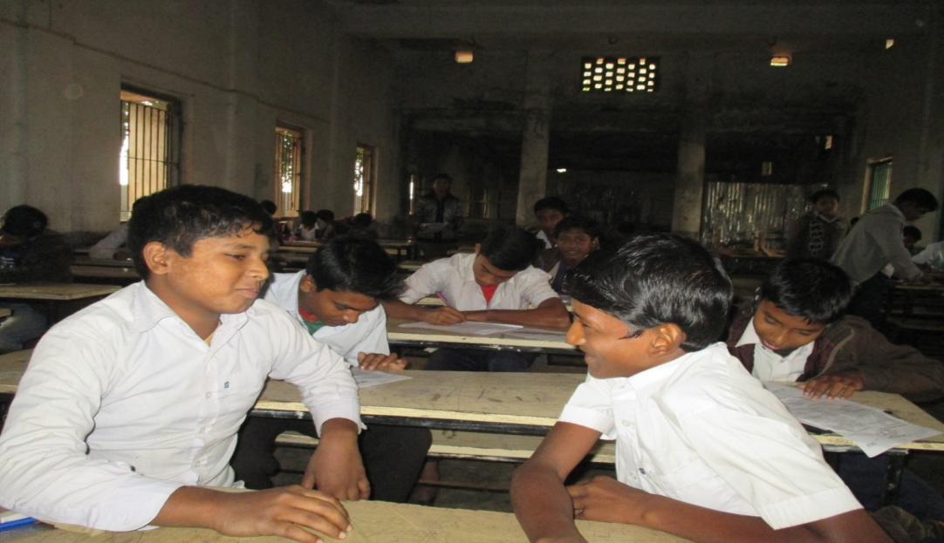
Pair works
Read the text again then ask and answer
the following questions :-
Natural cures are made of natural things, most often herbs and plants.
Herbal cures are not modern invention. They are ancient.
For skin problems, garlic, neem or turmeric is used.
What are natural cures made of?
Are herbal cures modern inventions?
What herbal cures are used for skin problems?
Notes:
After showing the conversation teacher will call 2/3 pairs for practice.

Slide 13
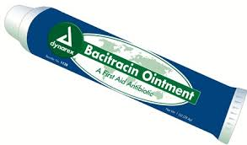
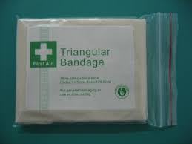
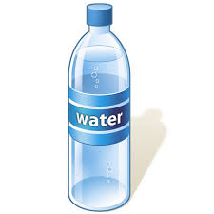
Look at the picture and try to say what is this? your answer must be within a sentence.
A tube of ointment
A box of aspirin
A bottle of water
A package of bandages
Let`s go to next slide
Notes:
Teacher will give sometime to elicit correct answer, then he/she will give the feedback.

Slide 14
Individual work
Complete the following expressions with words from the box.
Bottle, box can package tube
tube
a ……………………. of ointment
a ……………………. of aspirin
a …………………… of bandage
a ……………………. of foot spray
5. a ……………………. of tissue
box,
package,
bottle/can
package,
Now write down some sentences using these phrases:
One is done for you. I have bought a tube of ointment.
Notes:
Teacher can elicit the answer by orally.

Slide 15
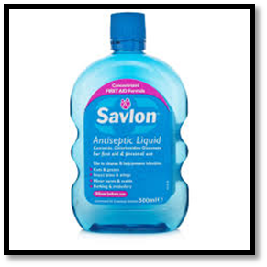
HOME WORK
Write the benefit of Savlon.

