Slide 1
WELCOME

Slide 2
Teacher’s identity
Chumki Das
Assistant teacher
Gonabelai Govt.Primary School
Vekatmary, Rampal, Bagherhat
E-mail: chumkidas2002@gmail.com
Cell phone Number-01718829182
Class-5
Subject-English
Unit: 12,L-
Lesson:

Slide 3
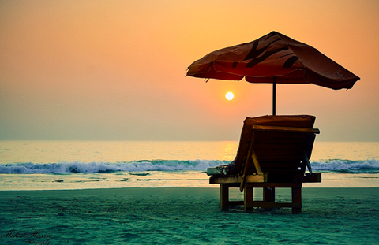
Where is it?
This is Saint Martin

Slide 4
Todays lesson is
How far is Saints Martin’s ?

Slide 5
By the end of this lesson’s students will be able to…
5.1.3 Read silently with understanding dialogues
8.1.1 Make sentences using words and phrases given in the
textbook.

Slide 6
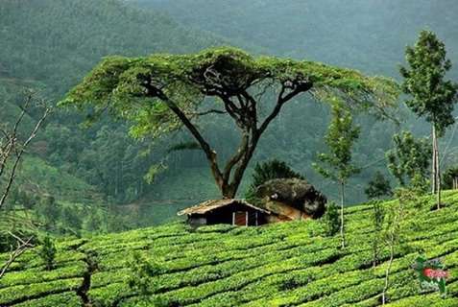
Tourist spot
Wanderer place
The tea garden is attractive tourist spot.

Slide 7
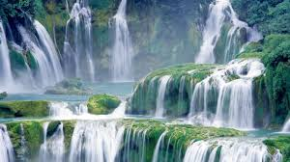
A source of water over a hill.
Waterfalls
Madhapkundu waterfalls is located in Moulobhibazar.

Slide 8
Special
Something particular
Birthday is the special day to me.

Slide 9
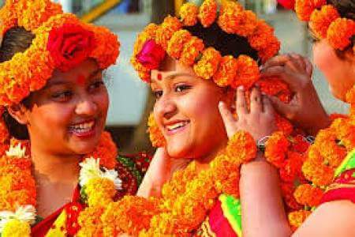
Wonderful
Something strange
Cox’s bazar is a wonderful place.

Slide 10
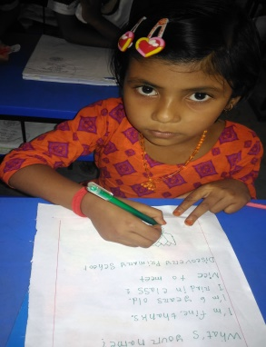
Bingo game
I .W
Tourist
Visit
Popular
Island
Beach
Wonderful
Waterfall
Special

Slide 11
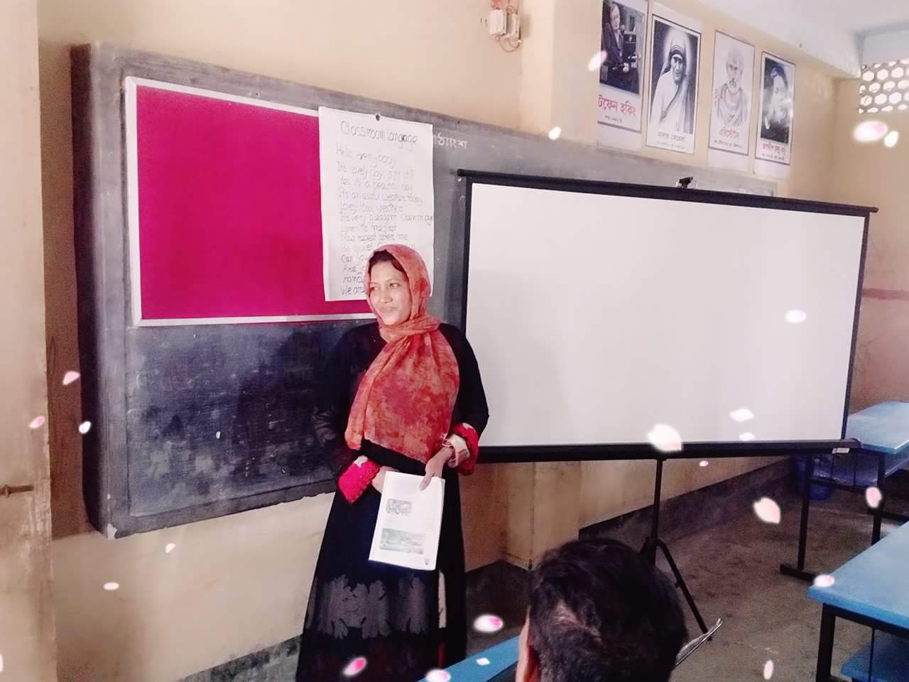
Open at page -46
Teachers loud reading

Slide 12
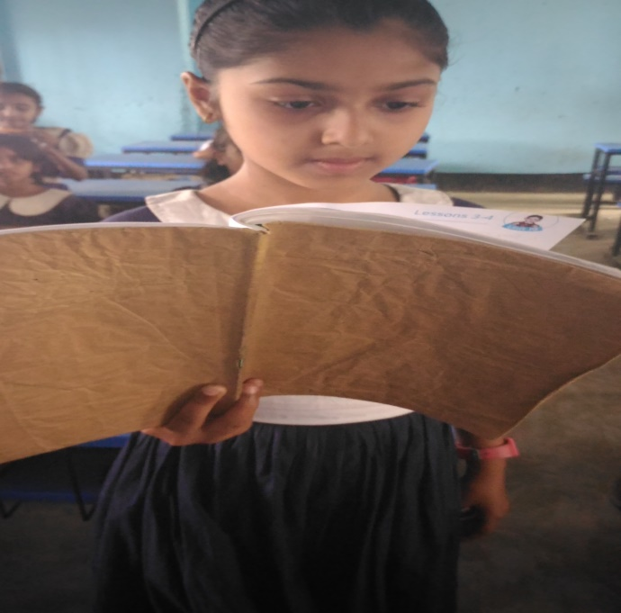
Students reading
Lets read by change role.

Slide 13
Answer the questions
G.W
1.What is the most tourist spots in Bangladesh?
2.Where is the beautiful tea garden?
3.What is the name of special places?

Slide 14
P.W
Make WH questions by underline word.
Now check the answer.
1.This Island is the Bay of Bengal.
Where is this Island?
2.We can go by wooden boats or sea truck.
How can you go the coral Island?
3.Tamal tells Andy about is the name of St Martin Island.
What is the name of the Island Tamal tells Andy about?

Slide 15
Word puzzle
Checking learning
w | r | y | h | j | g | o | c | k | m
c | r | h | i | k | l | m | o | p | n
t | o | u | r | i | s | t | l | n | m
c | b | x | n | o | p | d | h | k | w
z | x | v | b | e | a | u | t | y | l
x | c | q | n | a | b | j | j | k | n
x | v | h | p | p | z | q | o | s | t
z | z | o | f | z | n | r | i | r | o

Slide 16
Home Work
You will write five sentences about your recent visits place.

Slide 17
See you soon

