Slide 1
welcome

Slide 2
INTRUDUCTION
MD.JALAL UDDIN
ASS:TEACHER(ENGLISH)
KUSMOIL ISLAMIYA
ALIM MADRASHA
NIAMATPUR,NAOGAO
MAIL:jalalku1981@gmail .com

Slide 3
LESSON INTRODUCTION
SUBJECT: ENGLISH Ist PAPER
CLASS: TEN
Unit - Eleven
Lesson: 3
TIME: 45 MINUTES

Slide 4
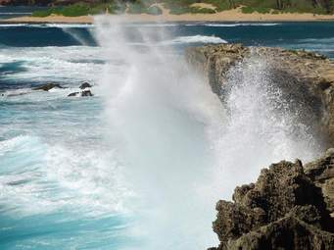
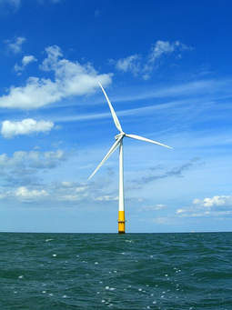
LOOK AT THE PICTURES

Slide 5
TODAY`S LESSON
Renewable energy sources.

Slide 6
LEARNING OUTCOMES
After studied this lesson,we will ableto-
Talk about renewable energy sources.
Identify renewable and non renewable energy sources.
Write to problems with non renewable energy sources.

Slide 7
Let us watch the video

Slide 8
Inividual works
1.What do you say about renewable Energy sources?
Renewable source of energe.
These sources-
Energe from sun
Energe from wind
Energe from water
Ocean wive
Flowing water
earth

Slide 9
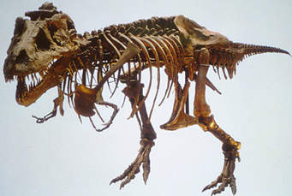
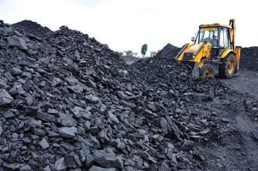
Pair work:
1) Do you identify renewable and non
renewable energy sources ?
Non renewable
Renewable
Renewable
Non renewable

Slide 10
Group work
Write to major problems on non
rerewable sources of energy.
Ans: Fastly, Non renewable sources of energy are limited.
secondly, they will become tooexpensive in the coming decades .
Thirdly, they have directly polluting impacts on the earth environmentCausing global warming.

Slide 11
Evaluation
a)What are the renewable sources
of energy?
Ans. Wind power, sun, ocean wive,flowing water are the renewable sources of energy
b)Choose the best answer.
i) Which word is related to renewable
energy sources?
a) forest (b) gas (c) sun (d) desert

Slide 12
Home work
Write the advantages of renewable
sources energy

Slide 13
Thanks

