Slide 2
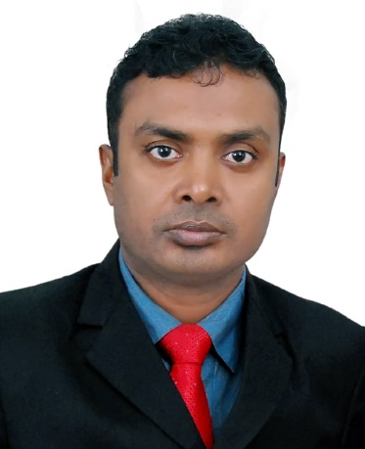
Introducing
Bipresh Chanda
Assistant Teacher
Brahmonjulia Govt. primary School.
Chhatak, Sunamgonj.
Class : Three
Subject: English
Lesson: 1 - 3
Lesson Unit: 32
Time: 45 minutes

Slide 3
Let’s enjoy a video

Slide 4
Today's lesson
Punctuation and capital letters

Slide 5
Learning outcomes
Students will be able to
Reading: 7.1.1- recognize punctuation marks,
capital letters and read accordingly.

Slide 6
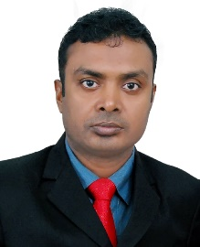
Good morning, students.
Good morning, teacher.
How are you today?
Fine. and you?
Fine, thank you.

Slide 7
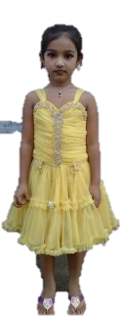
What do you see in the picture?
Maliha is Bangladeshi.
She comes from Dhaka.
Notes:
T: Who I am? Ss: You’re a teacher.

Slide 8
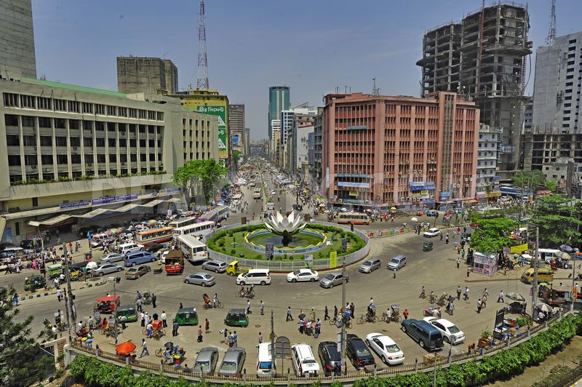
What do you see in the picture?
Dhaka is the capital of Bangladesh.

Slide 9
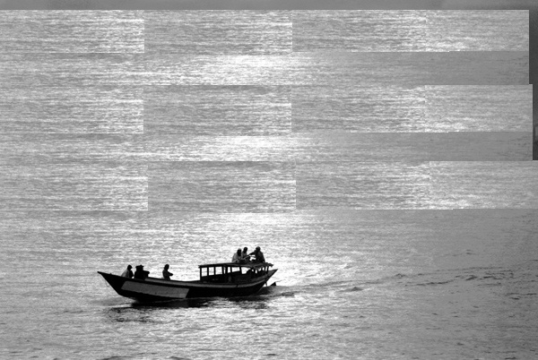
Look at the picture and think about it
Maliha lives near the Buriganga River.

Slide 10
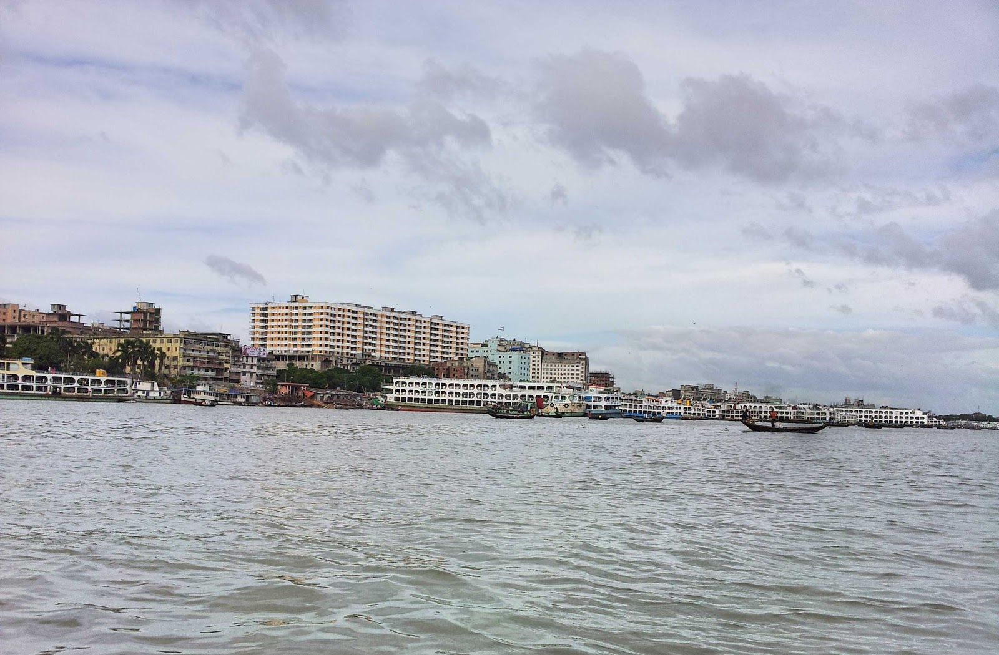
What do you see in the picture?
The river is very big.

Slide 11
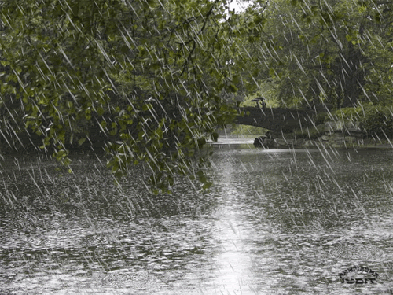
What do you see in the picture?
In June, July and August, there is a lot of rain in Bangladesh.

Slide 12
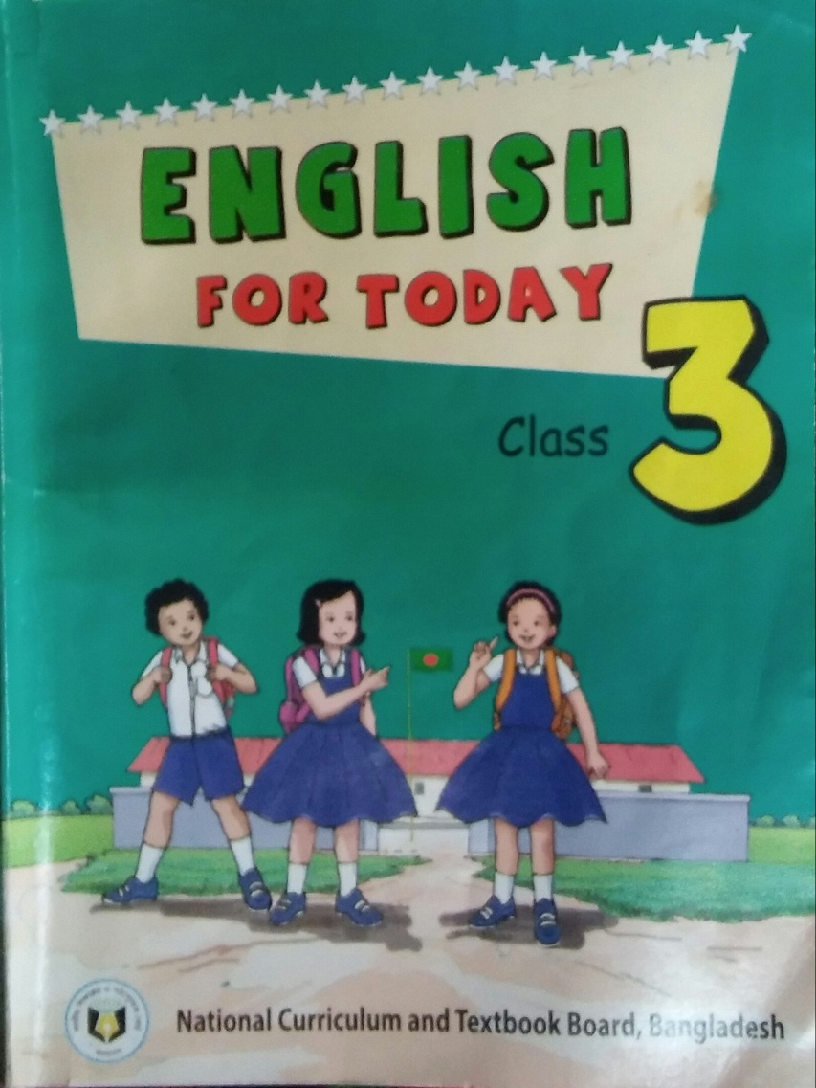
Open your book at page 64.

Slide 13
Everybody listen and say after me.
Maliha is Bangladeshi.
She comes from Dhaka.
Dhaka is the capital of Bangladesh.

Slide 14
Maliha lives near the Buriganga River.
The river is very big.
In June, July and August, there is a lot rain in Bangladesh.

Slide 15
She comes from Dhaka.
He works in a primary school in Narail.
Dhaka is the capital of Bangladesh.
Maliha is Bangladeshi.
Maliha lives near the Buriganga River.
.

Slide 16
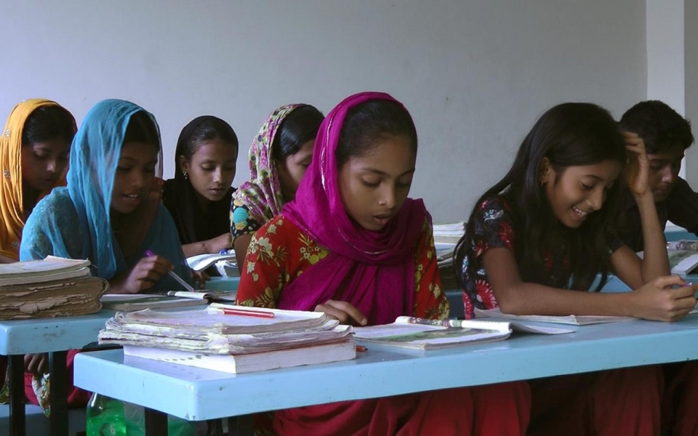
Student’s reading silently

Slide 17
Let us find out new words
Dhaka
Capital
Bangladeshi
River
Buriganga

Slide 18
Group work
.
Find the punctuation and capital letters.
.
Maliha is Bangladeshi.
M
B
.
She comes from Dhaka.
S
D
.
Dhaka is the capital of Bangladesh.
D
B
.
Maliha lives near the Buriganga River.
M
B
R
.
The river is very big.
T
In June, July and August, there is a lot rain in Bangladesh.
I
J
A
R

Slide 19
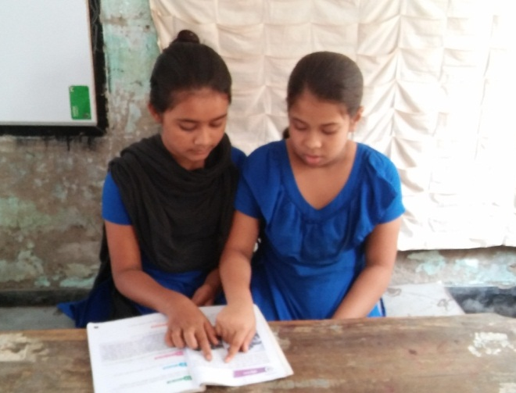
Let’s work in group
Read the text again & again and say punctuation and capital letters.
Maliha is Bangladeshi. She comes from Dhaka. Dhaka is the capital of Bangladesh. Maliha lives near the Buriganga River. The river is very big. In June, July and August, there is lot of rain in Bangladesh.

Slide 20
Individual Work
Lets play bingo game.
Bangladesh

Slide 21
Checking learning
Correct the sentences.
1. rahin is bangladeshi
2. he comes from chittagong
3. Chittagong is a big city in bangladesh
4. in august september and october a lot of
rain in chittagong
5. the jamuna river is very big

