Slide 1
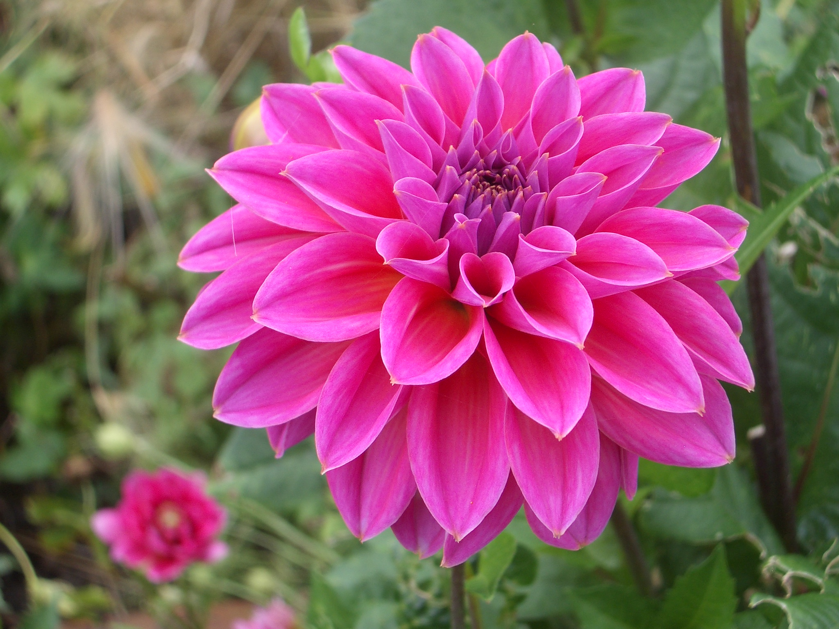
WELCOME

Slide 2
Presented By
Miss:Zahanur Begum.
Assistant Teacher.
Dharmopur Master Para GPS .
Class:One.
Subject:English.
Lesson:Rhyme(Rain rain go away).
Sundorgonj ,Gaibandha.

Slide 3
Learning outcomes
Listening:
4.1.1Enjoy the rhyme and music of simple rhymes.
Speaking:
1.1.1Repeat after the teacher simple words and phrases .
4.1.1Repeat rhymes after the teacher.

Slide 4
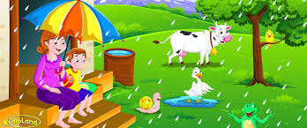

Slide 5
Rain rain go away

Slide 6
New Words
Rain
Go away
Play

Slide 7
Let’s see a video

Slide 8
https://www.youtube.com/watch?v=Zu6o23Pu0Do

Slide 9
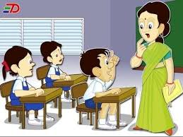
Teacher Recite

Slide 10
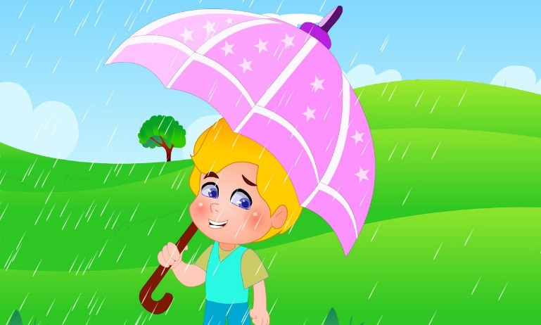
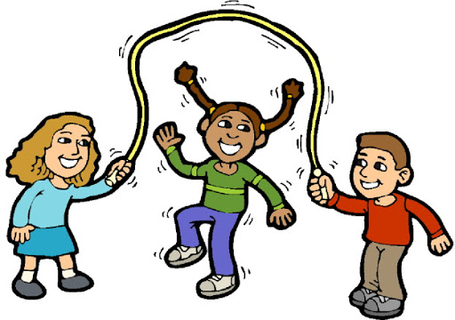
Rain ,rain ,go away.
Come again another day .
Little children want to play.
Rain,rain,go away.

Slide 11
Group Works
Advanced group:
I will recite the rhyme.
Class level group:
I will recite the rhyme.
Slow learner group :
Look at the picture and recite the rhyme.

Slide 12
Task
Recite any other rhymes.

