Slide 2
Welcome

Slide 3
Identity
Class- Eight
MD. NOOR E ALAM SIDDIKI
Asstt. Teacher
NAGESWARI KERAMOTIA M.L HIGH SCHOOL.
Mobile- 01716962418
Email- nooralam.na35@gmail.com
Title- Sentence

Slide 4
Exclamatory
Assertive
Which sentence ends with this mark?
Which sentence ends with this mark?

Slide 5
Todays lesson title is…
Exclamatory
to
Assertive

Slide 6
Learning outcome
After studied the lesson, students will be able to…
tell about exclamatory sentence.
express feelings of mind.
tell how to transfer exclamatory to assertive.

Slide 7
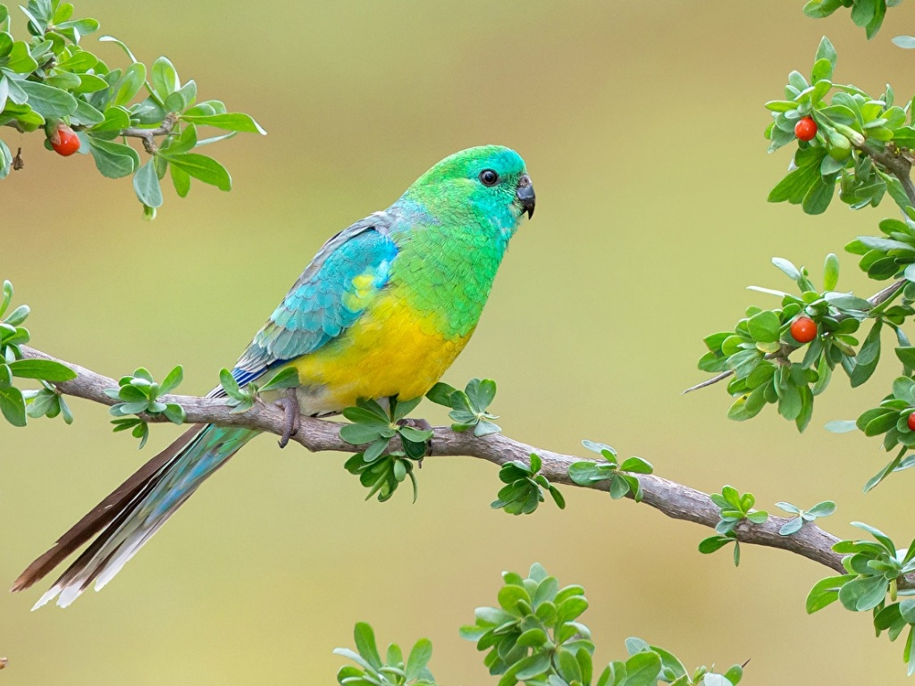
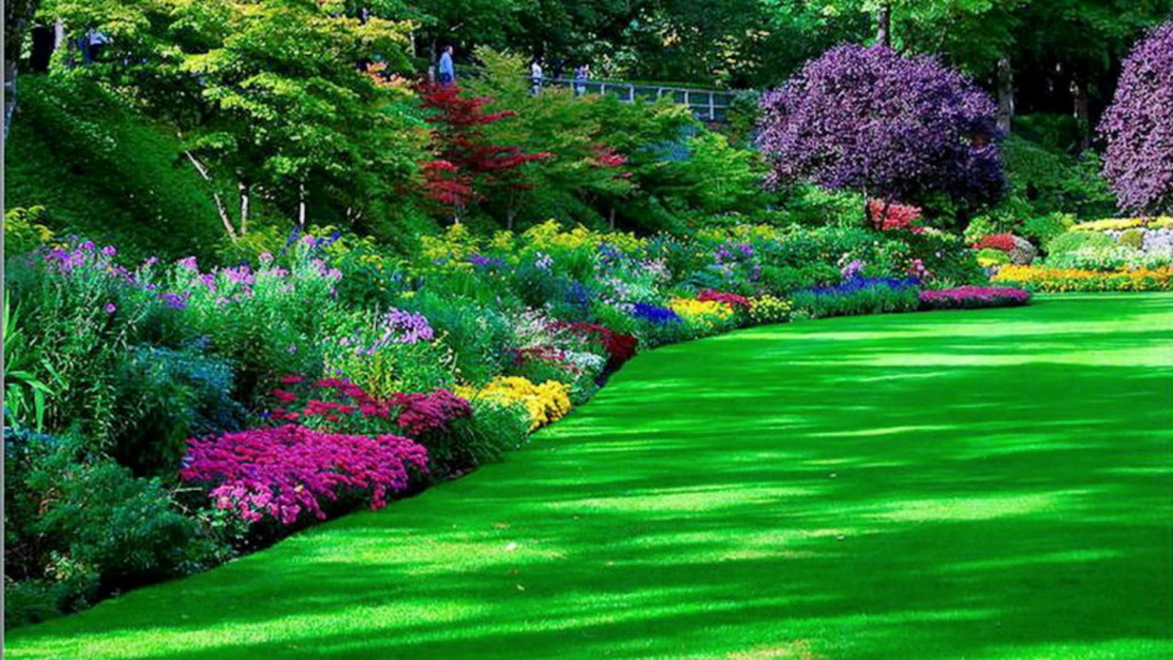
What a fine bird it is!
How beautiful the garden is!

Slide 8
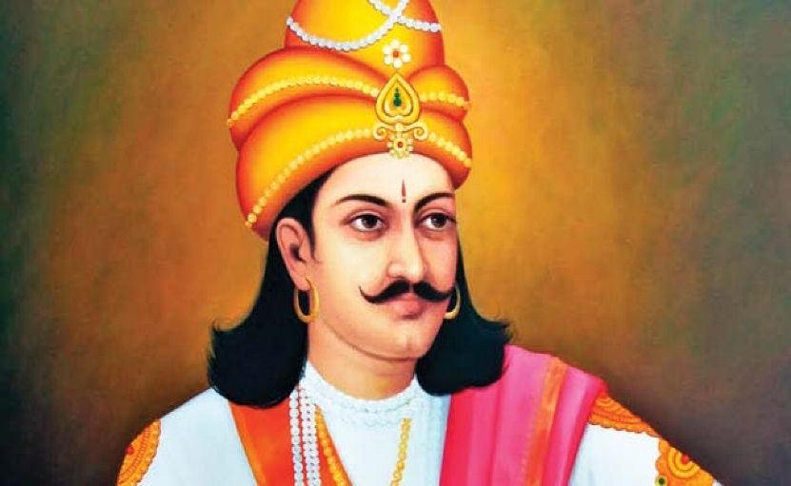
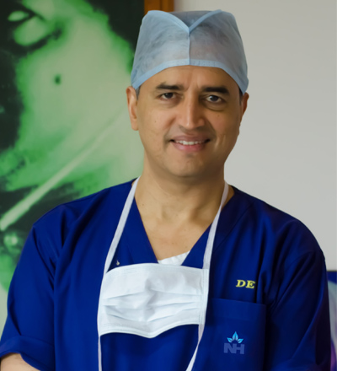
If I were a prime minister!
Had I been a King!
Would that I could be a doctor!

Slide 9
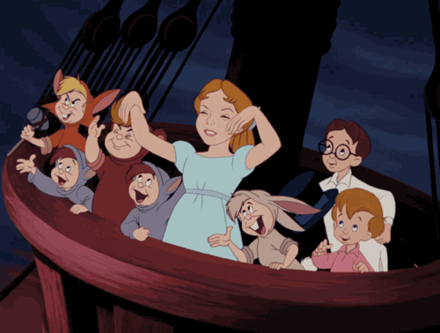
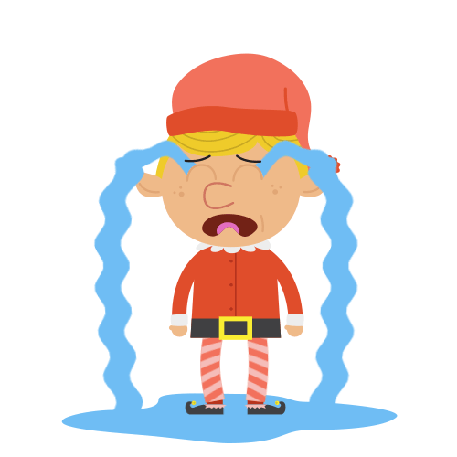
Hurrah! We have won the game.
Alas! He is dead.

Slide 10
Time : 10 minutes
Pair work
Make five exclamatory sentence

Slide 11
Time : 10 minutes
Group- A
Make five exclamatory sentence using ‘ what/How’
Group- B
Make five exclamatory sentence using ‘ If/ would that/had’
Group- C
Make five exclamatory sentence using ‘ alas/ hurrah/ Bravo/ fie’

Slide 12
What
a
What
a
fine bird
it
is
fine bird
it
is
!
very

Slide 13
To make An Exclamatory sentence into assertive sentence which starts with ‘what/How’ we have to follow the structure…
Subject+ verb+ a + very/great + Ex
What
a
big river
The Padma
is
!
The Padma
is
a
very
big river.

Slide 14
Look at the following sentences…
If I were a king!
I wish I were a king.
Would that I could be a prime minster!
I wish I could be a prime minster.
To make An Exclamatory sentence into assertive sentence which starts with ‘If/Would that/Had’ we have to use subject+wish instead of those words…

Slide 15
Look at the following sentences
Alas! I am undone.
It is a matter of sorrow that I am undone.
Hurrah! We have won.
It is a matter of joy that we have won.
Fie! You are a liar.
It is a matter of shame that you are a liar.

Slide 16
To make An Exclamatory sentence into assertive sentence which starts with ‘alas/Hurrah/Bravo/Fie’ we have to use following words instead of those words…
Alas
It is matter of sorrow that
Hurrah
It is a matter of joy that
Bravo
It is a matter of joy
Fie
It is a matter of shame that

Slide 17
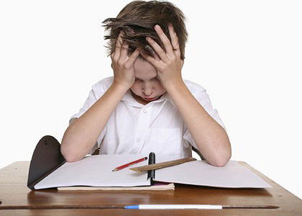
Individual work
Time : 10 minutes
Transform the following sentences into assertive…
1. How sweetly the cuckoo sings!
2. What a nice flower the rose is!
3. What a fool you are!
4. How talkative she was!
5. What a beautiful bird it is!
6. If I were a philosopher !
7. How time does fly!
8. Hurrah! We are victorious.
9. Would that I could be a child again!
10. Had I been a millionaire!

Slide 18
Match your answer
1. The cuckoo sings very sweetly.
2. The rose is a very nice flower.
3. You are a great fool.
4. She was very talkative.
5. It is a very beautiful bird.
6. I wish I were a philosopher.
7. Time flies very fast.
8. It is a matter of joy that We are victorious.
9. I wish I could be a child again.
10. I wish I had been a millionaire.

Slide 19
