Slide 1
Well come to all

Slide 2
Introduction of Teacher
Name:Noormohammad.
Assistant teacher
Sheberdangi Govt Primari School.
Mobil:01983697576.

Slide 3
Introduction Of Lession
Class:Three.
Subject:English.
Time:40 minit
Date:18/02/2020.

Slide 5
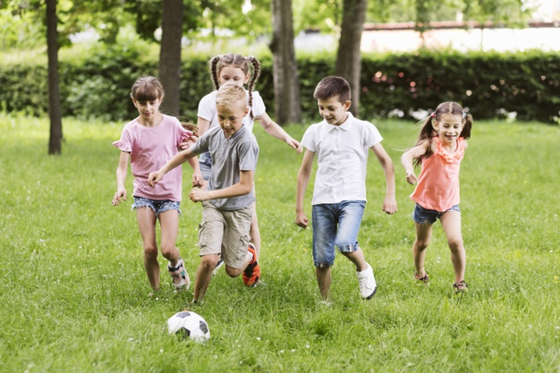
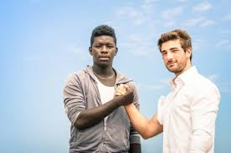

Slide 6
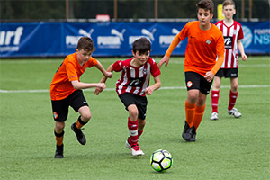

Slide 7
Well come to all

Slide 10
Well come to all

Slide 12
My friend
Todays Lessions

Slide 13
Learning Outcomes
5.1.1.Students will be able to writing simple pragraph.
5.1.2.Students able to reading simple storise.

Slide 14
Presentation

Slide 15
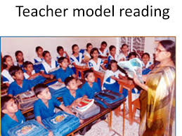
Model reading

Slide 16
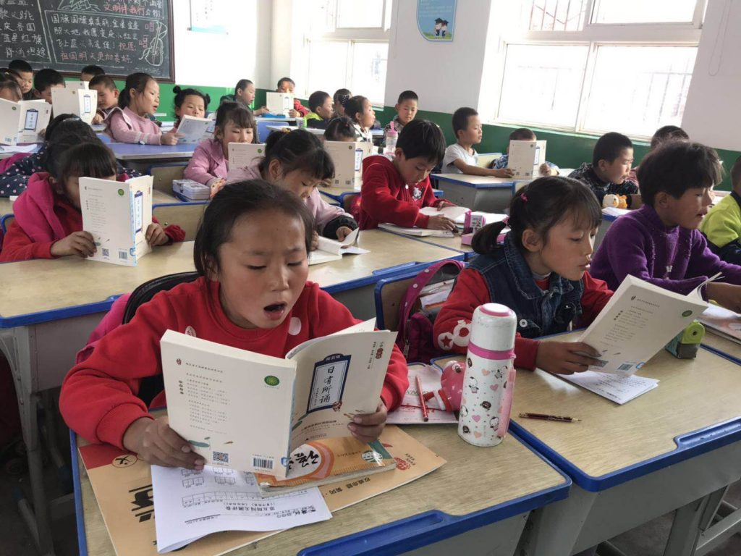
Students reading

Slide 17
Introduce of new words and make sentense
Friend -Anik is my friend
Play - We are play football

Slide 18
Group work
1.Fill in the blank.
a.Anik is my-----------.
b.Radif is------years old.
2.Multiple choose question.
a.Who is eight years ?
1.Radif 2.Anik 3.Rofik
b.Who is Anik friend?
1.Radif 2.Robi 3.Roki.

Slide 19
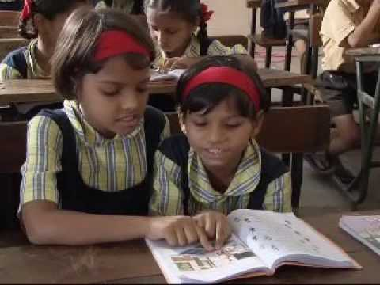
Pair work

Slide 20
Evaluation
I shall evaluate by giving some questions
1.Who is anik ?
2.How old is Radif ?

Slide 21
THANK YOU EVERYBODY
Thank you every body

