Slide 1


GOOD MORNING TO ALL

Slide 2

Teacher’s Introduction
Mohammad Faisul Alam, Assistant Teacher Shambhupur Government Primary School, Bhairab,kishoreganj.

Slide 3
Lesson identity
Class : Three
Subject : English
Lesson : 1 - 3
Lesson Unit : 2
Time : 40 minutes

Slide 4
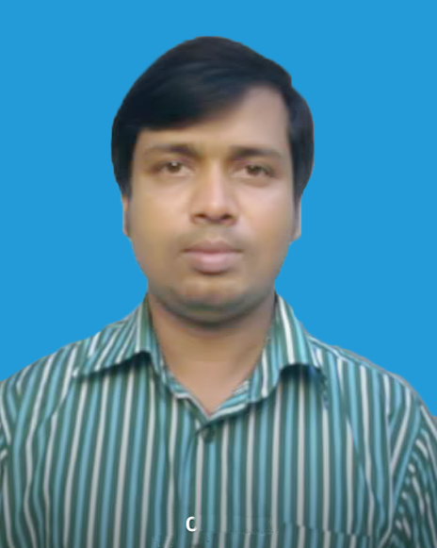
Whom can you see in the picture?
Notes:
T: Who I am? Ss: You’re a teacher.

Slide 5
Today's lesson is:
Introducing a teacher

Slide 6
Learning outcomes:
Listening:
3.1.1- understand simple questions about students, family and friends.
3.3.1- understand statements
Speaking:
1.1.1 say words, phrases and sentences with proper sound strees and intonation.
Reading:
1.5.1- read simple sentences with proper sounds and stress.

Slide 7
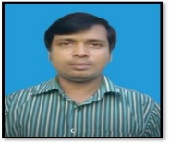
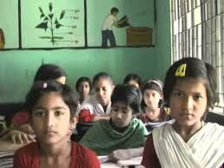
Greeetings.
Good morning, students.
Good morning, teacher.
How are you today?
Fine. and you?
Fine, thank you.

Slide 8
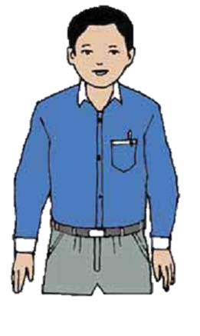
Look and say
Think about the picture.
Who is the man ?
This is Mahbub Alam.
How old is he?
He’s 3o years old.

Slide 9
Look and say
Think about the picture.
What does he do?
He’s an English Teacher
Where does he work?
He works in a primary school
in Narail.

Slide 10
Everybody listen and say after me.
This is Mahbub Alam
He’s 30 years old.
He’s an English teacher.
He works in a primary school
in Narail.

Slide 11
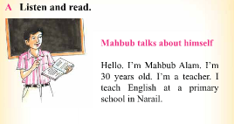
Open your book at page 4.
Listen carefully and repeat after me.

Slide 12
Let us find out new words.
Teacher
Work
Old
Primary
Year

Slide 13
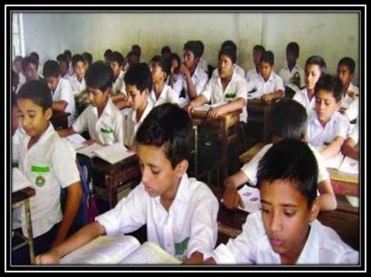
Student’s reading silently

Slide 14
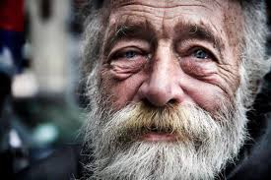
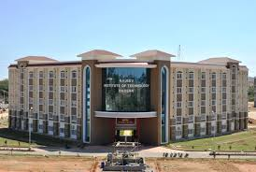

Similar Words
Old
Aged
School
Institute
Teacher
Master

Slide 15
Let’s work in group
Complete the table with Mahbub’s information
Name:
Age:
Job:
Work place:
Mahbub Alam
30 Years
Teacher
Primary school in Narail.

Slide 16

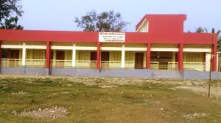
Individual Work
Lets play bingo game.
Teacher
English
Work

Slide 17
Checking learning
How old is Mahbub Alam?
What does he do?
Where does he work?

Slide 18

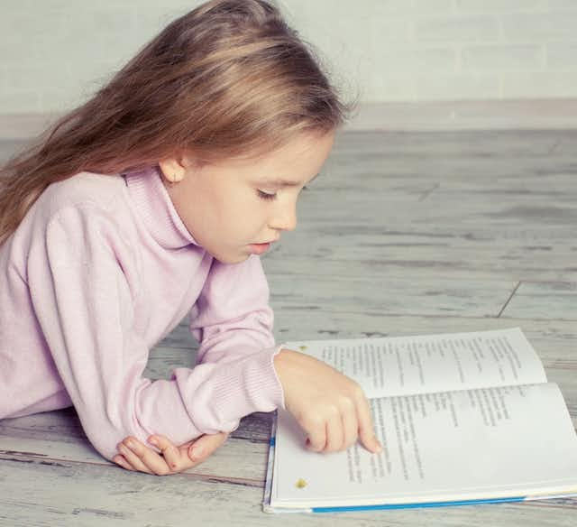
Hometask.
Everybody will make three sentences about Mahbub Alam.

Slide 19



