Slide 1
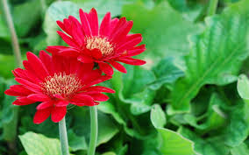
Wel come

Slide 2
Teacher’s Identity
Lesson Identity
Subject: English 2nd Paper
Class:Viii
Unit: Six, Lesson: 1
Date: 01/ 19/2020
Time: 45 minutes
M.A. FAKHER
Assistant Senior Teacher
Karpura Karimia Fazil Madrasah
Ulipur, Kurigram.

Slide 3
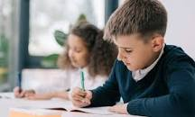
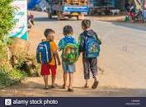
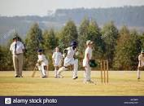
Look at the picture
The boy reads a book.
They wrote a poem last day.
The plyers are playing cricket.
The boys will go to school tomorrow.

Slide 4
Today's Topic
“Tense”

Slide 5
Learning Out comes
learn what tense means
learn about kinds of tenses
Use tenses in different Sentences.

Slide 6
Tense means time.
Tense denotes the time of a verb.
The baby sleeps at noon.
The baby slept last night.
The baby will sleep now.

Slide 7
Tense
Present
Future
Past

Slide 8
See the Vedio

Slide 9
Look at the picture
Emran Ali is an ideal farmer. He has a lot of lands. He grows different crops plentifully. He sells these crops in market. He earns a good deal of money. He works very hard. He leads a happy life.

Slide 10
This passage describes the action of present time.
It belongs to present tense.
Example: Emran Ali leads a happy life.
Structure: Subject+ Verb (of present form) + Object.

Slide 11
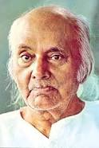
Look at the pictures.
The national poet Kazi Nazrul Islam was born in . He worte agaist the British rule and familiared as the rebel poet. He died in .

Slide 12
This passage describes the action of past time.
It belongs to past tense.
Example: The poet kazi Nazrul Islam born in.
Structure: Subject+ Verb (of past form) + Object.

Slide 13
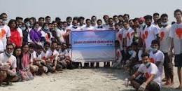
Look at the picture.
We shall go on a study tour in the next week. Our preparation will finish tomorrow.The principal will give expenditure fund today.So we will make fun in picnic spot.

Slide 14
The passage indicates the future time.
The sentences describe the action of future. They belong to future tense.
Structure: Subject + Auxiliary Verb (Shall/Will)+Verb + Object.

Slide 15
Individual Work
What do you mean by Tense?

Slide 16
Pair work
How are the mainly kinds of Tense?

Slide 17
Group work
Write some sentences is used 3 tenses.

Slide 18
Evaluation
He will buy more land with that money.
He leads a happy life (make it simple past)
She will go to Dhaka (make it simple present)
They played cricket (make it simple future)

Slide 19
Home Task
Write a dialogue on
“Your daily Routine”.

