Slide 2
Subject Identity
Teacher’s Identity
English for Today
Class: one
Unit : 3 Alphabet
Lesson:4- 6 ( A )
Time: 45 minutes
Date: 03/ 01/ 2020
Mst. Lucky Akhter parveen
Assistant teacher
Bihari Govt.Primary School
Pirgachha, Rangpur

Slide 3
Learning outcomes
Students will be able to-
Listening: 1.1.1 become familiar with English sounds by listening to command English words.
Speaking: 1.1.1 repeat after the teacher simple words and phrases.
1.1.2 say simple words and phrases.
Reading: recognize and read the alphabet both small and capital.( non-cursive)
Writing: to practice letter shapes/ simple writing patterns,etc.

Slide 4
Let’s enjoy the video

Slide 5
Look and think.
What they are called?

Slide 6
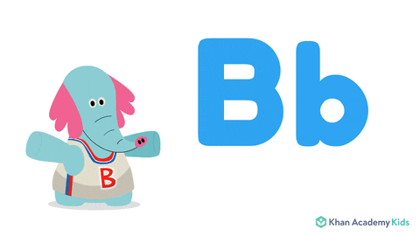
Todays lesson
Alphabet B b

Slide 7
What is this?
b
ball

Slide 8
Look, listen and say.

Slide 9
Look ,listen and say.Trace in the air.
B
B
ball

Slide 10
Look ,listen and say.Trace in the air.
b
ball

Slide 11
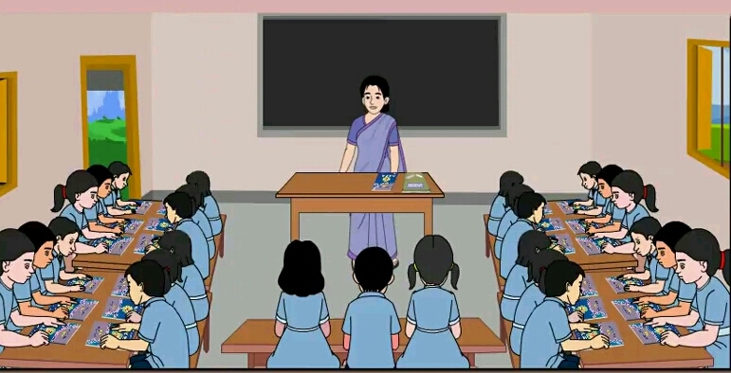
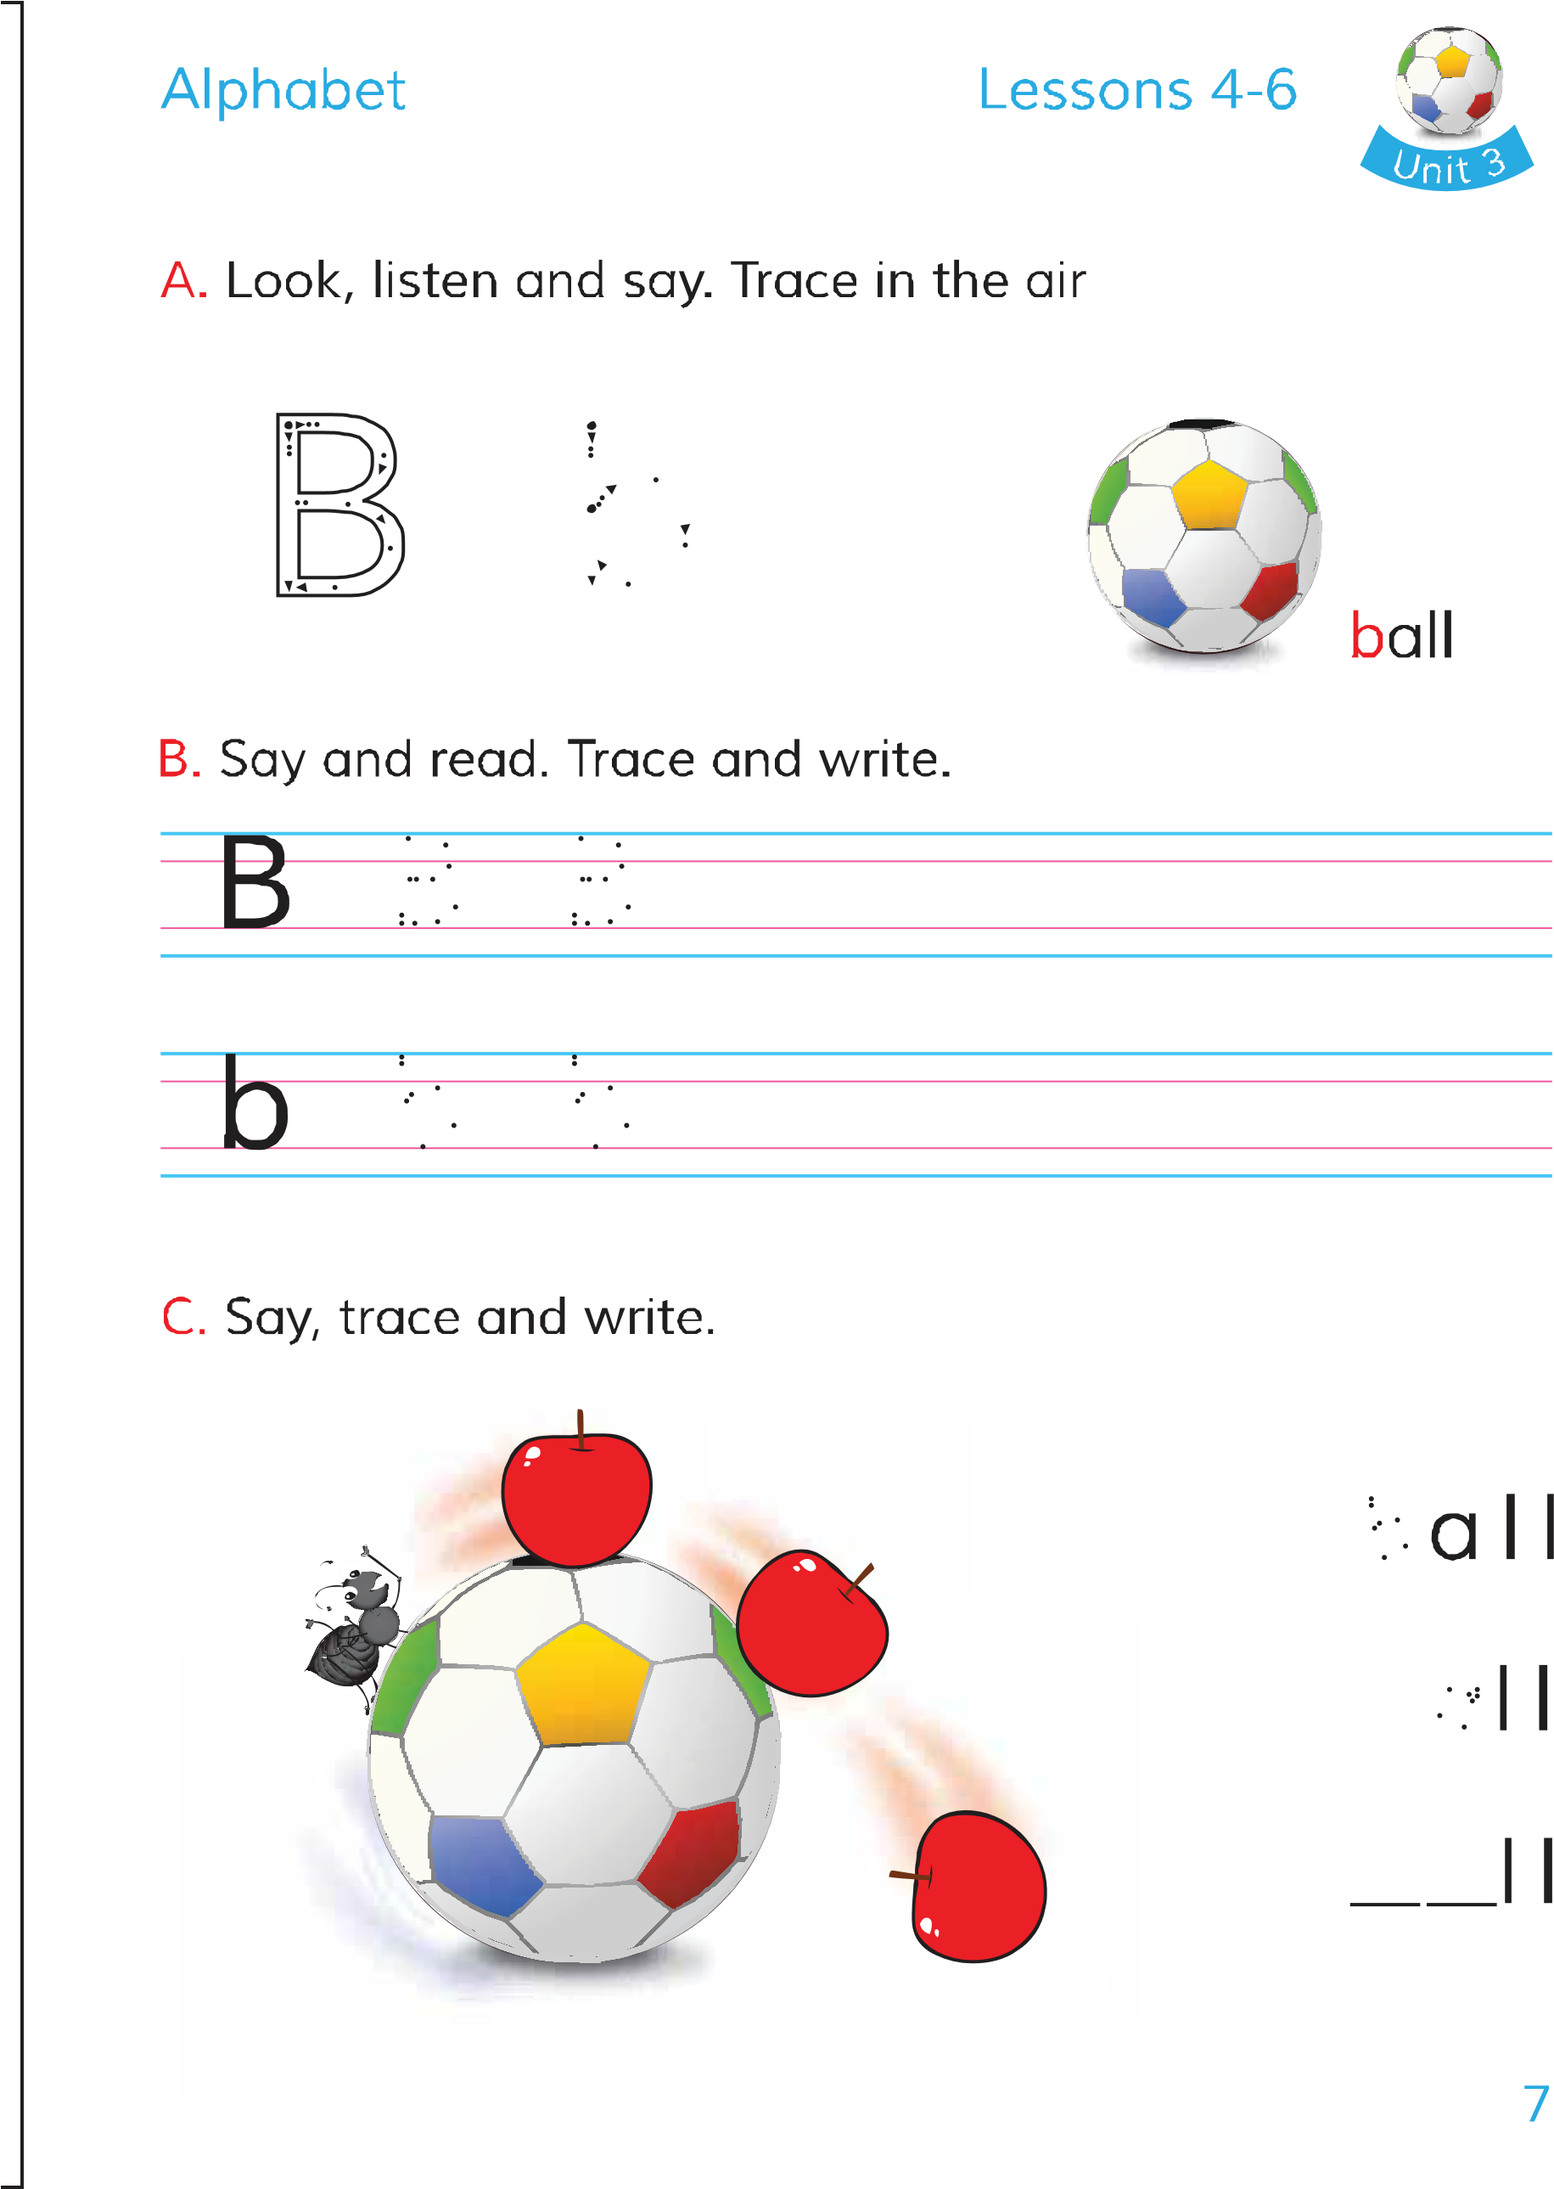
Open your English book page at 7

Slide 12
Look ,listen and say.

Slide 13
Pair work.
What is this?
b
ball

Slide 14
Evaluation .
What is this?
b
ball

