Slide 1
welcome

Slide 2
Teacher’s Identity
Mst. Jesmin Akter
Assistant teacher
Sohorabaria Govt. Primary School
Gangni,Meherpur.
Email: jesminjesmin2020@gmail.com

Slide 3
Lessone Identity
class: one
Sub: English
Caption of lessone: Numbers
Today,s lessone: A. look listen and say
Time: 40 min
Date:

Slide 4
Learning Outcomes
Students will be able to
Reading:
2.1 To recognize and read the cardinal numbers up to 10.
Reading
2.1.1Recognize and read cardinal numbers up to 10.

Slide 5
Lets we play a bingo game
Write down any three of the following words in your note book and follow my instructions
B
A
C
D
F
E

Slide 6
Let’s we see a video
https://drive.google.com/drive/my-drive

Slide 7
Today’s our lessone is
Numbers

Slide 8
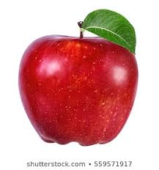
Let’s we see some picture
What is this?
How many apple?
1
Apple

Slide 9
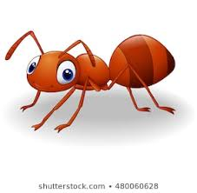
What is this?
How many ant?
1
Ant

Slide 10
What is this?
How many ball ?
1
Ball

Slide 11
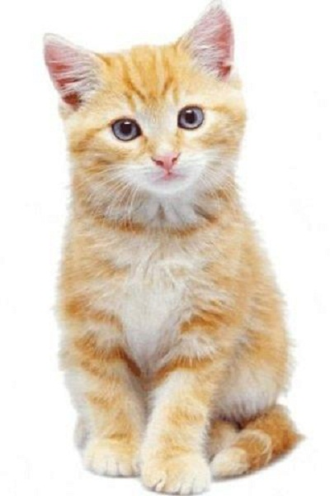
What is this ?
How many cat?
1
cat

Slide 12
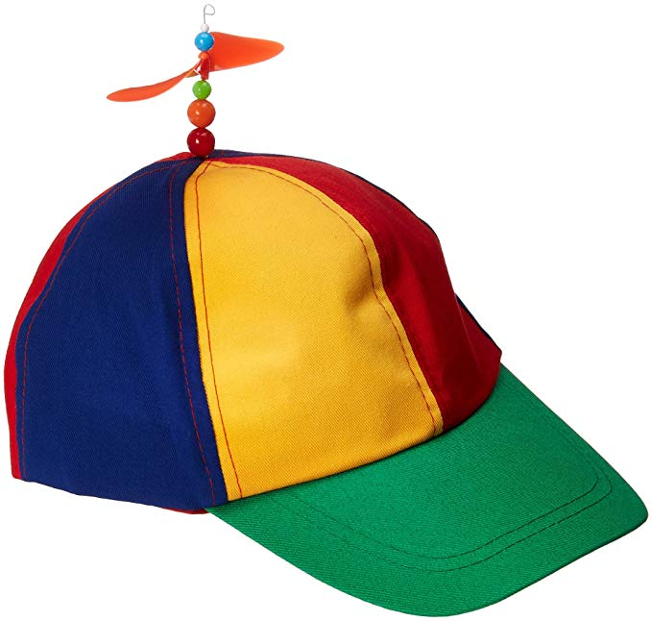
What is this?
How many cap?
1
cap

Slide 13
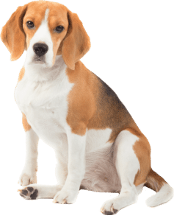
What is this?
How many dog?
1
Dog

Slide 14
2
How many apple’s?

Slide 15
2
How many ant’s?

Slide 16
2
How many ball’s ?

Slide 17
2
How many cat’s ?

Slide 18
2
How many cap’s ?

Slide 19
2
How many dog’s?

Slide 20
3
How many apple’s?

Slide 21
3
How many ant’s?

Slide 22
3
How many ball’s?

Slide 23
3
How many cap’s ?

Slide 24
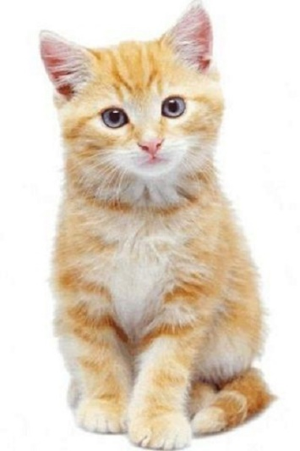
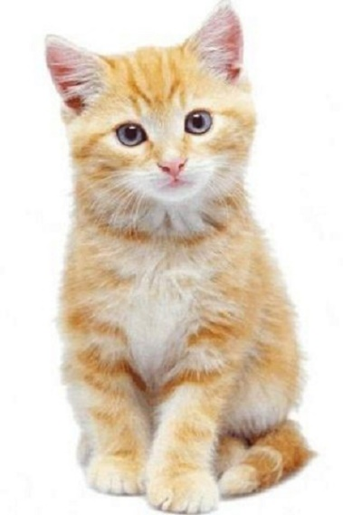
3
How many cat’s

Slide 25
3
How many dog’s ?

Slide 26
1
3
2

Slide 27
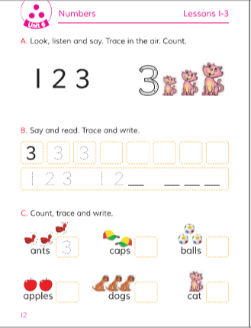
Open your English book at page

Slide 28
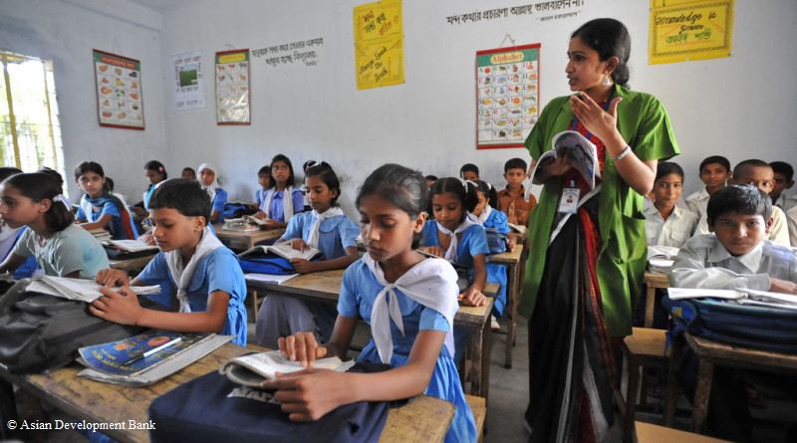
Teacher’s reading

Slide 29
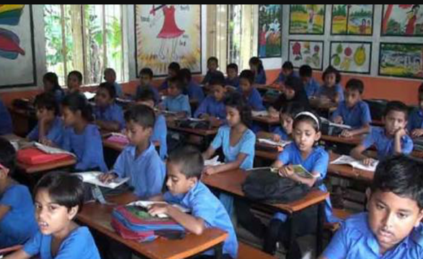
Student’s reading

Slide 30
Evalution
Count and say the numbers
1
2
3

Slide 31
Match the picture with numbers
1
3
2

Slide 32
Thanks

