Slide 1
WELCOME

Slide 2
TEACHER`S INTRODUCTION
Most.Anjuma Khatun
Assistant Teacher
Bangla Hili-1 Model GPS
Hakimpur,Dinajpur.

Slide 3
LESSON INTRODUCTION
Class:Two
Subject: English
Unit: 24
Lesson: Animals and where they live

Slide 4
LEARNING OUTCOMES
Speaking:
1.1.1 Repeat after the teacher simple words and phrases with proper sounds.
Writing:
3.1.2 Write words and phrases using non cursive small letters.

Slide 5
TODAY`S LESSON
Animal and where they live

Slide 6
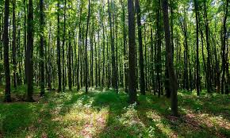
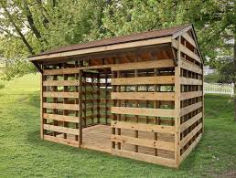
Look and say
Forest
Shed

Slide 7
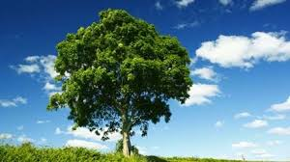
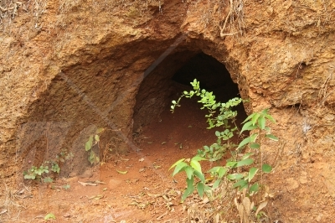
Look and say
Den
Tree

Slide 8
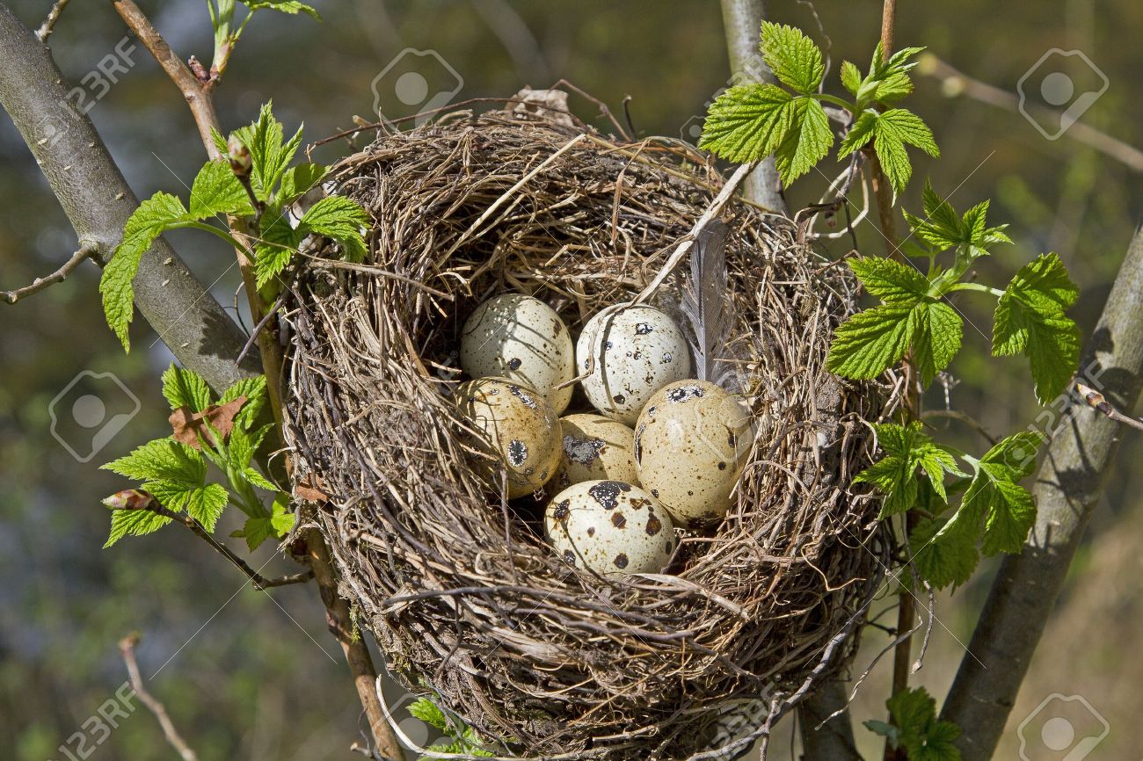
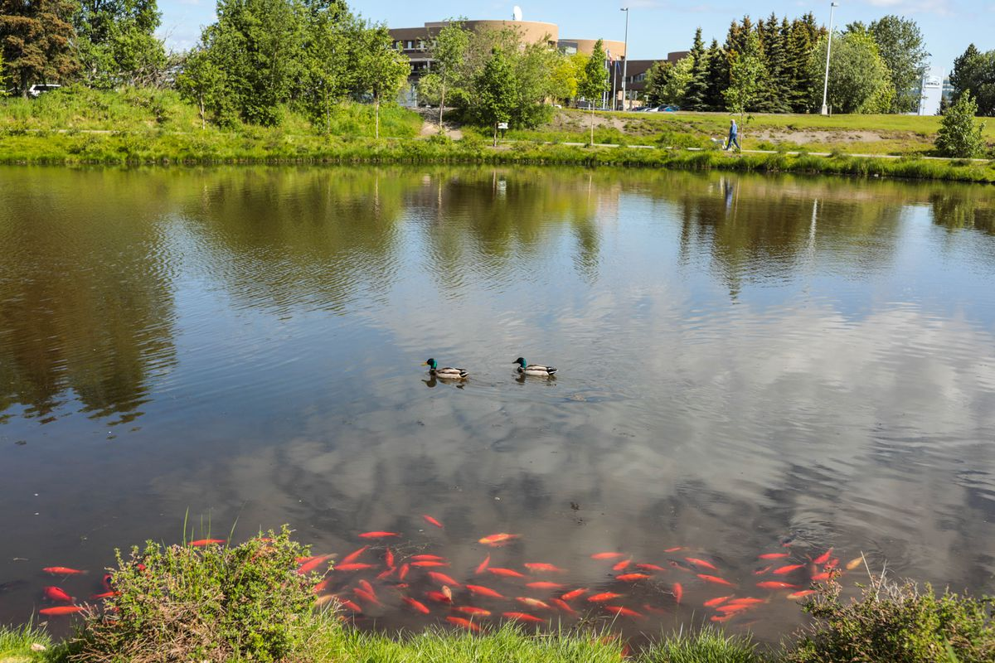
Look and say
Nest
Pond

Slide 9
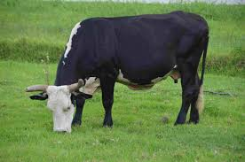
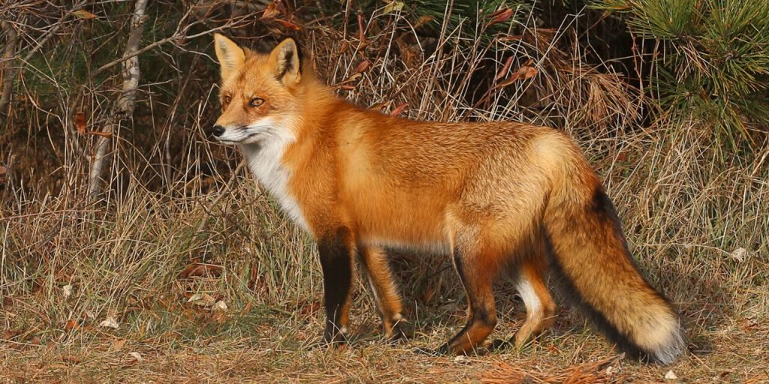
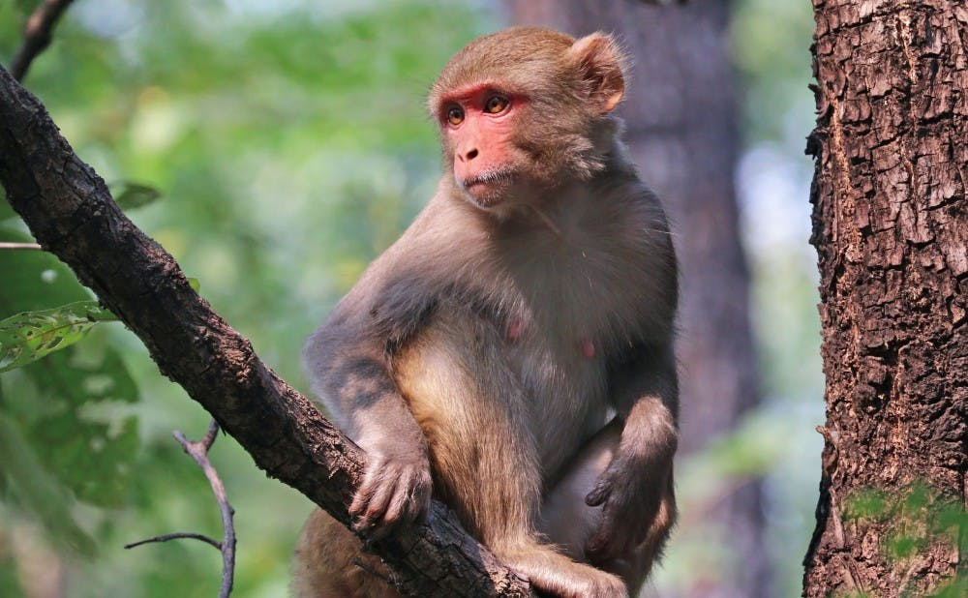
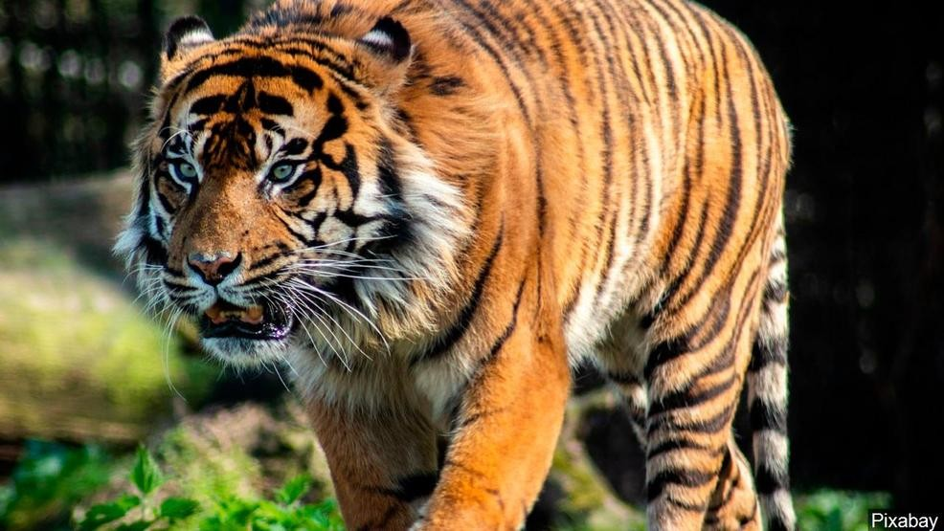
Look and say
Cow
Fox
Monkey
Tiger

Slide 10
Look and say
Forest
Den
Shed

Slide 11
Look and write
Tiger
Fox
Cow
Monkey

Slide 12
Match words with picture
Nest
Shed
Cow

Slide 13
Look and say where they live
Shed
Den
Forest

Slide 14
Look and say
Nest
Den
Tree
Pond

Slide 15
THANKS ALL

