Slide 1
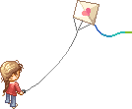
Good morning students.
How are you?

Slide 2
Identity
Teacher
Lesson
Dewan Rezaul Hassan
(Assistant Teacher)
Baropakhia Rothindrapara Government Primary School
Delduar, Tangail.
E-mail:drezaulhassan@gmail.com
Cell phone# 01731145063
Class: Two
Sub: English
Unit: 1 Lesson: 2(B)
Page # 2
Lesson title: Greetings and Introductions

Slide 3
Learning outcomes:
Students will be able to:
Listening:
1.1.1 become familiar with English sounds by listening to common
English words.
3.1.1 Understand simple questions and statements about them.
3.1.2 Understand simple questions and statements about familiar
objects.
Speaking:
1.1.1 repeat after the teacher simple words and phrases with
proper sounds and stress.
1.1.2 say simple words and phrases with proper sounds and stress.
2.1.2 ask ‘How are you.’ reply ‘I am fine, Thank you’ etc.

Slide 4
Let us listen a song

Slide 5
Checking homework and justify the previous lesson.

Slide 6
Lessson declaration :
Today we will learn
Unit: 1
Lesson: 2(B)
Lesson title: Greetings and Introductions

Slide 7
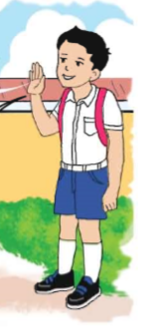
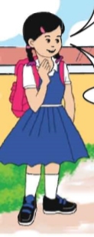
Open your English book at page-2 and see the Activity- B
Look, listen and say
.
How are you, Rafi?
I’m fine, Thanks.
Fine, Thanks. And you?
Reading- SGW

Slide 8
Bye!
Bye!
!

Slide 9
Pair work
Shuva
Rafi
One more times

Slide 10
Pair work
Say about yourselves.
One more times

Slide 11
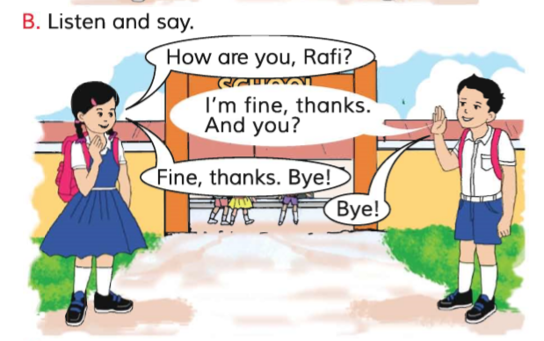
Connection with the text :
Open your
“English for Today” Book
page at # 2

Slide 12
Read and say.
How are you, Rafi?
I’m fine, thanks.
And you?
Fine, thanks. Bye!
Bye!
Identifying and feedbacking for weak students and taking care of.

Slide 13
WCW:
Repeat after me.
How are you,Rafi?
I’m fine,thanks.
And you?
Fine,thanks. Bye!
Bye!

Slide 14
Home work
Activity-B
will be well read and written.

Slide 15
Task
1. What’s your name? 2. How are you?

Slide 16
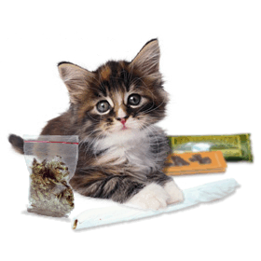
One day one word
Do you understand the picture?
cat
বিড়াল
Spell out the word - SGW

Slide 17
Find out the letters that are made by the word------.
t
b c t e a m p
c
a
Find out the right word-------.
orange
ox
cat
on
onion

Slide 18
Say the missing letter.
c_t _at ca_
Write the word to your notebook.
Date-
/ /20
cat
বিড়াল

Slide 19
Pair work:
Practice in pair
Chain drill
Notes:
1st student will ask Questions 2nd student will give Answer.
Teacher will observe the class.

Slide 20
Teacher practice with students in the classroom.
Teacher ask students
Students reply.

Slide 21
Evaluation:
What’s your name?

Slide 22
Home work :
What’s your name?
Ans: I’m ………………

Slide 23
That’s all for today. Goodbye. See you tomorrow.
.

