Slide 1
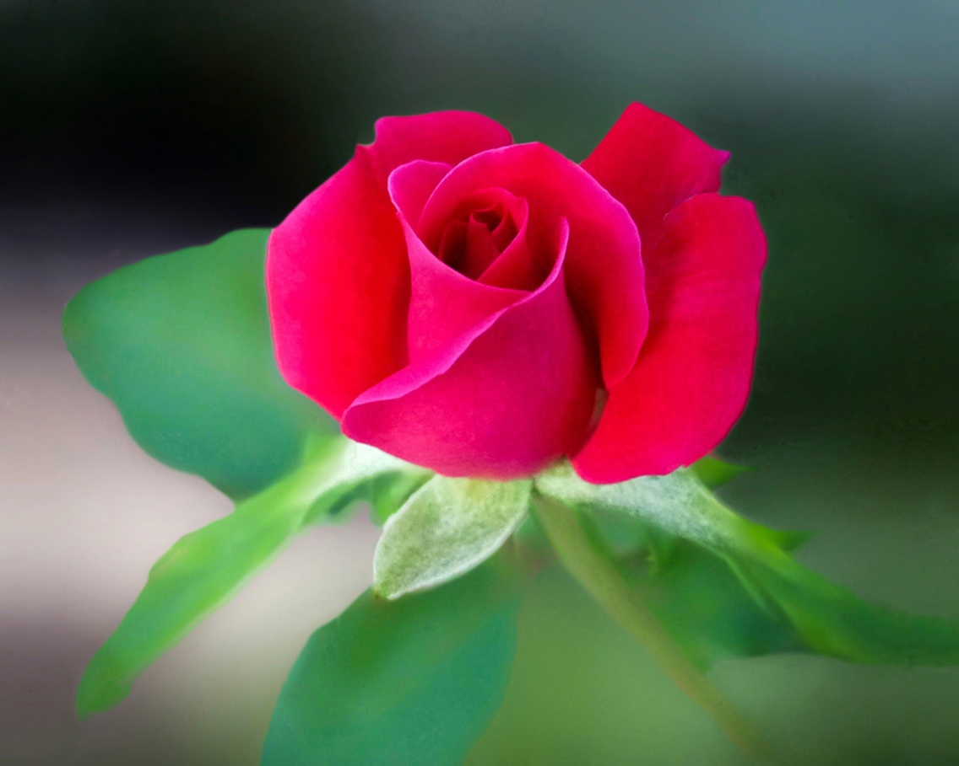
WELCOME

Slide 2
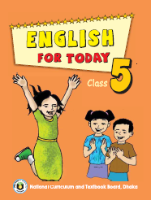
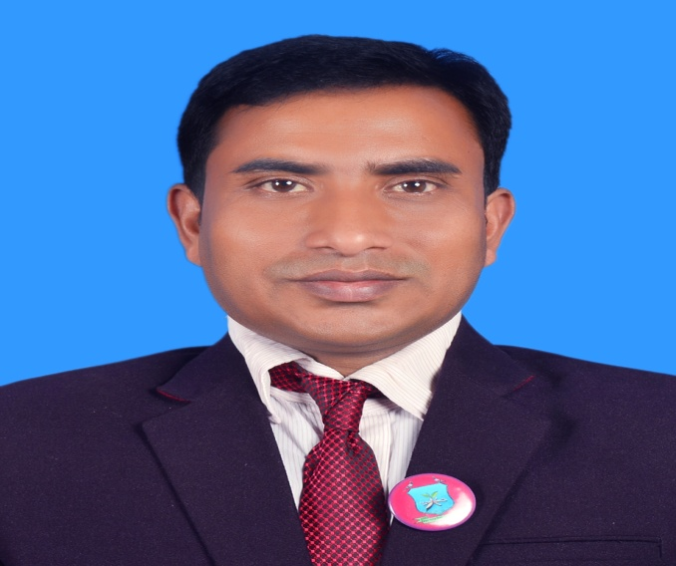
INTRODUCTION
Suranjit Talukder
( BA, B-Ed; MSS, M-Ed; C-in-Ed )
Assistant teacher
Voishber Govt. Primary School.
Sunamgonj Sadar , Sunamgonj.
Class: Five
Subject: English
Unit:19,Lesson: 1-2.
Date:
Time:40 Minutes

Slide 3
CREATING EMOTION
Good morning , students.
Good morning , teacher.
How are you?
Fine . And you?
I’m also fine. But you are looking pale .(By showing a student)
Have you any problem?
No/Yes , Sir.
Let’s sing a song …

Slide 5
We live in Bangladesh. It is an independent country. Who declared the independence of Bangladesh?
Bangabandhu Sheikh Mujibur Rahman .
Where do the rare photographs, objects etc which are used by the freedom fighters exhibit ?
In the Liberation War Museum.
Today’s topic is “The Liberation War Museum”

Slide 6
LEARNING OUTCOMES
Students will be able to………
3.4.1: Understand statements made by the teacher and students.
1.1.1: Say words, phrases and sentences with proper sound stress and intonation .
5.1 .To read silently with understanding paragraph, stories,
Dialogues, personal letters and others texts materials.
10.2.write short compositions on familiar objects, people, places and events.

Slide 7
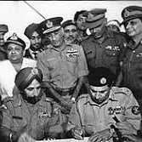
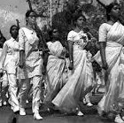
Please think about the pictures and discuss in pairs.
What does the picture indicate?
It indicates our liberation war.

Slide 8
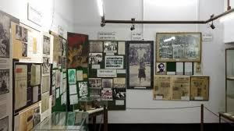
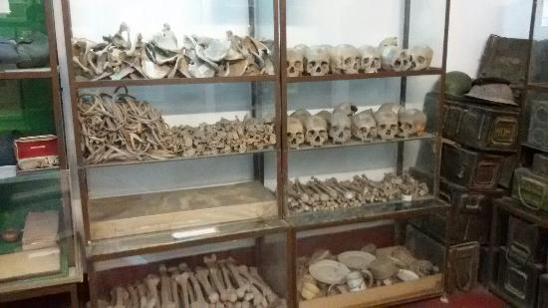
Please think about the pictures and discuss in pairs.
What does the picture indicate?
It indicates our liberation war Museum.

Slide 9
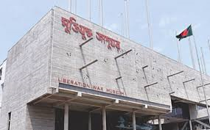
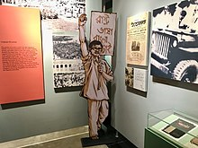
Please think about the pictures and discuss in pairs.
What do you see in the picture?
It is the Liberation War Museum.

Slide 10
NEW WORDS MEANINGS
Liberation War Museum: The museum where the rare photographs and objects which were used by the freedom fighters are stored..

Slide 11
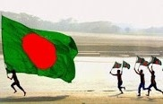
NEW WORDS MEANINGS
Newspaper: A printed publication which carries news.
Independence: Freedom , Liberty

Slide 12
NEW WORDS MEANINGS

Slide 13
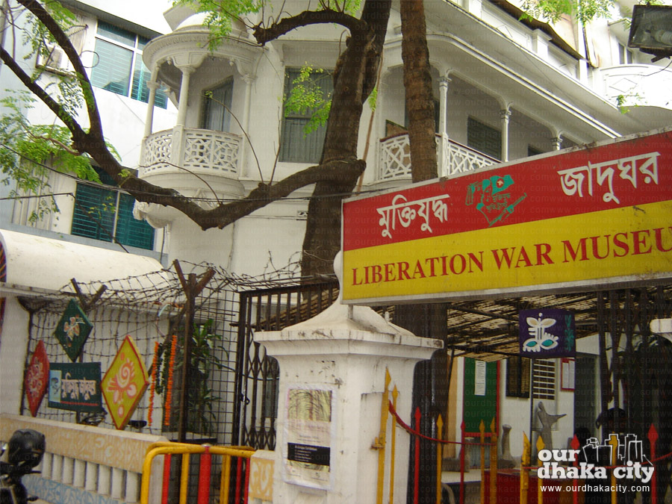
NEW WORDS MEANINGS
Liberation War Museum
War: Fight

Slide 14
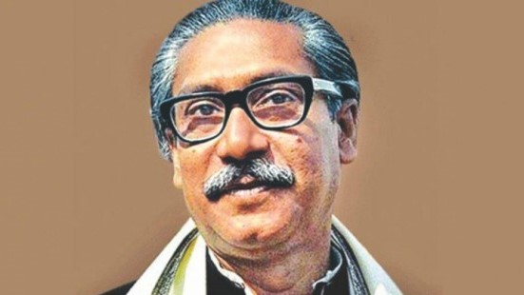
NEW WORDS MEANINGS
Bangabandhu Sheikh Mujibur Rahman
Liberation war: The fight of setting someone free from imprisonment slavery or oppression

Slide 15
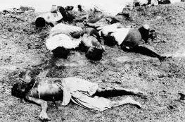
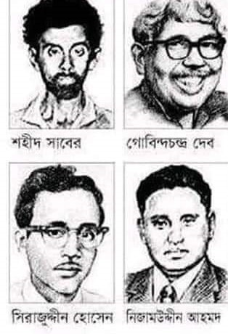
NEW WORDS MEANINGS
Martyrs : a person who is killed because of their religious or other beliefs
Intellectuals: A person possessing a highly developed intellect.

Slide 16
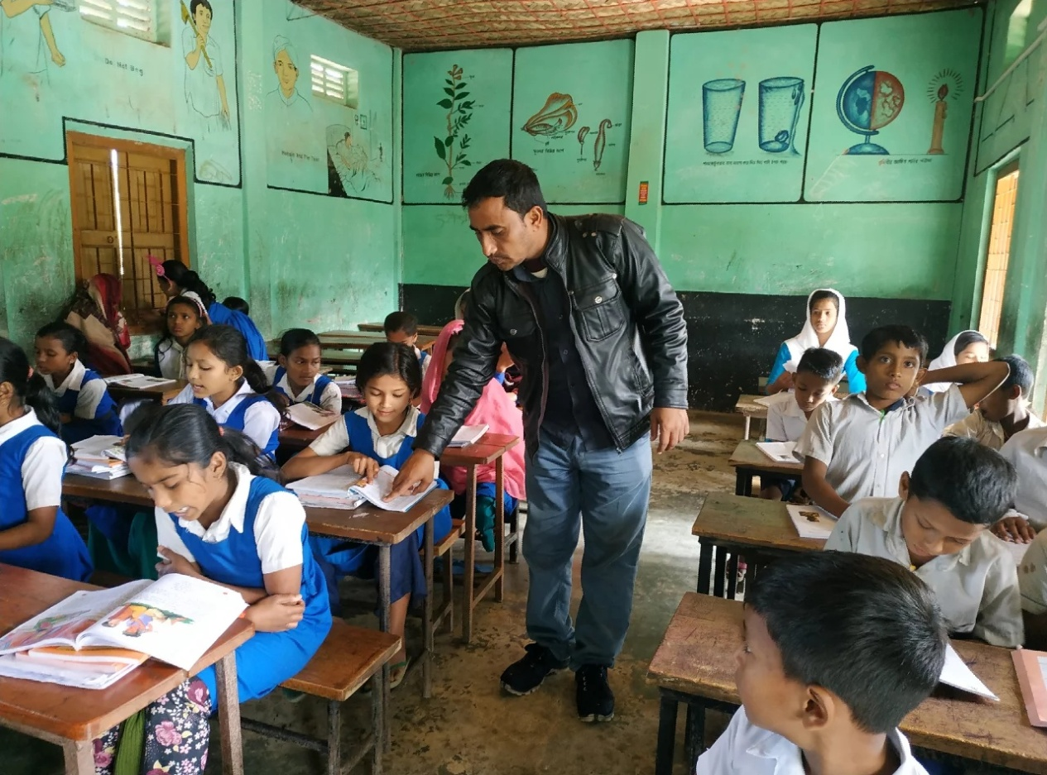
Listen to the text with me and put your finger under the line.
Now read loudly after me.

Slide 17
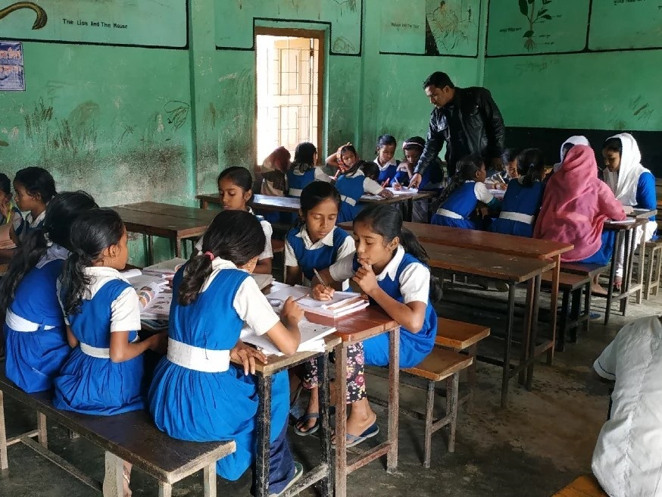
Now read the text in groups.

Slide 18
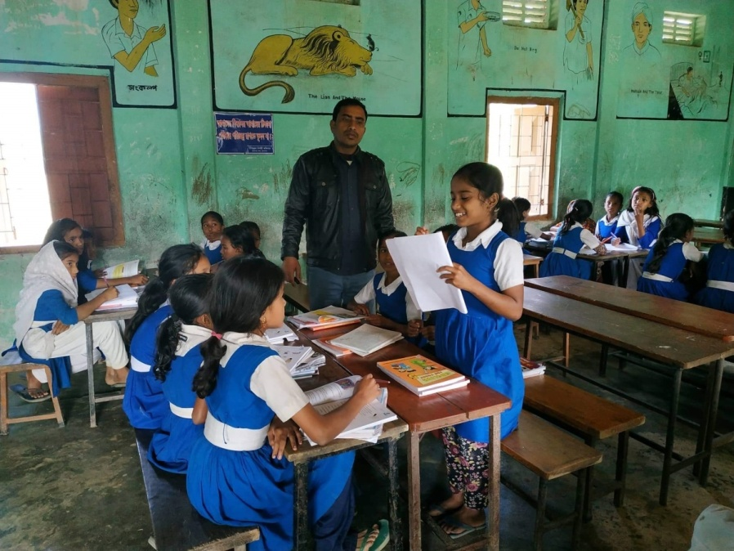
A student will be selected from every group to present their group work.

Slide 19
Ask and answer in pair
Answer the questions:
1.Who declared the independence of Bangladesh?
2.Where is the Liberation War Museum?
3.How many galleries are there in the Liberation War Museum?
4.Which personal belongings are kept in the Liberation War Museum?
5.When did the class go to the Liberation War Museum?

Slide 20
INDIVISUAL WORK
(Fill up the blanks with suitable words from the text )
1. …………..declared the independence of Bangladesh.
2.The Liberation War Museum is at …………
3. The trip was planned as part of ……………
4. ………welcomed warmly.
5.The name of that magazine was …….where about the Liberation war museum was written.

Slide 21
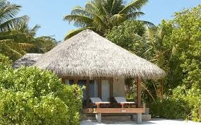
Homework
Write a letter to your friend about your illness at least six sentences.

Slide 22
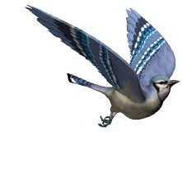
GOODBYE

