Slide 1
Wel come

Slide 2
Teacher Identity
Md. Zahidul Islam.
Asst.teacher(ICT)
Purba Kewabunia Akbaria Dakhil Madrasha.
Master Trainer Of ICT,UITRCE,
Amtali,Barguna.
Mobail No:-01718-165920
Email No:zahidulislam7994@gmail.com

Slide 3
Let us see some pictures and try to say the answer:

Slide 4
What do you see in the picture?

Slide 5
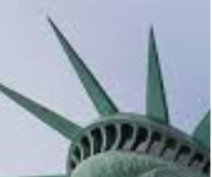
What can it be?

Slide 6
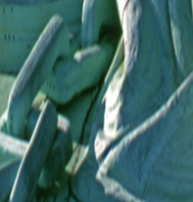
What is this ?

Slide 7
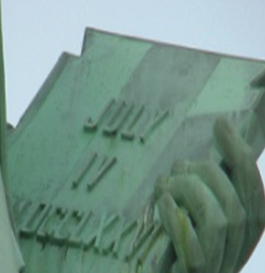
What is written in the picture?

Slide 8
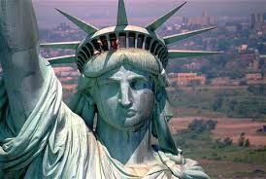
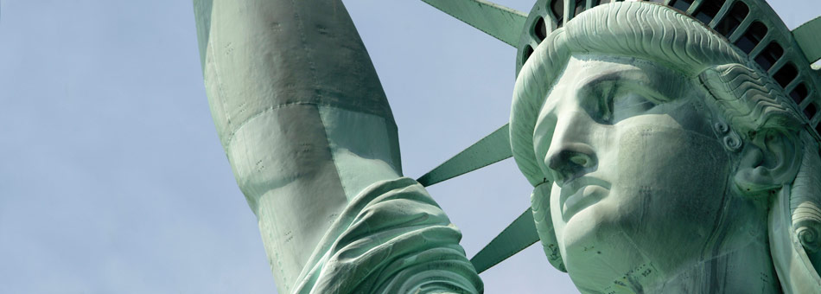

Slide 9
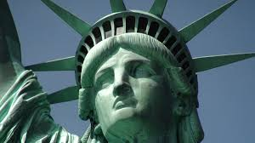

Slide 10
The statue of liberty
Unit:Eight
Les:three

Slide 11
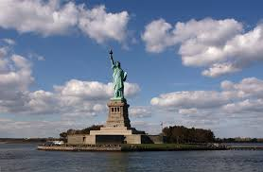

Slide 12
After this lesson the students will be able to:
Listen for specific information.
Ask and ans question
Describe a monument
Write a short composition

Slide 13
Word | Mean/synonym | Antonym
Sculptor | artist | *
Sculpture | idol/statue/monument | live
symbol | stand/mean | *
pedestal | Where an idol is kept | *
unveiling | opening/exhibit | hide
construction | build/make | Demolish/break
raise | collect | donate

Slide 14
Let us see a video

Slide 16
Designer was The French sculptor frederic Auguste Bartholdi.
It is a gift for the Americans by the Franch.
Celebrating of the American declaration of independence .
On the occasion of celebrating the hundred years of indepen..
Joint venture between the USA and Franch.
France built the statue and the USA build the pedestal.

Slide 17
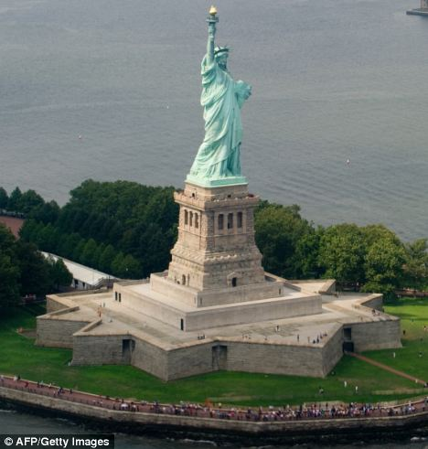
Raising money for the pedestal (1885).
The construction of the padestal was finished in(1886).
In the mean time Franch completed the statue(July1884).
Franch sent it to New york on board the French war ship ‘Isere’(1885).

Slide 18
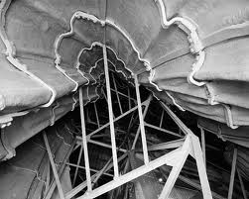
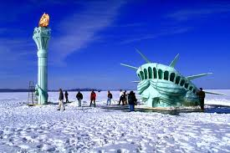
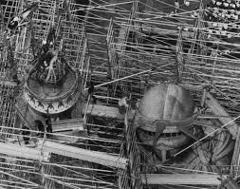
While transporting the statue , it was spilt up into 350 pieces and packed in 214 crates.

Slide 19
The original torch was replaced by a new copper torch in 24K gold leaf in 1984.
The original torch is in the lobby of the monument now.
The torch is lighted by flood light.

Slide 20
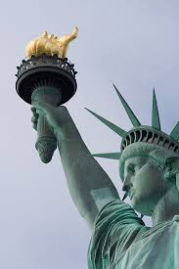
The statue of liberty was named “Liberty Enlightening the World Wide Web .” on her 125th anniversary from October 28,2011.
As a series of web cameras placed around the torch one can see it from any where in the world.

Slide 21
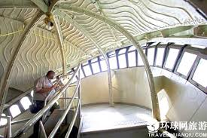
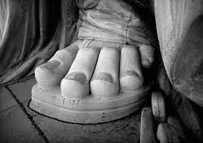
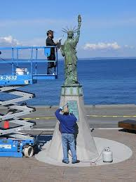
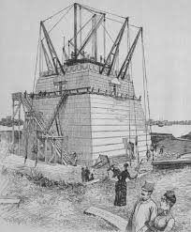
It took 4 months to put the statue together.
Unevailing ceremony on October 28th 1886 .
^{It} was centennial gift after ten years.

Slide 22
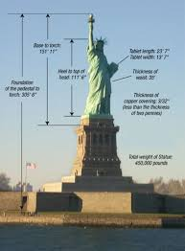

Slide 23
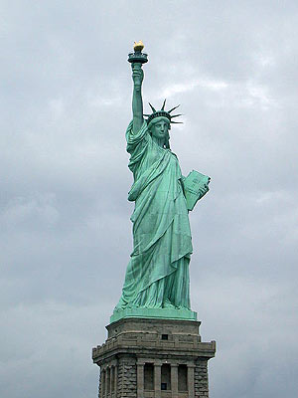
The statue was made up of copper.
It took 4 months to put the statue on the pedestal.
Its unveiling ceremony was in October 28th 1886.

Slide 24
Enlighte-ning the world with her torch,free from oppression and slavery.

Slide 25
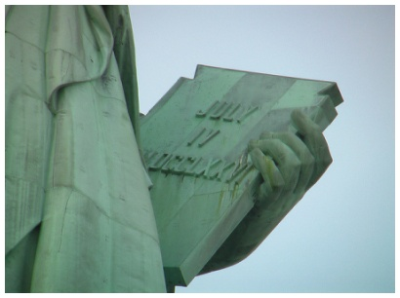
Symbolizes education that can enlight a nation.

Slide 26
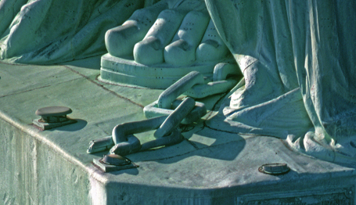
The broken chain symbolizes free forward movement.
Broken chain
robe

Slide 27
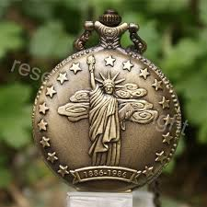
Group work
Do you like this idea of presenting the statue to the USA by Franch? why ?

Slide 28
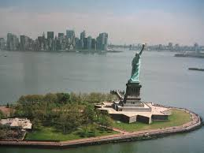
Evaluation

Slide 29
What do you mean by “enlightening the world?”
What does the broken chain mean?
How has new technology made it possible for people to see the statue from anywhere?
On what occasion the statue was given?
What does the statue represent?
What is inscribed in the book?
How was she transported?
When did it reach to her destination?

Slide 30
Home work

Slide 31
Write 15 sentences about the Statue of Liberty using these clues.
Situated
Artist
Gift from
Reason for the gift
Presented on
Occasion
The statue stands for
Framework made of
Pedestal
Torch
Web cams
Enlightening the world

Slide 32
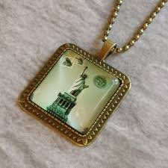
Thank you

