Slide 1
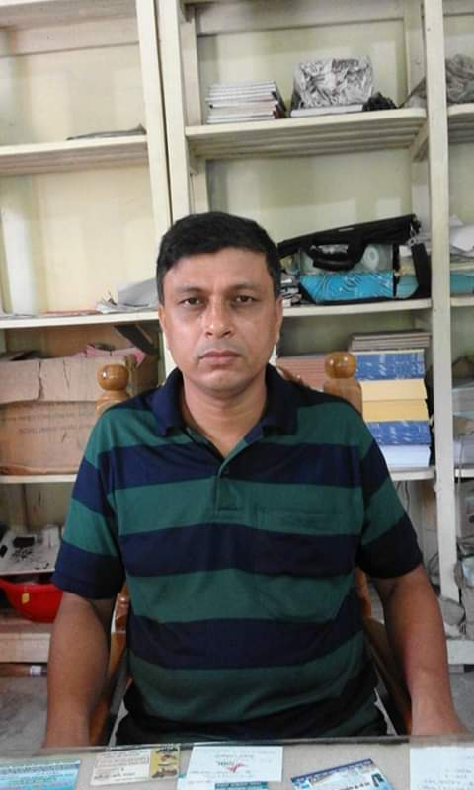
Notes:
In this picture, the boy with me, is Mahtab Shakib Rahman, a student of class eightis a marks all rounder in the folk song section.

Slide 2
Sultan Ahmed Miazi
Astt. Teacher(English)
Balia K.B.D.N. Dakhil Madrasah
Chandpur Sadar,Chandpur.
Mo-01817106106
sultanshapdi@gmail.com

Slide 3
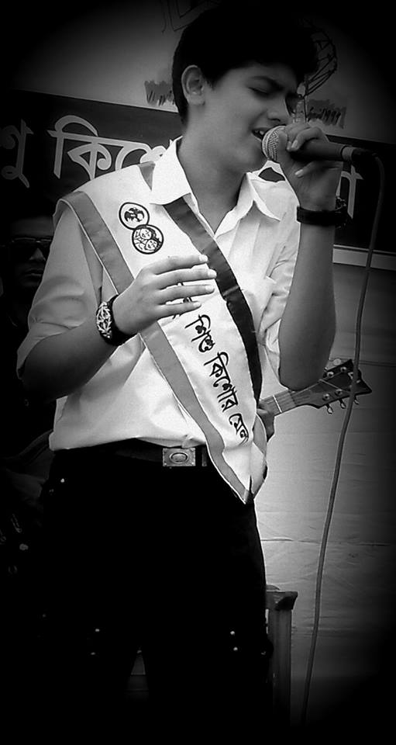
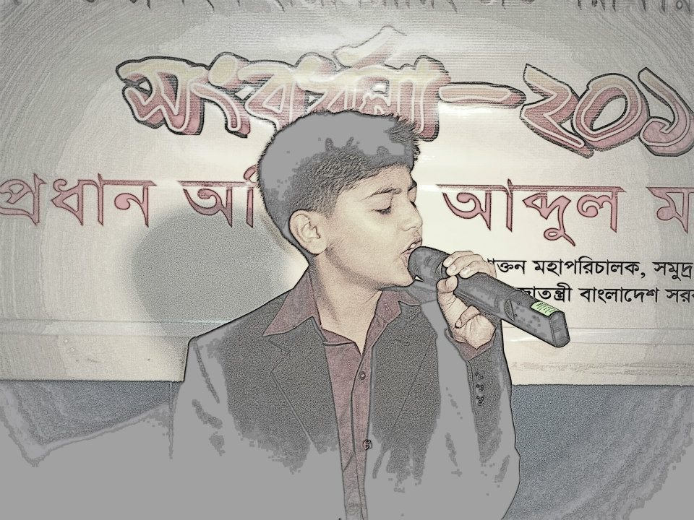
WELCOME
TO
ENGLISH
1ST PAPER CLASS
Notes:
In this slide, this picture has been used to draw the students’ attention to the class.

Slide 4
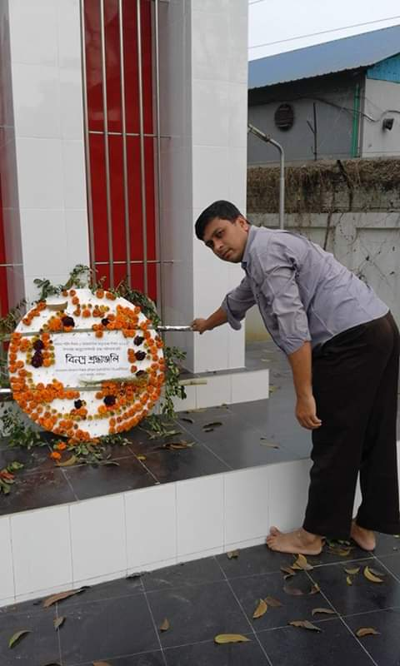
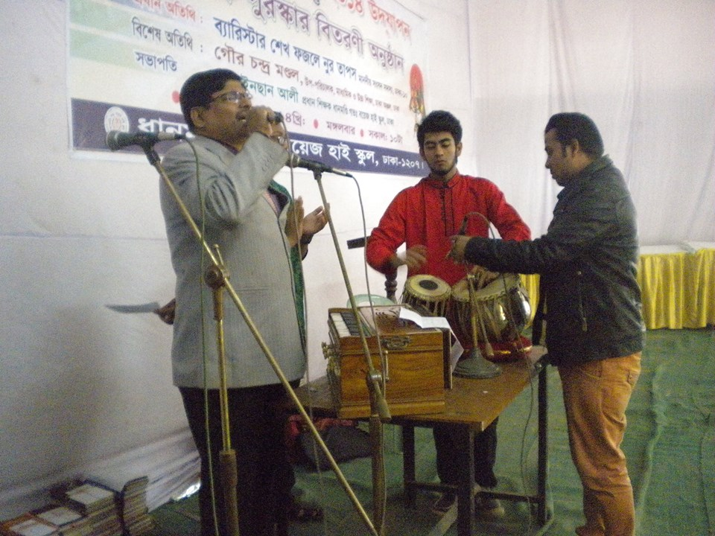
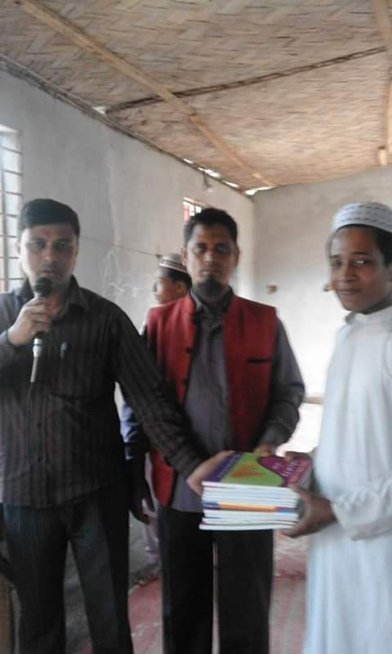
The head & another teachers are performing a renowned folk songs.

Slide 5
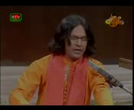
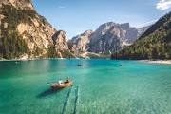
LET’s ENJOY A SONG.
After enjoying the video, you will have to
answer the following questions
look at the screen / board before enjoying it.
* What have you seen in the video clip?
Notes:
2-3 learners can be asked to describe what they have seen in the video. At first 3-4 learners can be selected from all the learners by a random selection. After listening to their description, the teacher can go for declaring the topic of the day.

Slide 6
TODAY’S TOPIC
our
FOLK SONGS
class viii
UNIT-6,LESSON-1

Slide 7
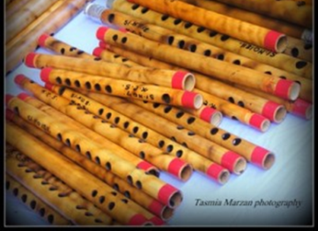
LEARNING OUTCOMES
By the end of the lesson, the learners will be able to…
ask and answer questions
name some folk songs, musical
instruments, lyricists and singers
explain the words and phrases
write a paragraph

Slide 8
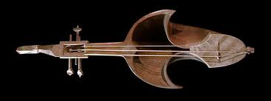
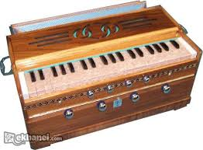
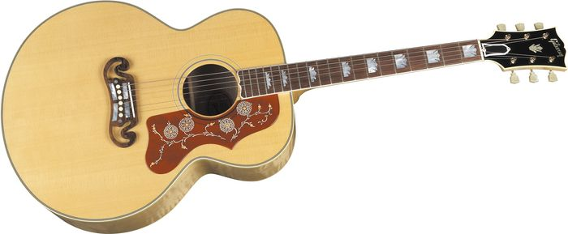
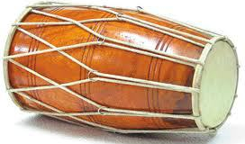
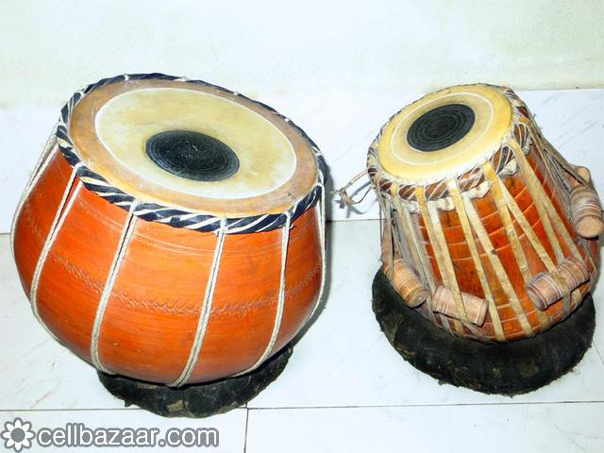
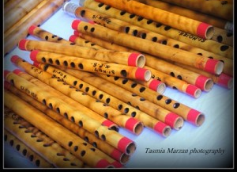
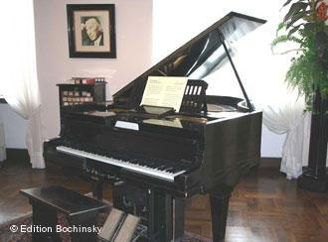
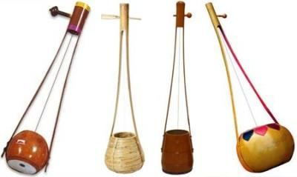
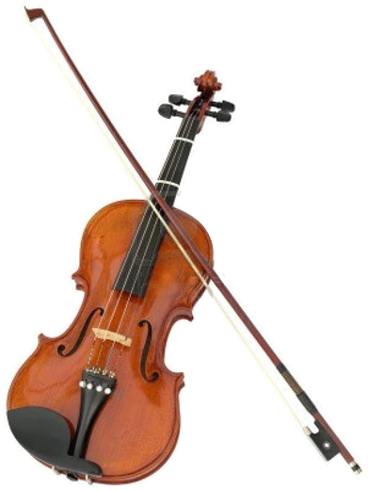
a.
Work in pairs. Looking AT the musical instruments read out their names and answer my following questions
sarinda
guitar
harmonium
dotara
drum
tabla
piano
Ek-tara
bamboo flute
violin
1.Gan you sing a song? 2.Can you play any of these musical instruments? 3.Do you know
anybody who can play any of these instruments? Tell me what you know about him / her.
1.Yes,mam. 2.yes, mam. Harmonium & tabla.3. Yes, mam. Our friend, MAHTIM SHAKIB
RAHMAN. He is s one of the Mark’s All-rounders . We are proud of him.
Notes:
Like me/unlike me the teacher may ask questions if they have any renowned singer or lyricist in their institution.

Slide 9
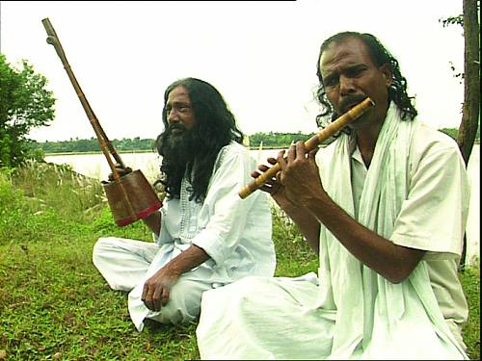
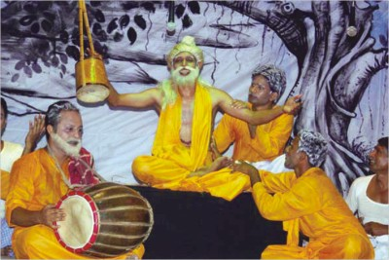
B. Text reading
The learners will be asked for reading the text for 10 mins.
I will monitor to facilitate them .
After that, I will help them to explain the text
through continuous assessment with the interaction .
Notes:
While monitoring the class, the teacher may ask the learners if they find any difficulties in reading the text, or face any problem to pronounce the word correctly.

Slide 10
Folk(Noun)
referring to particular groups of people.
Notes:
The teacher may allow the students to utter some words with correct pronunciation.The learners will be asked for making sentences.

Slide 11
Folk songs
a traditional or composed song typically characterized by stanzaic form, refrain, and simplicity of melody which are performed with the traditional musical instruments.
Notes:
The teacher may invite 3-5 students to tell 2/3 sentences about folk songs. If needed, he/she shwoed them the given description.

Slide 12
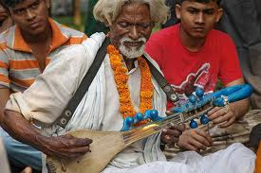
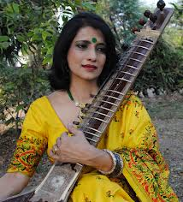
TRADITIONAL (adj)
in accordance with a customary / or characteristic method or manner:
of or pertaining to a long-established or inherited way of thinking or acting:
Notes:
The learners will be asked to make sentences with the words.

Slide 13
Traditional
Musical Instruments
What are these?
sarinda
harmonium
dotara
dhol
tabla
bamboo flute
Ek-tara
violin
Notes:
Showing the pictures ,the teacher may ask the learners to name the instruments. After that he/ she may tell them to check their answers with his/hers.

Slide 14
Popular folk songs
Who are they?
Folk lyricists
What are these ?
palligiti,
bhatiali,bhawaiya
palagan,
jari , sari
Hason Raja
lalon giti
Shah Abdul Karim
gambhira
Pollikobi Jasim Uddin
Lalon
songs of Hason Raja
Gambhira Rajshahi
Notes:
The learners will be asked for identifying the singers and relating them with the folk songs given beside them above.

Slide 15
Common people (noun)
people in general from different classes and occupations,
specially the country people, according to the text
Notes:
The learners will be asked to make sentences with this word.

Slide 16
Let’s know the name of renowned Folk Singers
Shah
Abdul
Karim
Hachon
Raja
Abdul
Alim
Abbas
Uddin
Shofiul
Alom
Raja
Mustafa
Zaman
Abbasi
Farida
parvin
Ferdousi
Rahman

Slide 17
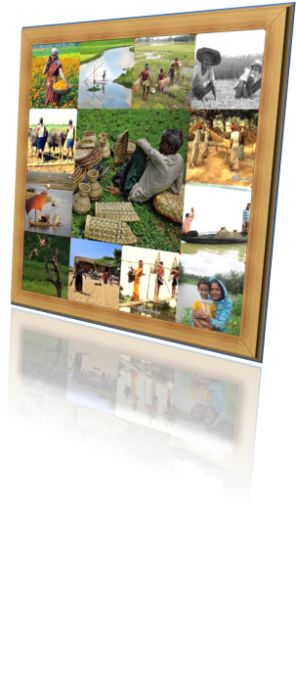
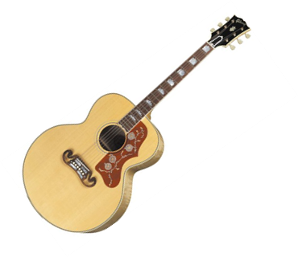
Answer the following questions
1.Who usually likes our folk songs?
2.Can you name some well known folk singers?
3.Do you like folk songs? If you do , who is your favourite singers?
4.Look at the musical instruments in A above and say which instruments
go well with the folk songs.
5.Discuss in groups whether the modern
instruments like the guitar and the piano
could be played with the folk songs.

Slide 18
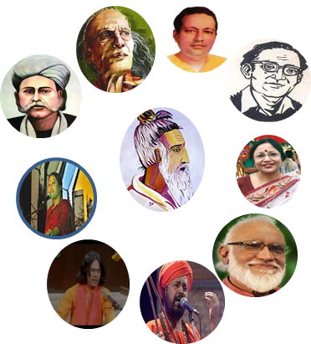
discuss in groups and write a paragraph on-
“Do you want more or less programs on folk songs
on our TV channels ? Why ?
Notes:
If time does not allow, no need to give it as a group work , It can be given as home work.

Slide 19
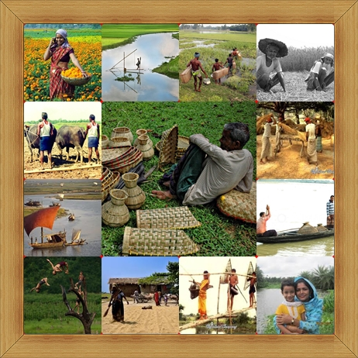
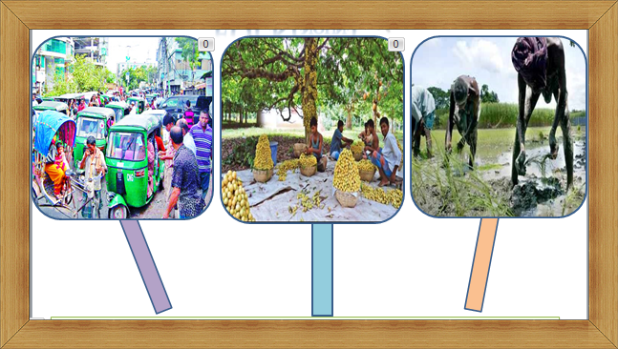
Thank you so much

Slide 20
