Slide 2
Teacher Identity
Aysha Pervin
Assistant Teacher
Dhaka cantt. Dhaka
Azampur Gps

Slide 3
Introduction of lesson
Class- one
Unit-8
Time-40 minute
Subject-English
Lesson-(1-3)
Date-29/02/2020

Slide 4
Learning Outcomes- Students will be able to.......
Listening-
1.1.1.become familiar with English sounds by listening
to common words.
3.1.2. understand simple questions about familiar object
3.2.1.understand simple statements.
Speaking-
1.1.1. repeate after the teacher simple words and phrases
1.1.2.say simple words and phrases.
3.1.2.answer questions asked by the teacher about a few familiar objects.

Slide 6
Do you like to see picture? Let’s see.

Slide 7
What’s this?
What is this?

Slide 8
What’s this?
It’s a tiger.

Slide 9
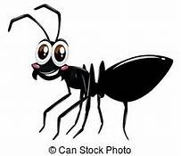
What’s this?
It’s an ant.

Slide 10
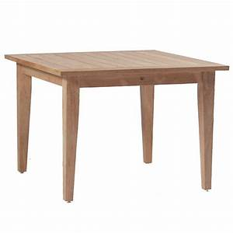
Let’s see more picture and repeat with me.
chair
pencil
book
What’s this?
table
bag
It’s a…

Slide 11
Open your book at page 16 and look at the lesson.

Slide 12
Pair work
see a book of picture with your partner and one showing a picture , ask question what’s this? Then other answer.
It’s a/an……………..

