Slide 1
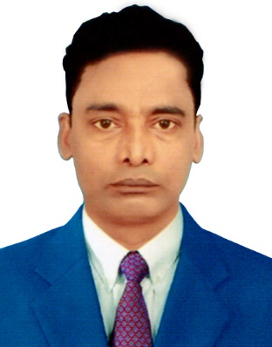
.Welcome to the world of PPT K.T SIR Presentation

Slide 2

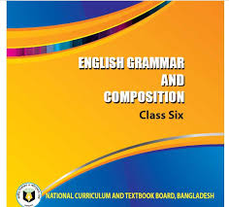
Introduction
Komal Kanta Ray Talukder
MA,MEd
Senior Teacher
L.P High School,Chhatak
Sunamgonj
Subject:English Second Paper(Article-Part-1)
Class-Six
Time:50 minutes
Date:25.01.2020

Slide 3

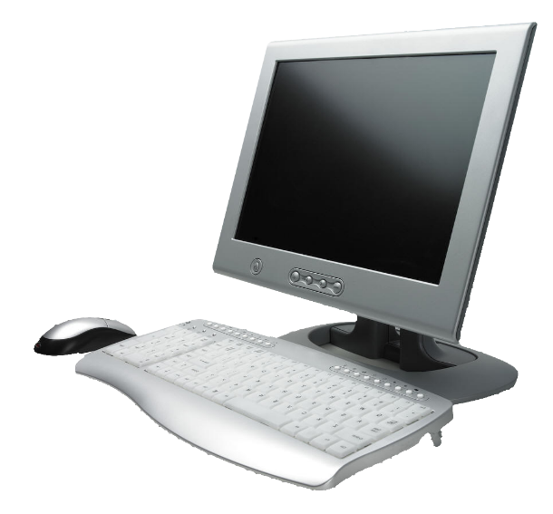
A Flower is a sign of beauty
Everyone should know how to
operate a computer.

Slide 4
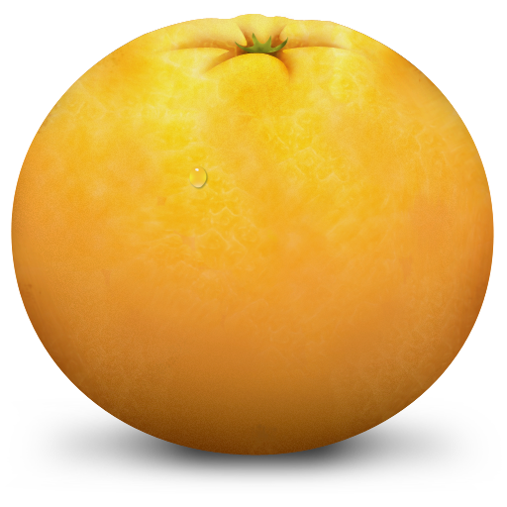

Eat an orange everyday.
An umbrella is useful in rain.

Slide 5

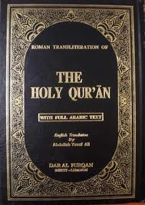
The sun gives light to all equally
Study the Quran to know Islam.

Slide 6
Can you guess what
are the pictures about?

Slide 7
Our Today´s lesson is-
Article(Part-1
Unit-03,Lesson-1

Slide 8
Learning outcomes
At the end of the lesson, we will be able to----
define article
use article ‘a’ & ‘an’ properly
use special use of articles

Slide 9
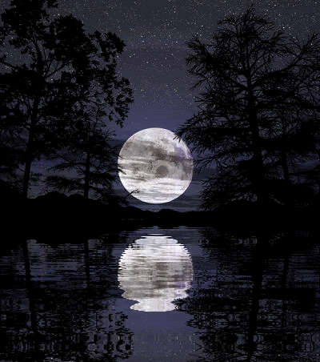
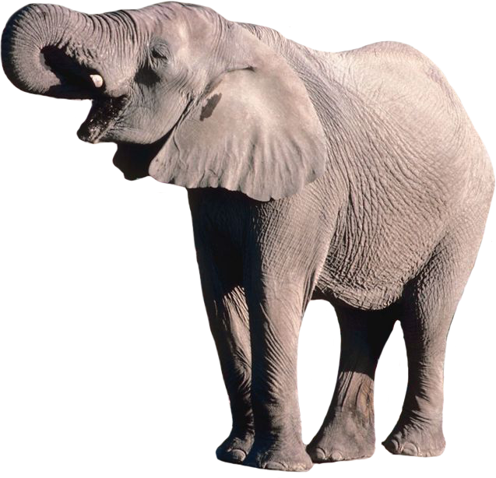
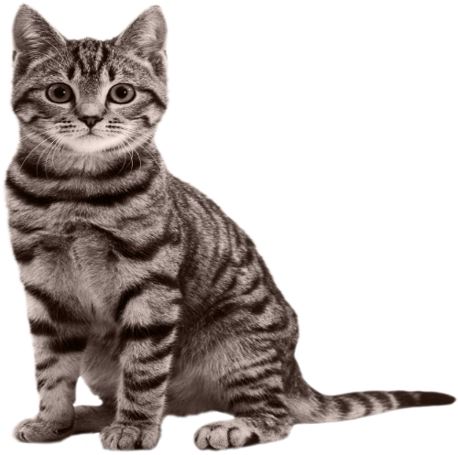
The moon shines at night
A cat is compered with a tiger
An elephant is bigger than a lion

Slide 10
What are called article?
The
A
An
Article Determiner

Slide 11
What are the divisions of article?
Article
Definite
The
Indefinite
A,An
Definite article is used to particularize a noun.
Indefinite article is used to generalize a noun.

Slide 12
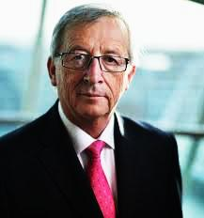
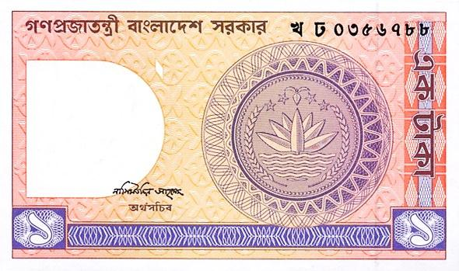
He is a Eurpean.
Give me a one taka note.

Slide 13
Follow some examples
a European
a union
a university
a useful book
a unique scene
a one-rupee note
a one-eyed deer
a High / Higher- Secondary School

Slide 14

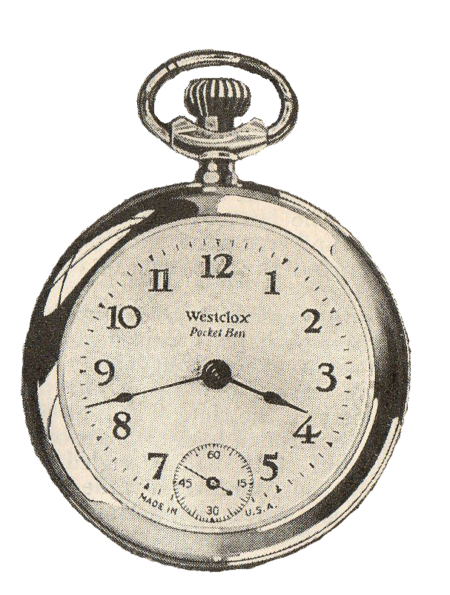
an
Mr. Amin is MBBS.
an
He is ___ honest man.
an
I will come after hour

Slide 15
Follow some examples
an hour ( ‘h’ silent)
an honest ( ‘h’ silent)
an M.A.
an M.P.
an L.L.B.
an M.L.A.
an S.D.O.
an H.S. School

Slide 16
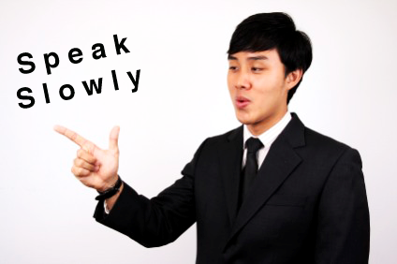
But
remember.

Slide 17
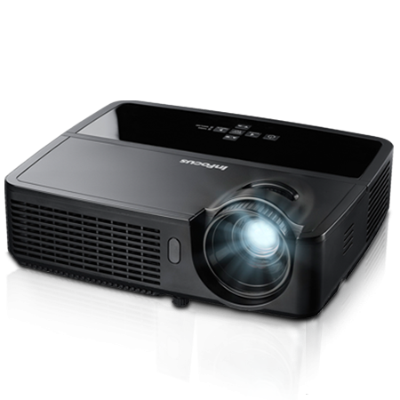

We have ______ projector in our class.
a
an
He sent me email

Slide 18
When you will find no sound of -
ইউ/ওয়া
এ,অ,আ
What will you do?

Slide 19
If you find a consonant as the first letter of the word , that means (b, c, d, f, g, h, j, k, l, m, n, p, q, r, s, t, v, w, x, y & z)
You have to write ‘a’ before the word.

Slide 20
If you find a vowel as the first letter of the word , that means
(a, e, i, o, u)
You have to write ‘an’ before the word.

Slide 21
Some common used articles
A ( Consonant Sound – before A ) |  | An ( Vowel Sound – before An )
a boy | a lion | an ass | an elephant
a book | a mango | an ant | an inkpot
a bag | a student | an apple | an ice-cream
a cat | a woman | an arm | an idiot
a chair | a table | an egg | an ox
a dog | a tiger | an ear | an orange
a horse | a tree | an eye | an umbrella

Slide 22
Activities
Orally
&
individually

Slide 23

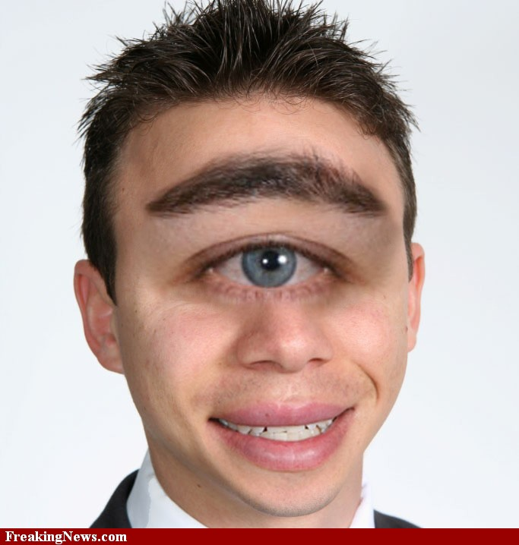
an
Dr.Sabina is FRCS.
a
He is one-eyed boy.

Slide 24
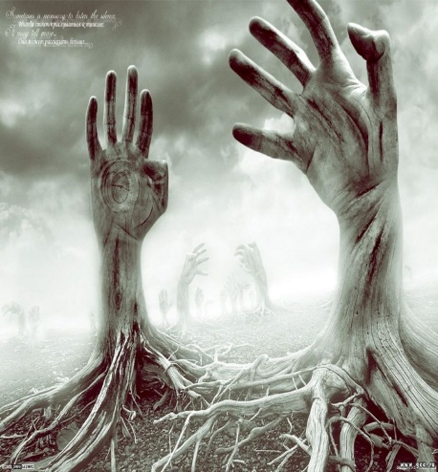

a
This is unique picture.
a
Md. Mijanur Rahaman is B.A

Slide 25
Evaluation
Fill in the blanks with appropriate article-
1.I have ______ mobile phone.
2.He is ______ brilliant boy.
3.You showed ______ excellent performance.
4.Saadik is ______ university student.
5.It takes ______ hour to go there.

Slide 26
Home Task
Fill in the blanks with a/an.
Kollol is _____ meritorious student. He studies in ____ renowned school. There is _____ expert headmaster in the school. He is ____ honest man. The school has achieved ____ unique position in regard of result.

Slide 27



