Slide 1
Welcome

Slide 2
Mafuza Akter
Lecturer of English
Kushtia City College,Kushtia
English First Paper
Class XI-II

Slide 3
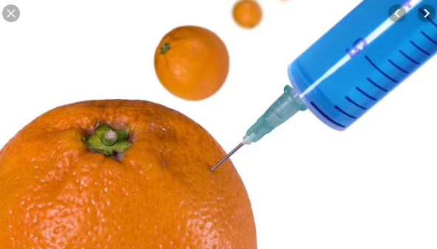
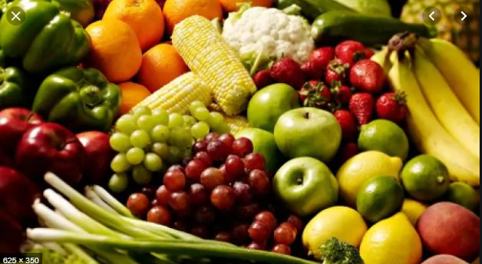

Slide 4
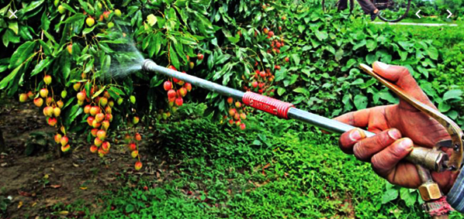
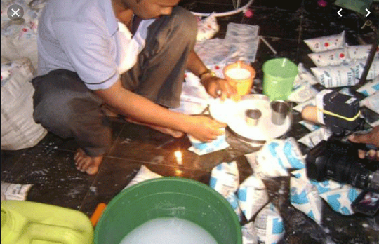
What do you understand?

Slide 5
OUR TODAY’S LESSON
Unit FIVE: Food Adulteration
Lesson 1
Food Adulteration Reaches New Height

Slide 6
Learning Outcomes
After we have studied this lesson , we will be able to---
ask and answer questions
understand through silent reading
describe about food adulteration.

Slide 7
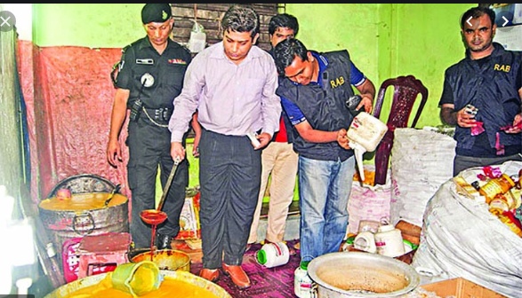
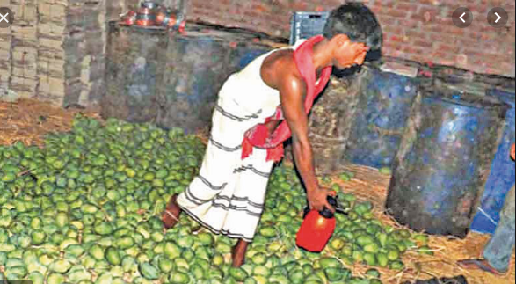
A. look at the picture. Work in pair Talk about the picture and ask and answer the following questions with your partner.
1.What are the health risks related to adulterated food?
ANS: The health risks related to adultereated food are fatal diseases like Cancer,Kidney failure and heart problems.

Slide 8
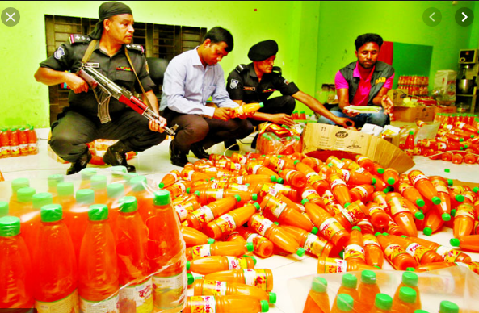
Banned
Something forbidden and refused,illegal
The banned food are harmful for human body.

Slide 9
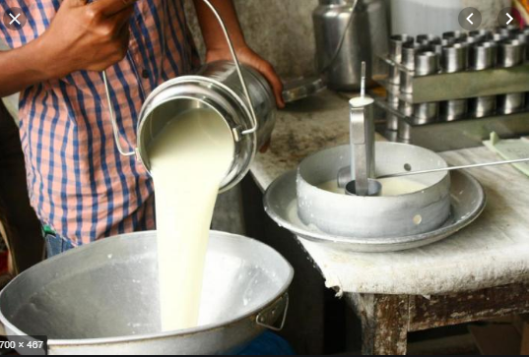
Pasteurised
The process of heating milk to a high temperature in order to kill harmful microorganism
Pasteurization is a process that kills harmful bacteria by heating milk to a specific temperature for a set period of time.

Slide 10
Sensitive
Quick to detect or respond to slight changes ,signals or influences.
The truth is, being sensitive means you notice things, you care about people's feelings, and you think deeply before you speak. It means taking the time to absorb and process, rather than rushing to a decision
She was sensitive to any change in his habits.

Slide 11
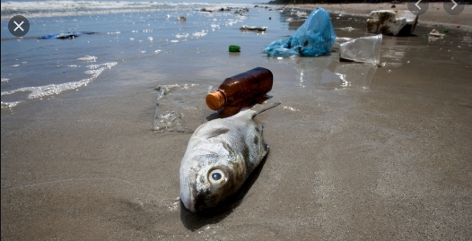
Contaminate
make (something) impure by exposure to or addition of a poisonous or polluting substance.
In our polluted world, mercury and other heavy metals can contaminate fish.

Slide 12
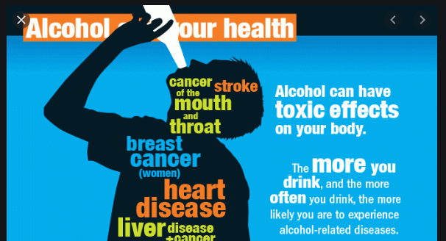
Consumption
Consumption is the vital foundation for economics, as well as the broader economy. Our whole system of reward and progress is based on consuming and producing ever more goods and services.
Synonym: expenditure, utilization
Adulterated food items are unsafe and and dangerous for consumption

Slide 13
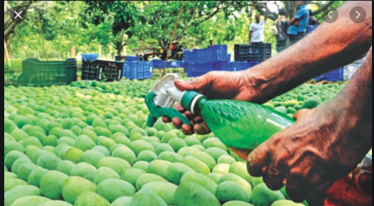
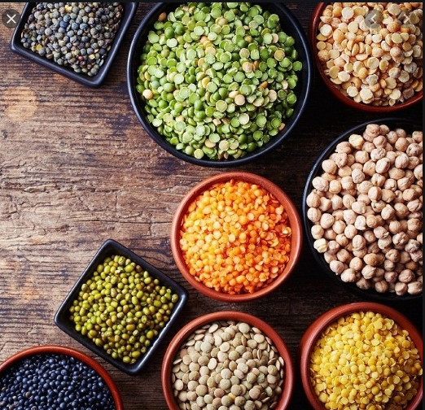
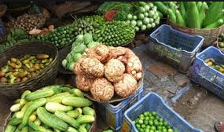
A 15-member team of the National Food Safety Laboratory, with support from the Food and Agriculture Organisation (FAO), came up with the findings after collecting and testing food samples from the capitalÕs Gulshan, Karwanbazar and Mohakhali markets

Slide 14
Let’s have a tour from the text to know the rest of the information by silent reading.
Dear students,
Open your text book unit-5,Lesson -1 page and start silent reading to answer the group questions. I am always with you to help in case of any inquiry.

Slide 15
2 Read the following feature
The survey report, a copy of which was acquired by the Dhaka Tribune, read that nearly 40% of 82 samples of milk, milk products, fish, fruits and vegetables contained banned pesticides such as DDT, Aldrin, Chlordane and Heptachlor. The amounts of pesticide in these samples were found to be 3 to 20 times greater than the limits set by the European Union. Around 50% vegetables and 35% fruits were found to be contaminated with unsafe level of pesticides.
Analysing more than 30 samples of turmeric powder (branded, packaged and open), the team also found that nearly 30% of the samples contained traces of lead chromate, which can be fatal if swallowed or inhaled. These samples also contained lead at 20 to 50 times above the safety limit of 2.5 parts per million set by the Bangladesh Standard Testing Institute (BSTI). Arsenic and chromium above safety limits were detected in a total of 5 out of 13 rice samples.
Using a sensitive High-Performance Liquid Chromatography (HPLC) method developed by the Food Safety Lab, 66 samples were analysed for the presence of formaldehyde. Adulteration was thereby detected in samples of coriander, mango and fresh shrimps.
Analysing more than 30 samples of turmeric powder (branded, packaged and open), the team also found that nearly 30% of the samples contained traces of lead chromate, which can be fatal if swallowed or inhaled. These samples also contained lead at 20 to 50 times above the safety limit of 2.5 parts per million set by the Bangladesh Standard Testing Institute (BSTI). Arsenic and chromium above safety limits were detected in a total of 5 out of 13 rice samples.
Using a sensitive High-Performance Liquid Chromatography (HPLC) method developed by the Food Safety Lab, 66 samples were analysed for the presence of formaldehyde. Adulteration was thereby detected in samples of coriander, mango and fresh shrimps.

Slide 16
A former Director General of the Health Services and senior national adviser of the FAO, said the findings were shocking for the whole nation. He added that instead of focusing only on the end products, the issue should be addressed at the root level. Pointing out that there were four steps in the production process-farmer, transport, wholesale, and retail trader, -he said better monitoring and supervision were mandatory for stopping food adulteration.
Adulterated food products are reportedly the cause behind thousands of people suffering from fatal diseases like cancer, kidney failure and heart problems. Health specialists told the Dhaka Tribune that the Ministry of Food had enacted a Food Safety Act, but was yet to prepare the necessary rules. As the issue of food safety was also linked to 14 other ministries, a coordinated agency should take responsibility of ensuring safety in food products, they added.

Slide 17
Group Work
Answer the following questions:
a. What does new height refer to in the title of the news report?
b. What confirms that even our poultry products are contaminated?
C. What are the health risks related to adulterated food?
d.What is the current state of the Food Safety Act?

Slide 18
Evaluation
3. Choose the right answer:
a. What percentages of the milk samples contained pesticide? i. 60 ii. 45 iii. 40 iv. 50
b. How did the scientists realize that the water supply was contaminated? i. because of microbial presence
ii. from the color of the water
iii. from an analysis of the mineral content
iv. through chemical test
c. Why were microbial populations present in pasteurised milk? i. because of widespread contamination in the water cows drink
ii. because of the formaldehyde content in the milk
iii. because of poor processing of the milk iv. all of the above
d. The amounts of pesticide in local food samples are ___ times greater than the limits set by the European Union. i. 3 ii. 20 iii. 3-32 iv. 60
e. How many ministries are concerned with the food safety issue? i. 10 ii. 15 iii. 1 iv. 14

Slide 19
6. Write a letter to the editor of a national daily pointing out the problems of food adulteration in your locality. Or, write a response to this news item published in Dhaka Tribune

