Slide 1

Welcome

Slide 2
Personal details
Class : 10
Sub : English
Unit:3
Lesson: 2
Time : 45m
Ferdous ara Begum
Assistant Teacher
Birinchi Sufia Nuria Senior Madrasha

Slide 3
Todays topic
May Day

Slide 4

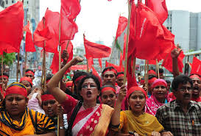
A . Look at the picture and talk about it.

Slide 5
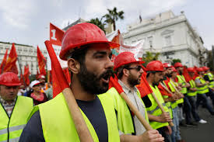
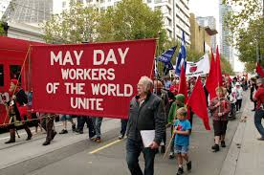
                1 . What do you see in the picture ?
2.Can you relate any historical event to this picture ? What happened on this day?

Slide 6
* Open your English book – page no 28 and read the text.
Do the pair work.
Make a group consisting of 6 members.
Discuss the issue with each other.
Share your views and thoughts.

Slide 7
Vocabulary
fdInterInternational = Global
Revolution =strike , war , struggle
Factory =industry , workshop
Rally =procession
Exploit =misuse , mistreat
Commemorate =remember , keep
Injury =wound , hurt, harm
Struggle =battle

Slide 8
1.Choose the best answer for the alternatives.
(a)The word ‘inspire’ means-------.
Struggle
Strike
Motivate
Fight
(b)The events of -------- was a reminder.
May 1,1886
May 1868
June 1, 1886
June 1868
(c)May day observed -------.
Only in Bangladesh
All over the world
In socialistic countries only
In capitalistic countries only
Motivate
May 1,1886
All over the world

Slide 9
(d)Workers were strike in------
Europe
The USA
Canada
The UK
(e)The police -------- the strikers.
Pacified
Misled
Tortured
Misguided
(f)The movement of May Day was for --------- of people.
Elite class
Working class
Officer level
Clerk level
(g)All on a sudden , almost -------- attacked the strikers.
100 leaders
100 policeman
200 leaders
200 policeman
The USA
Tortured
Working class
200 Policeman

Slide 10
2. Answer the following questions.
(a)What does May Day refers to?
(b)How long did the workers have to work a day before the May Day?
(c) Why did the workers in Chicago go on a strike?
(d)What was the demand of the workers?
(e) How many workers joined the rally?

Slide 11
Answering Questions
Ans.(a) May Day refers to the Day for the workers all over the world.
Ans.(b)Before the May 1 strike the workers had to work 14 hours daily.
Ans.(c)The workers in Chicago go on a strike with a demand of 8 hours working span daily.
Ans.(d)The demand of the workers was 8 hour working span only.
Ans. (e)Nearly 6000 workers joined the rally.

Slide 12
Home Work
Write a summary of the passage in no more than 90-100 words

Slide 13

Thank you everyone

