Slide 1


Good morning

Slide 2
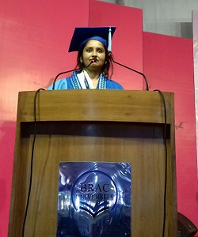


Identity
Hemia Afrin
Assistant Teacher
Digholia (south) Govt. Primary school.
Digholia,Khulna.
Email : hemia1922@gmail.com

Slide 3
Introduction of the lesson
Class: One
Subject: English For Today
Unit-2
Topic- Alphabet.
Lesson- (4-6).B. say and read trace and write.

Slide 4
Learning Outcomes:
Students will be able to--------
Listening:1.1.1 become familiar with English sounds by listening to common English words.
Speaking: 1.1.2 say simple words and phrases with proper sounds and stress.
Writing: 1.1.1 practice letter shapes/simple writing patterns, etc.
1.2.1 write non-cursive capital letters and small.

Slide 5
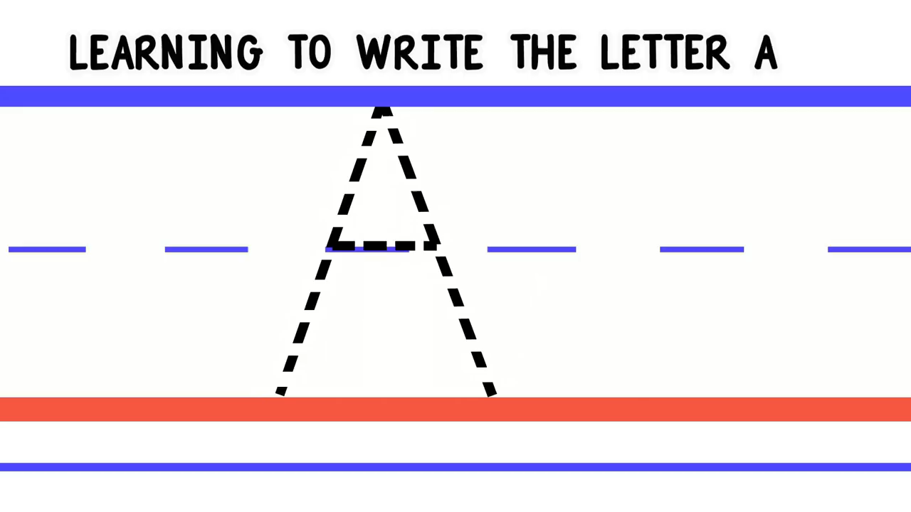
Video

Slide 6



Slide 7



Slide 8

Open at page 5

Slide 9


A
A
A
A
A

Slide 10
Evaluation

Slide 11

Write non cursive small letter

Slide 12
Write non cursive capital letter
A

Slide 13
What have you learned in today’s lesson?

Slide 14

Thanks Everybody
Goodbye.

