Slide 1
Good morning students
How aer you today?

Slide 2
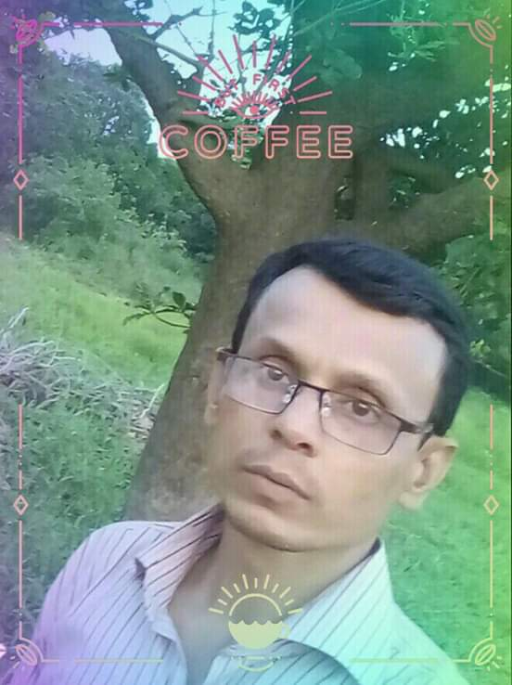
Identity
Md Kamruzzaman Khan
Head Teacher
Baghata Govt Primary School
Baniachong,Hobiginj

Slide 3
Lessons identity
Class- Three
Subject- English
Lesson 1-2
Unite-19

Slide 4
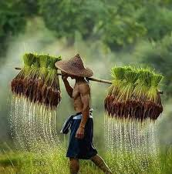
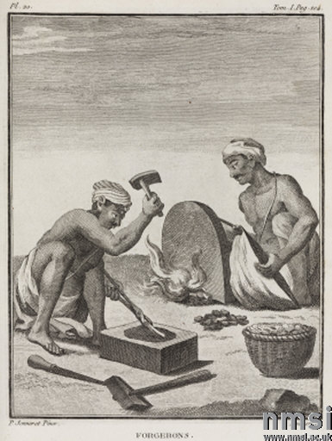
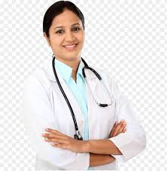
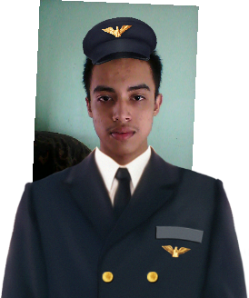
Now look at some pictures.
Think alone or fair and tell me about these pictures.
farmer
blacksmith
doctor
pailot
What do you see in this picture?
D0 you know any one?

Slide 5
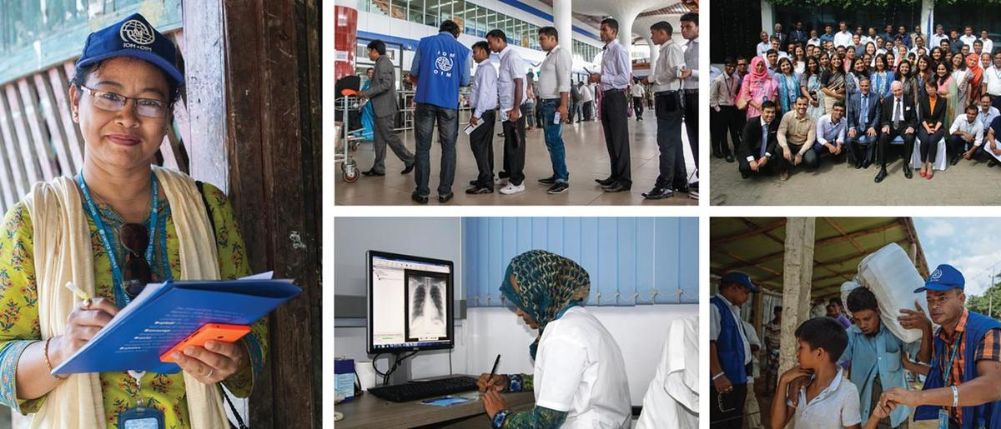
Today”s our lesson is
OCCUPATION

Slide 6
Learning out comes
Student will be able to...
6.2.1 talk about people and objects
1.4.1 read and match word and sentences with picture
3.1.2 to write word meaning and make sentence

Slide 7
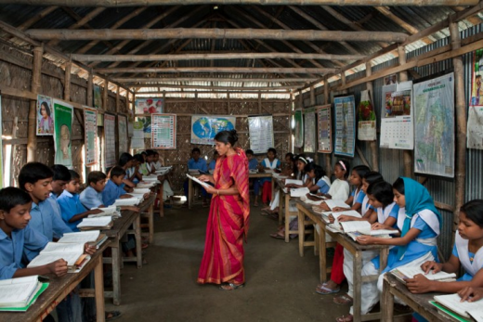
Teachers read loudly
Students repeat again and again

Slide 8
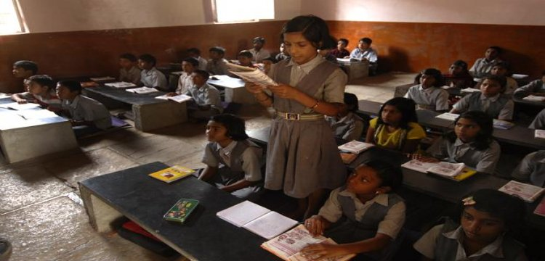
Students read

Slide 9
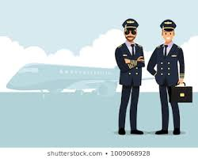
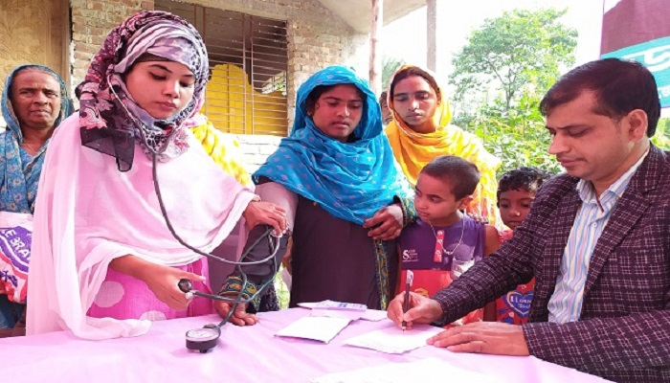
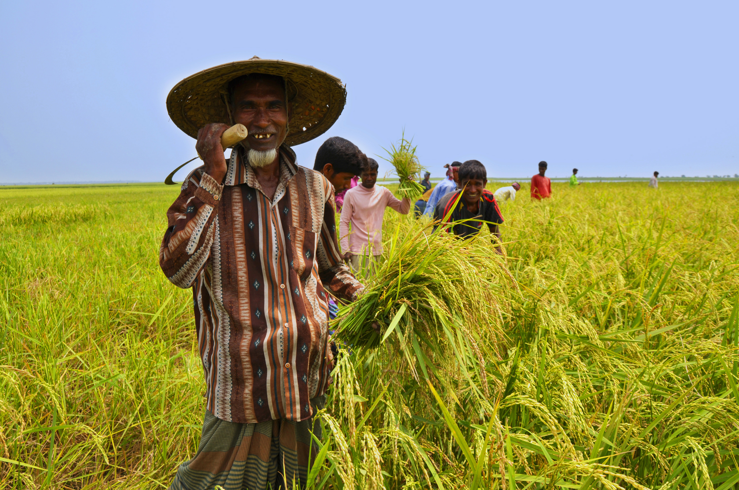
Teachers activity
A Pailot
A blacksmith
A doctor
A farmer
Who can tell about this pictures?
What does he or she do?

Slide 10
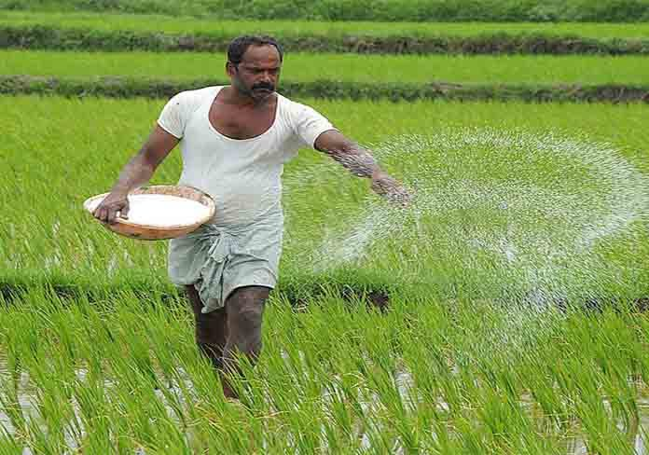
1.Do you know a farmer?
2. What does he do?
Ans:
1. He is a farmers.
2. He grows crops for food.
A farmer

Slide 11
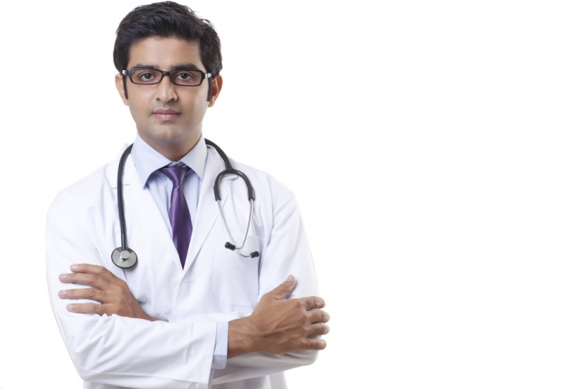
1. Who is he?
2 . What does he do?
Ans:
He is a doctor.
Hs helps the people in diesase.
A doctor

Slide 12
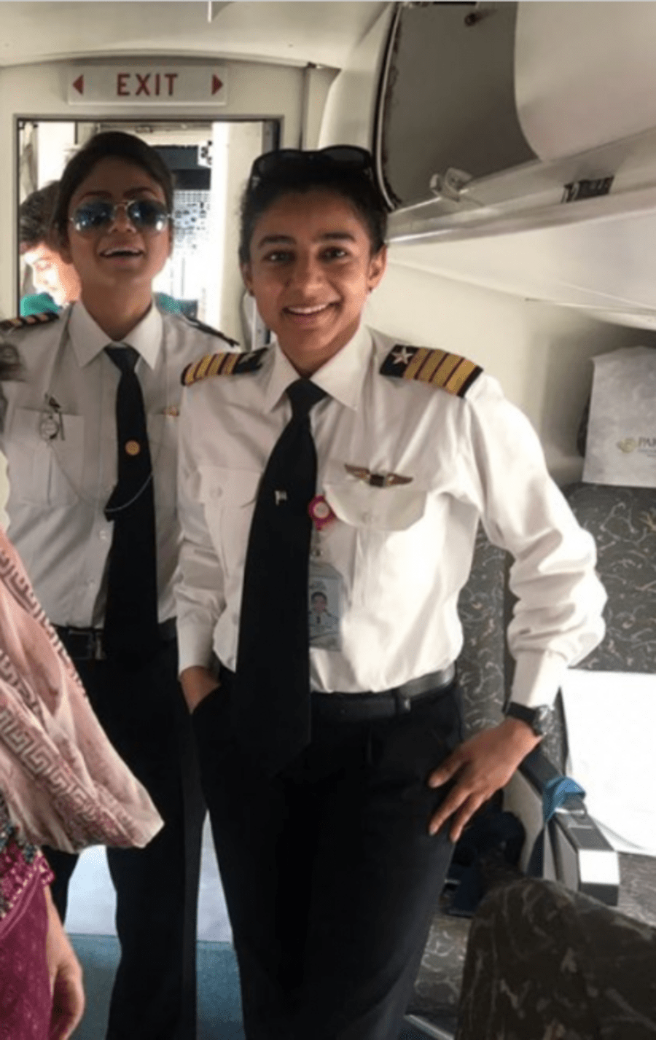
1.Who are they?
2.What does a pilot do?
Ans:
1. They are pilots.
2. A pilot flies a plan.
A pilot

Slide 13
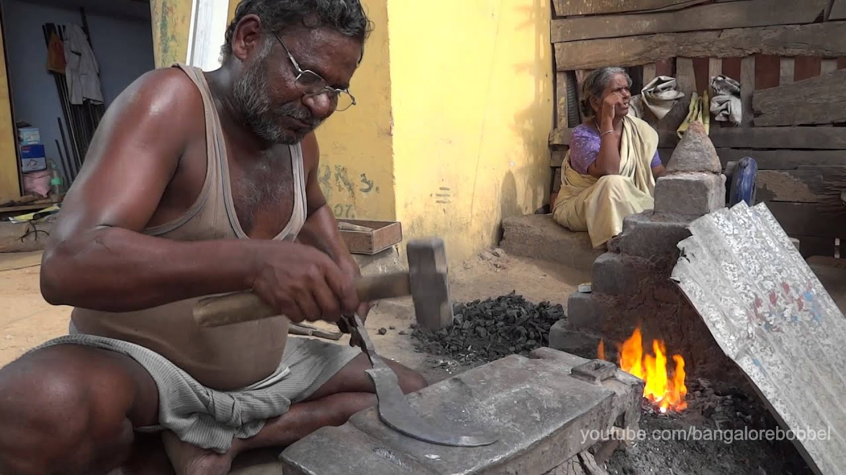
1.Who is he?
2.What does he make?
Ans:
1.He is a blacksmith.
2.He makes things form metal.
A blacksmith

Slide 14
Group work
Fill in the blanks:
Group A
Group B
Grows
Help
Metal
Plan
1. A farmer ………….food
2. A doctor ………….the people.
A blacksmith make a …………….. thing.
2. A pilot flies a …………..

Slide 15
Indivitual work
Word meaning
Farmer
কৃষক
Doctor
ডাক্তার
Pilot
বৈমানিক
Blacksmith
কামার

Slide 16
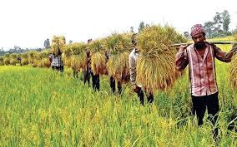
Evulation
Matching word
Doctor
Pilot
Blacksmith
Farmer

Slide 17
Read and match
1 A blacksmith
Flies a plan
2 A doctor
Grows food
2 A pilot
make metal things
2 A farmer
Help the people

Slide 18
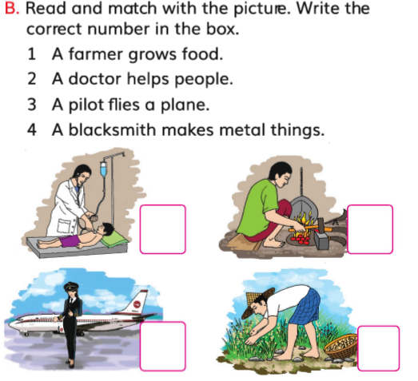
1
2
3
4

Slide 19
Home work
Answer the following questing
What does a farmer grow?
What does a doctor do for the people?
3. What makes a blacksmith?

Slide 20
Good bye students
See you tomorrow

