Slide 1


Welcome
dear students
Notes:
Welcome slide.

Slide 2

Introduction
Sultan Ahmed miazi
Astt. Teacher
Balia Kazir Bazar D.N. Dakhil Madrasah,
Farakkabad,Chandpur Sadar,Chandpur
01817106106
Class-IX-X
English 2nd Paper
Notes:
Identity of teacher & class.

Slide 3
Let’s see some image and texts to guess something.
Notes:
Advance to suspension.

Slide 4
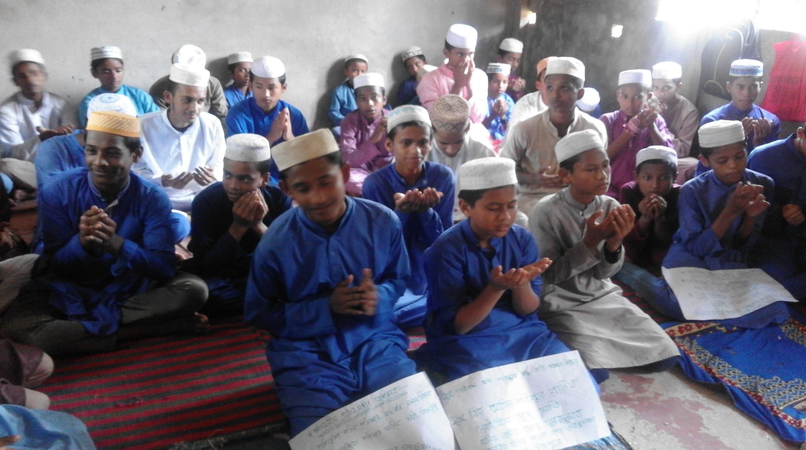
They said, “ We are happy.”
They said that they were happy.
Notes:
Suspension of direct & indirect speech.

Slide 5
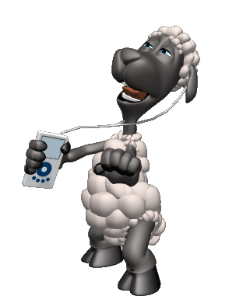
He says, “ I love music.”
He says that he loves music.
Notes:
Suspension of direct & indirect speech of present indefinite tense.

Slide 6
What have you guessed by
the images and texts?
Direct and indirect speech
Notes:
Asking lesson declaration.

Slide 7
Our Today’s lesson is-
Direct and indirect speech
Narration Part-1
Notes:
Lesson declaration.

Slide 8
Learning outcomes
After we have studied this lesson,
we will be able to---
define speech
identify the classification of speech
change speech from direct to indirect
Notes:
Target of today’s class.

Slide 9
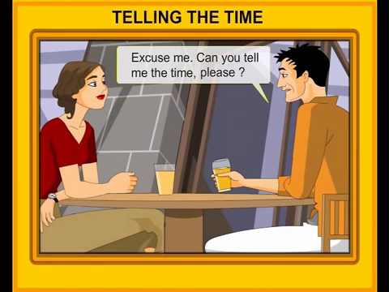
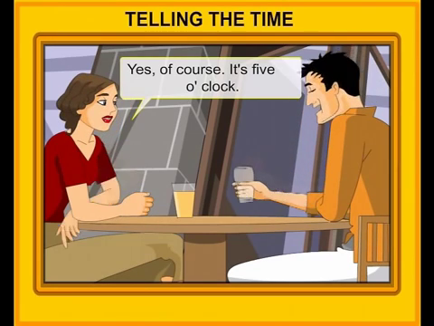
What is speech?
Speech is an expression which is expressed by the speaker.
Notes:
Definition of speech.

Slide 10

Follow
Talib said to me, “ I have done my duty.”
Talib told me that he had done his duty.
Speeches are classified into two kinds.
Direct speech
Indirect speech
Speech spoken directly by the speaker is direct speech.
Speech spoken indirectly by another is indirect speech.
Notes:
Classification of speech.

Slide 11
He said to me, “You are my best friend.”
There are two parts of a direct speech.
He said to me,
“ You are my best friend.”
Reporting verb
Reported speech
Out of inverted comma.
Inside of inverted comma.
Notes:
Parts of direct speech.

Slide 12
Let us know the basics of
Speech / Narration.
Notes:
Lead to narration basics.

Slide 13
How to change ‘verbs’ from Direct to Indirect speech.
Direct | Indirect
am/is/are
was/were
shall/will
have/has/did
can/may
must/have to/has to/ought to
Present indefinite
Past indefinite
was/were
had been
should/would
had +v₃
could/might
had to
Past indefinite
Past perfect+v₃
Notes:
How the verbs change from direct to indirect.

Slide 14
How to change ‘Adverb’.
DIRECT | INDIRECT
now
tomorrow
tonight
today
yesterday
last night
last week
here
this
these
then
the next day
that night
that day
the previous day
the previous night
the previous week
there
that
those
Notes:
How adverbs converts from direct to indirect.

Slide 15
How the subject, object & possessive of direct speech change.
Reported speech | Reporting verb
I
We
You
my
our
your
He/She/they
He/She
He/She/they
me/us (I, we)
his/her
their
my/your
no change
Notes:
Change of possessive pronouns in indirect speech.

Slide 16
How to convert assertive sentence into indirect speech.
Sub + said to + object
Sub +told + object
that
Reported speech with desirable change
He said to me, “I am well.”
He told me that he was well.
Notes:
Structure how to convert assertive sentence from direct to indirect speech.

Slide 17
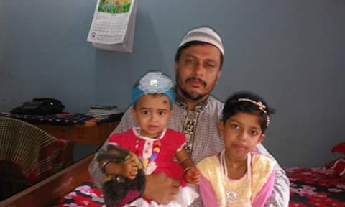
She said to me, “ I was ill.”
Direct speech
Indirect speech
She told me that she had been ill.
Notes:
Practice through example.

Slide 18
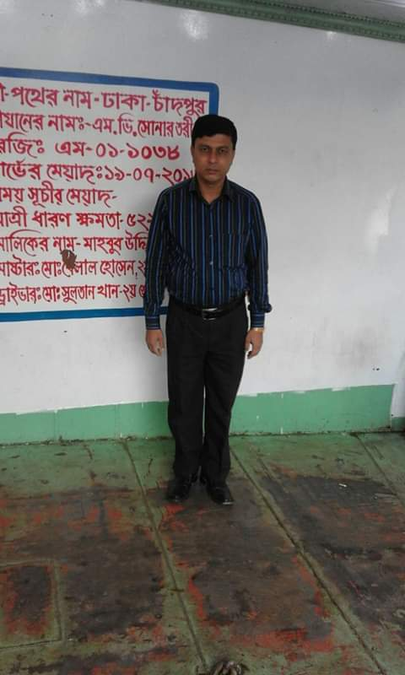
Sumon said, “I will meet you tomorrow.”
Direct speech
Indirect speech
Sumon said/told that he would meet me the next day.
Notes:
Practice & implementation of verb & adverb shown through example.

Slide 19

He said to me, “ I have done my job.”
Direct speech
Indirect speech
He told me that he had done his job.
Notes:
Practice & implementation of verb & adverb shown through example.

Slide 20
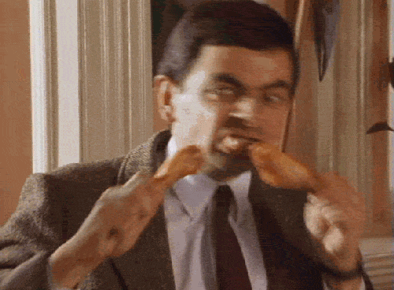
“Mr. Bean did the best last night.”
He told that Mr. Bean had done the best the previous night.
Notes:
Practice & implementation of verb & adverb shown through example.

Slide 21

” I go to school regularly.”
Direct speech
Indirect speech
He said that he went to school regularly.
Notes:
Practice & implementation of verb & adverb shown through example.

Slide 22

“I visited London in 2005”
Direct speech
Indirect speech
She told that she had visited London in 2005
Notes:
Practice & implementation of verb & adverb shown through example.

Slide 23
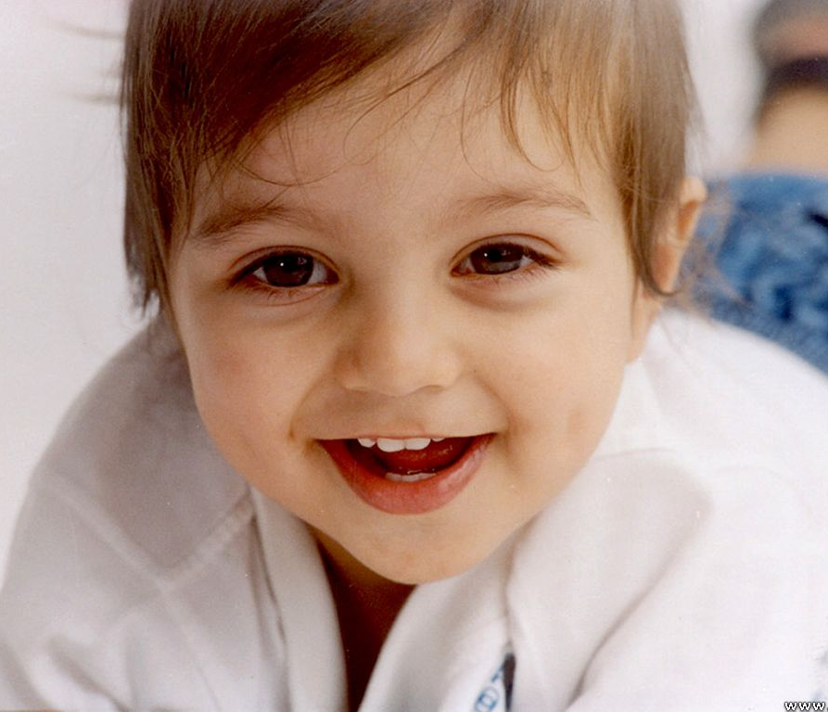
Exception
If the reporting verb is in present & future tense, there will be no change of the verb of reported speech.
He says, “ My mother loves me more than her life.”
Direct speech
Indirect speech
He says that his mother loves him more than her life.
Notes:
Practice & implementation of verb & adverb shown through example.

Slide 24
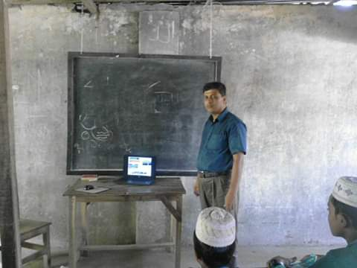
The student says, “ I have completed my home work.”
Direct speech
Indirect speech
The student says that he has completed his home work.
Notes:
Practice & implementation of verb & adverb shown through example.

Slide 25
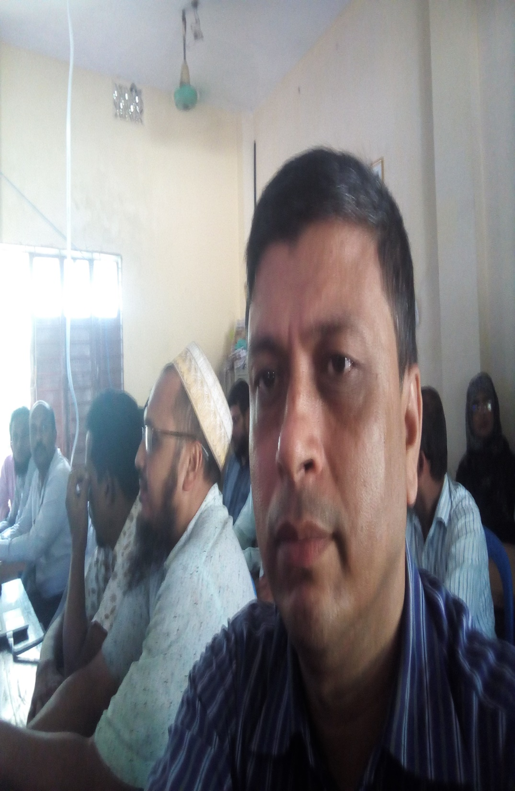
The man says, “ I will lead a corruption free life.”
Direct speech
Indirect speech
The man says that he will lead a corruption free life.
Notes:
Asking students for practice.

Slide 26
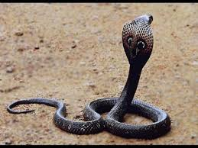
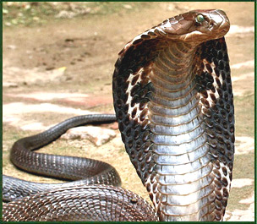
Remember
Universal truth will not be changed in indirect speech.
My father said, “Evil always remains in evil.”
My father told that evil always remains in evil.
Notes:
Asking students for practice.

Slide 27
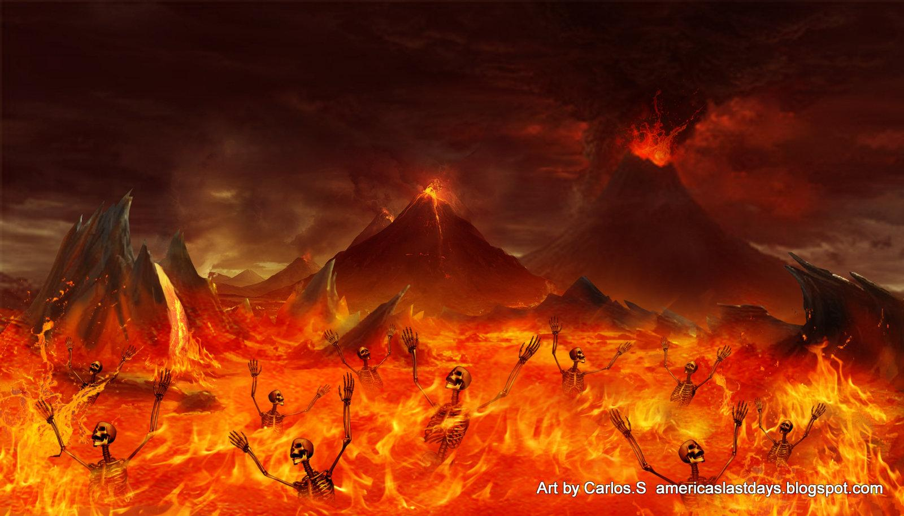
The teacher said, “The sinner will suffer in the long run.”
The teacher told that the sinner will suffer in the long run.
Notes:
Asking students for practice.

Slide 28
Pair Work
Group-1& 3
Make a list of the verbs and their changing form in indirect speech.
Group-2 & 4
Make a list of the adverbs and their changing form in indirect speech.
Notes:
Group work for revision of the narration basics.

Slide 29
Home work
Change the following speech from direct to indirect—
The teacher said to me, “The earth moves round the sun.”
Father said to his son, ”I want to make you a man of truth.”
He said to me,” I was there in 1990.”
“Practice makes a man perfect.”
“Newspaper is a store house of knowledge,” said the Principal.
Notes:
Assignment at home.

Slide 30
Continue to
Narration Part-2
Allah Hafez

