Slide 1
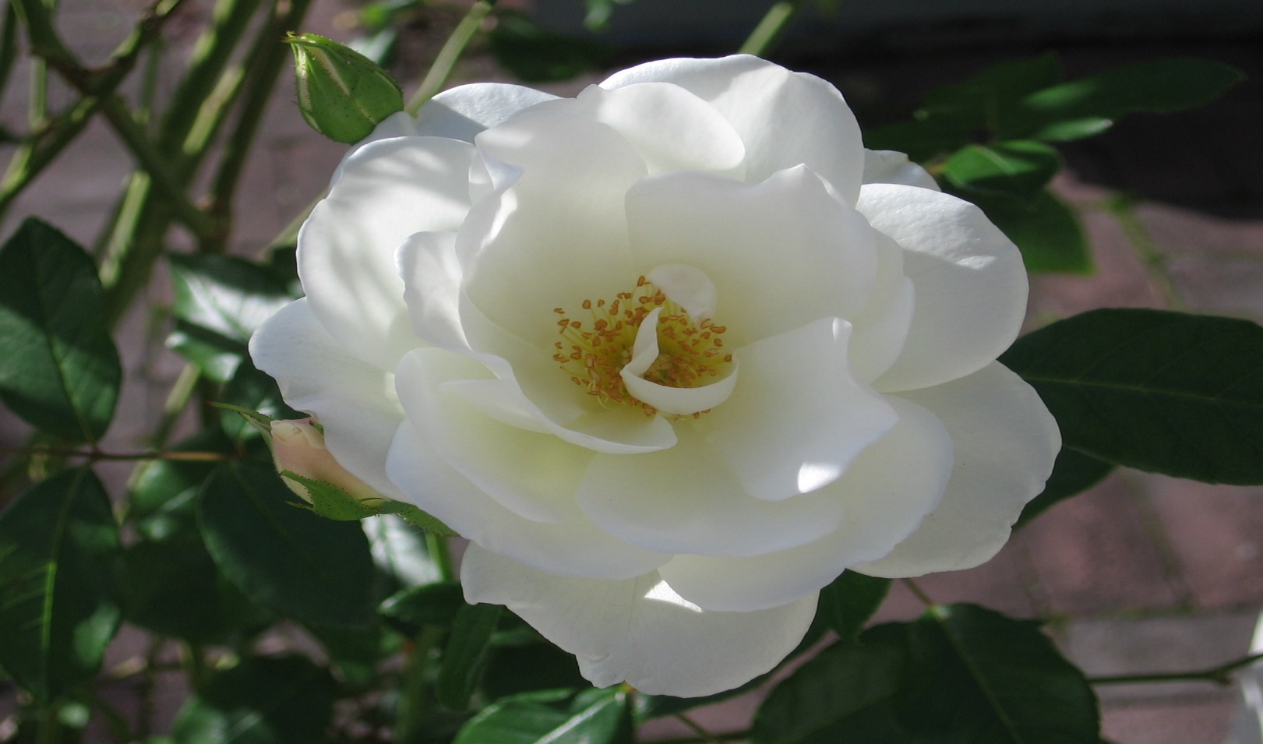
Welcome

Slide 2
Class: Eight
Sub: English
Unit:7 Lesson:3
River gypsies in Bangladesh
Time:45m
Personal details
Ferdous Ara Begum
Assistant teacher
Birinchi Sufia Nuria Alim Madrasah
Feni Sadar , Feni

Slide 3
Today’s Topic
River gypsies in Bangladesh

Slide 4
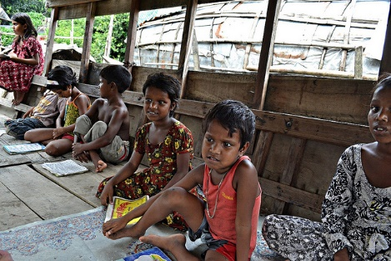
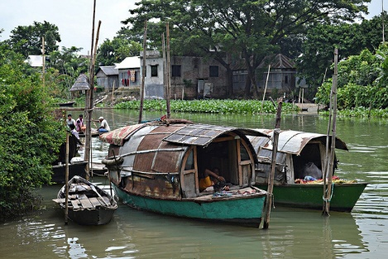
The lifestyle of river gypsies

Slide 5
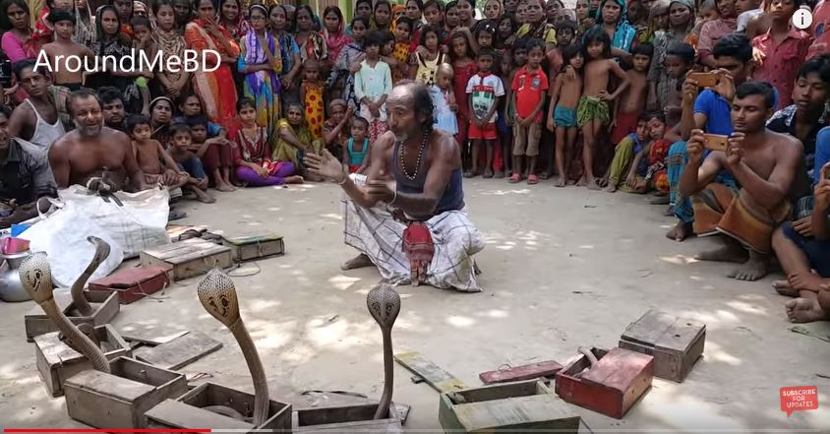
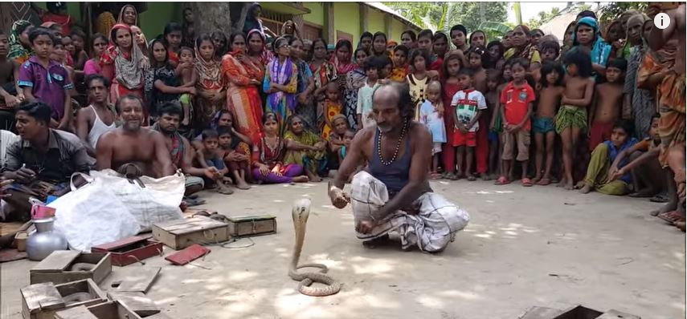
Snake charming by a gypsy man

Slide 6
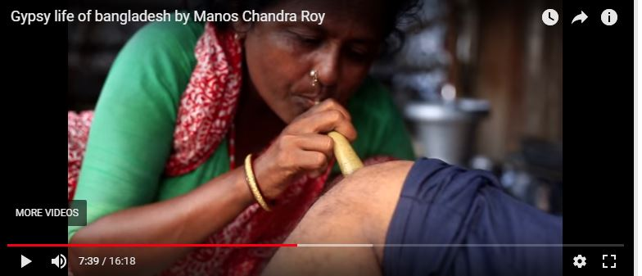
Sucking out blood technic by a gypsy women

Slide 7
* * Open your English book – page no 74 & 75. ** Read the text.
Do the pair work.
Make a group consisting of 6 members.
Discuss the issue with each other.
Share your views and thoughts.

Slide 8
Vocabulary
Ethnic=pagan
Tents=camps
Nomadic=a wandering tribe
Remedy=redress
Roam=move about

Slide 9
1 . Choose the best answer from the alternatives.
a. River gypsies live a---life.
Poor
Different
Cultured
nomadic
b. They live and travel----.
In vehicles
In boats
In trawlers
Inautos
c. They are part of----.
Culture
Water bodies
Community
Life
Ans :nomadic
Ans: in boats
Ans: water bodies

Slide 10
Choose the best answer from the alternatives.
d.----they live in tents.
In winter
In summer
In the rainy season
In spring
e. They remain busy catching fish----.
In autumn
In wet season
In the rainy season
In hot season
Ans : in winter
Ans :in the rainy season

Slide 11
2.Answer the following questions.
a.Where do they live?
b.Where do they roam?
c.What do river gypsy women do for a living?
d.How long do they stay on boats?
e.How is their life?
Ans.a)They live on boat for eight months of the year but for four months they live in make-shift tents along the banks of our rivers.
b)They roam across our rivers and water bodies from May to December.
c.River gypsy women go from door to door and sell bengles,cosmetics and other things.
d)They stay for eight months on boats.
e)They live a nomadic life.
3.Summarize the above passage in your own words.

Slide 12
Home work
Write a short composition about how you can help the gypsy children with learning.

Slide 13
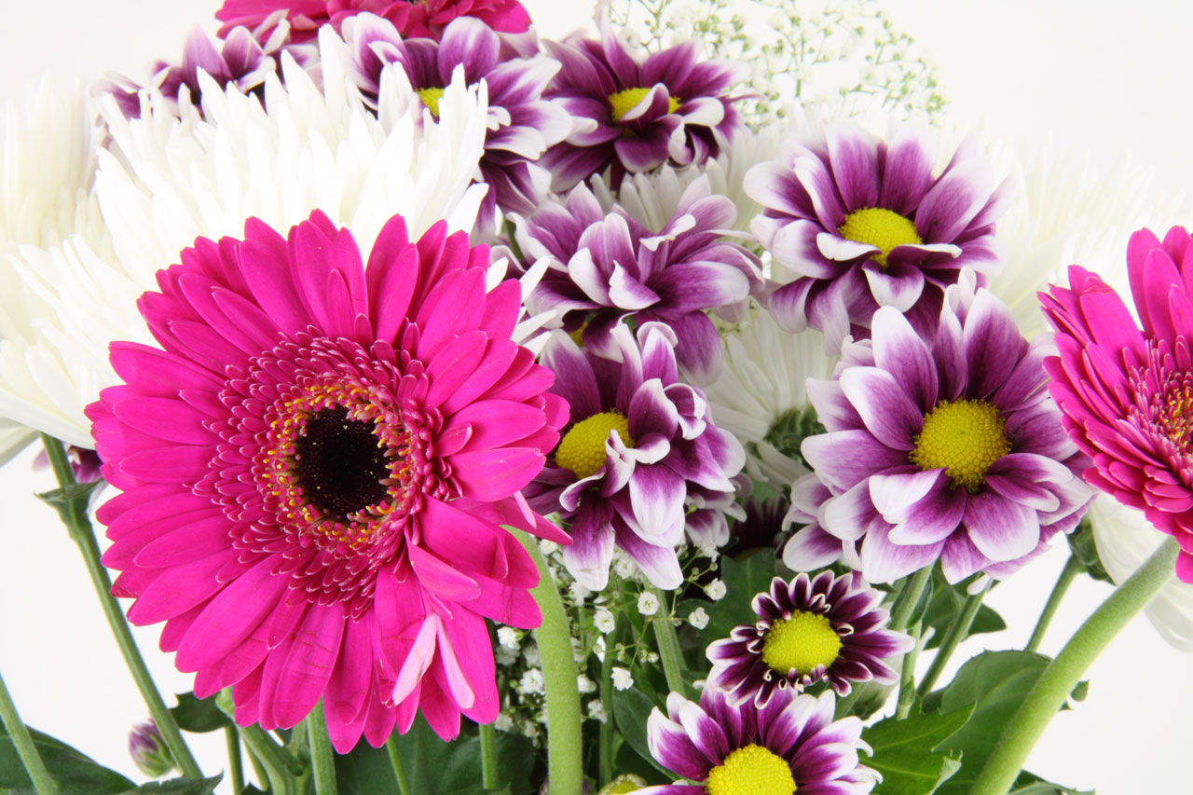
Thank you everyone

