Slide 1


Welcome
you all
Today’s class.

Slide 2
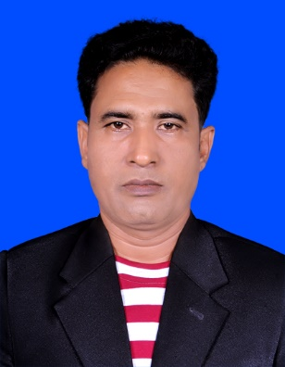
Introduction
Class: Eight
Sub: English 1st paper
Unit: One, Lesson: 5
Total Students: 40
Present Students: 32
Date: 9 February 2020
Md. Mahbub Alalm
Assistant Teacher
Gogda Mozafarpur Dakhil Madrasah
Kendua, Netrakona.
Mob: 01721405063

Slide 3
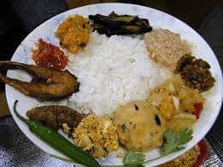

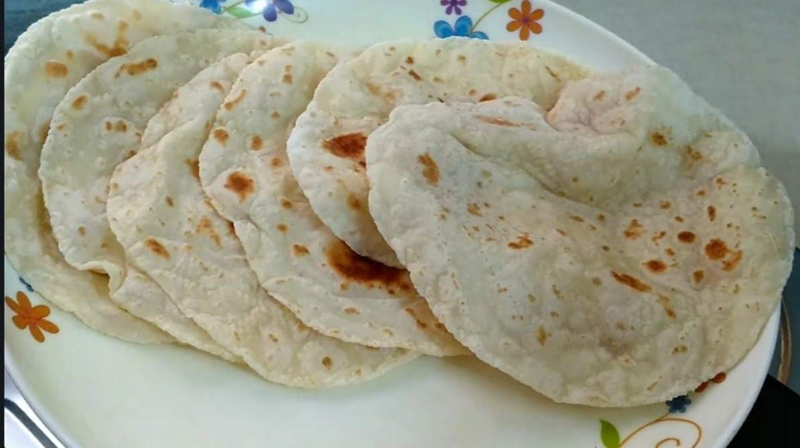
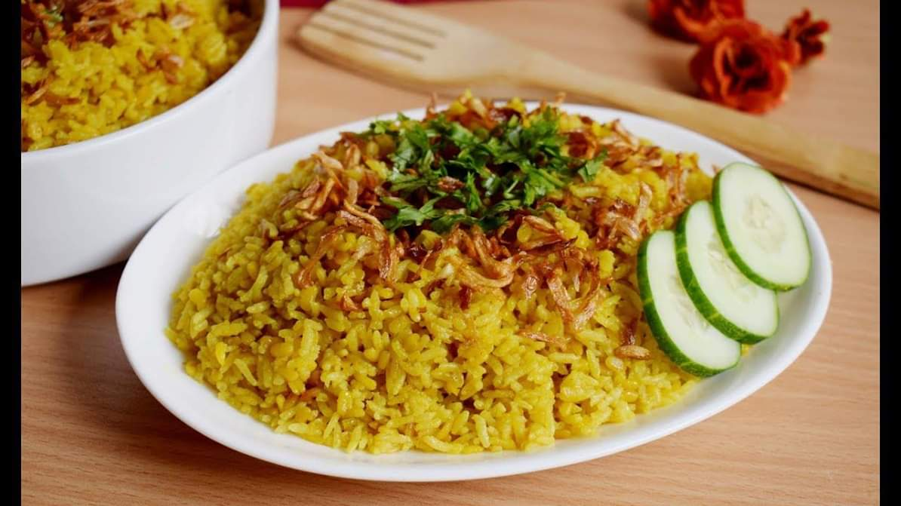
Let us see some pictures.
Bangladeshi food.

Slide 4
Our today’s Lesson is-
Bangladeshi cuisine.

Slide 5

Learning Outcomes
After studied this lesson the students will be able to..
Say the main food of Bangladesh,
Describe the traditional food of Bangladesh,
Write the importance of vegetables & vitamin.

Slide 6
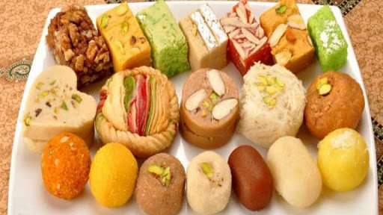
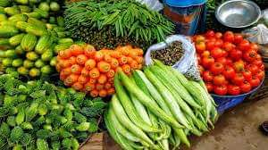
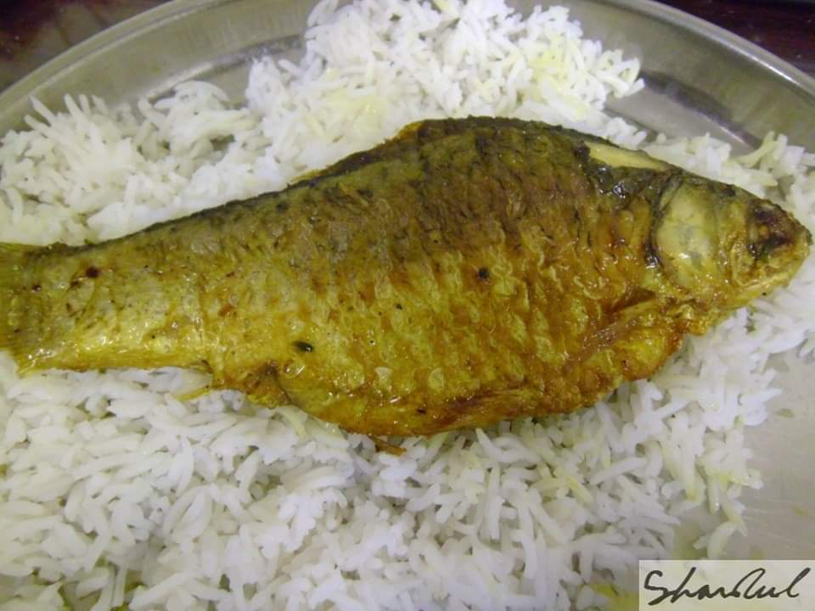
Look at the pictures and answer the question below.
Which food do you like most and why?

Slide 7
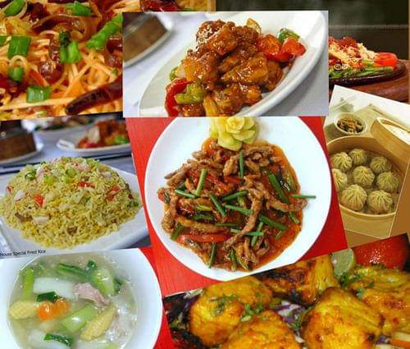

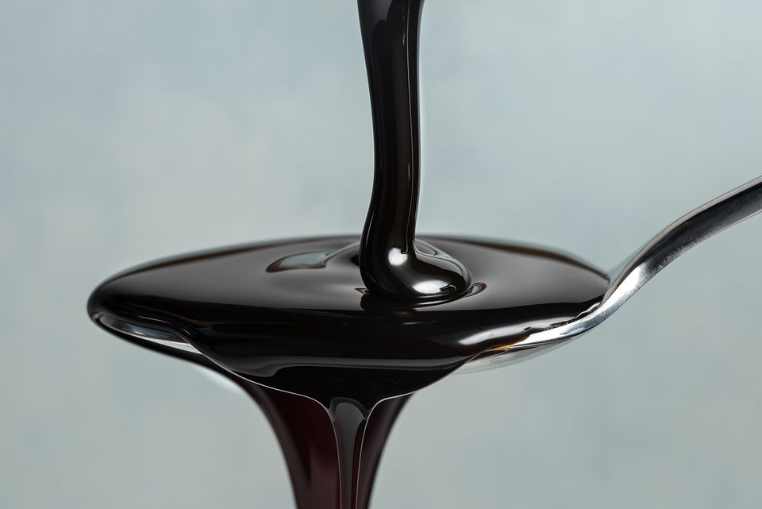
Key words and their meaning
Cuisine:
A style or method of cooking.
Platter:
A large flat dish or plate.
Molasses:
Dark brown syrup obtained form
raw sugar refining process.

Slide 8
Pair work
Read the text B at pate 8 an answer the question below.
What is the main food of Bangladeshi people?
Make a list of our traditional food.

Slide 9
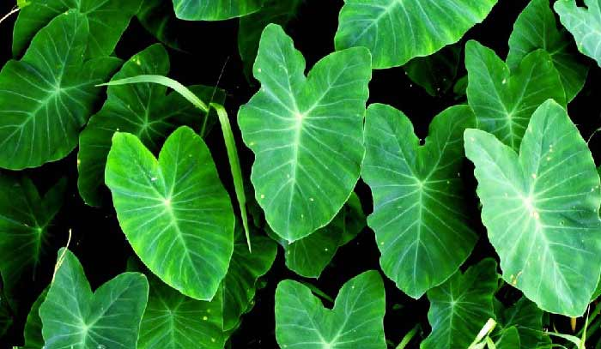
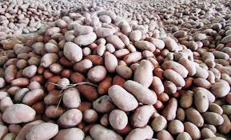
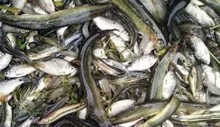
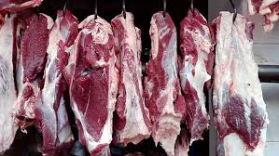
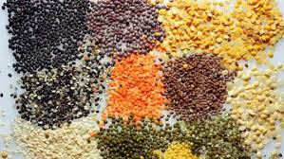
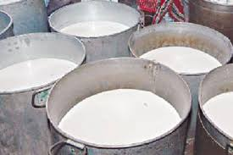
Look at the pictures and think about it.
For right food or good health you need this type of food.

Slide 10
In Bangladesh we have…
Every people of Bangladesh is
fond of sweet, pitha & occasional
food.
A great source of food like sweet,
Many traditional food,
Great source of good food,
Many fish from river, haour & bill,
Our woman is fond of cooking.
But we have to careful about the right food.

Slide 11
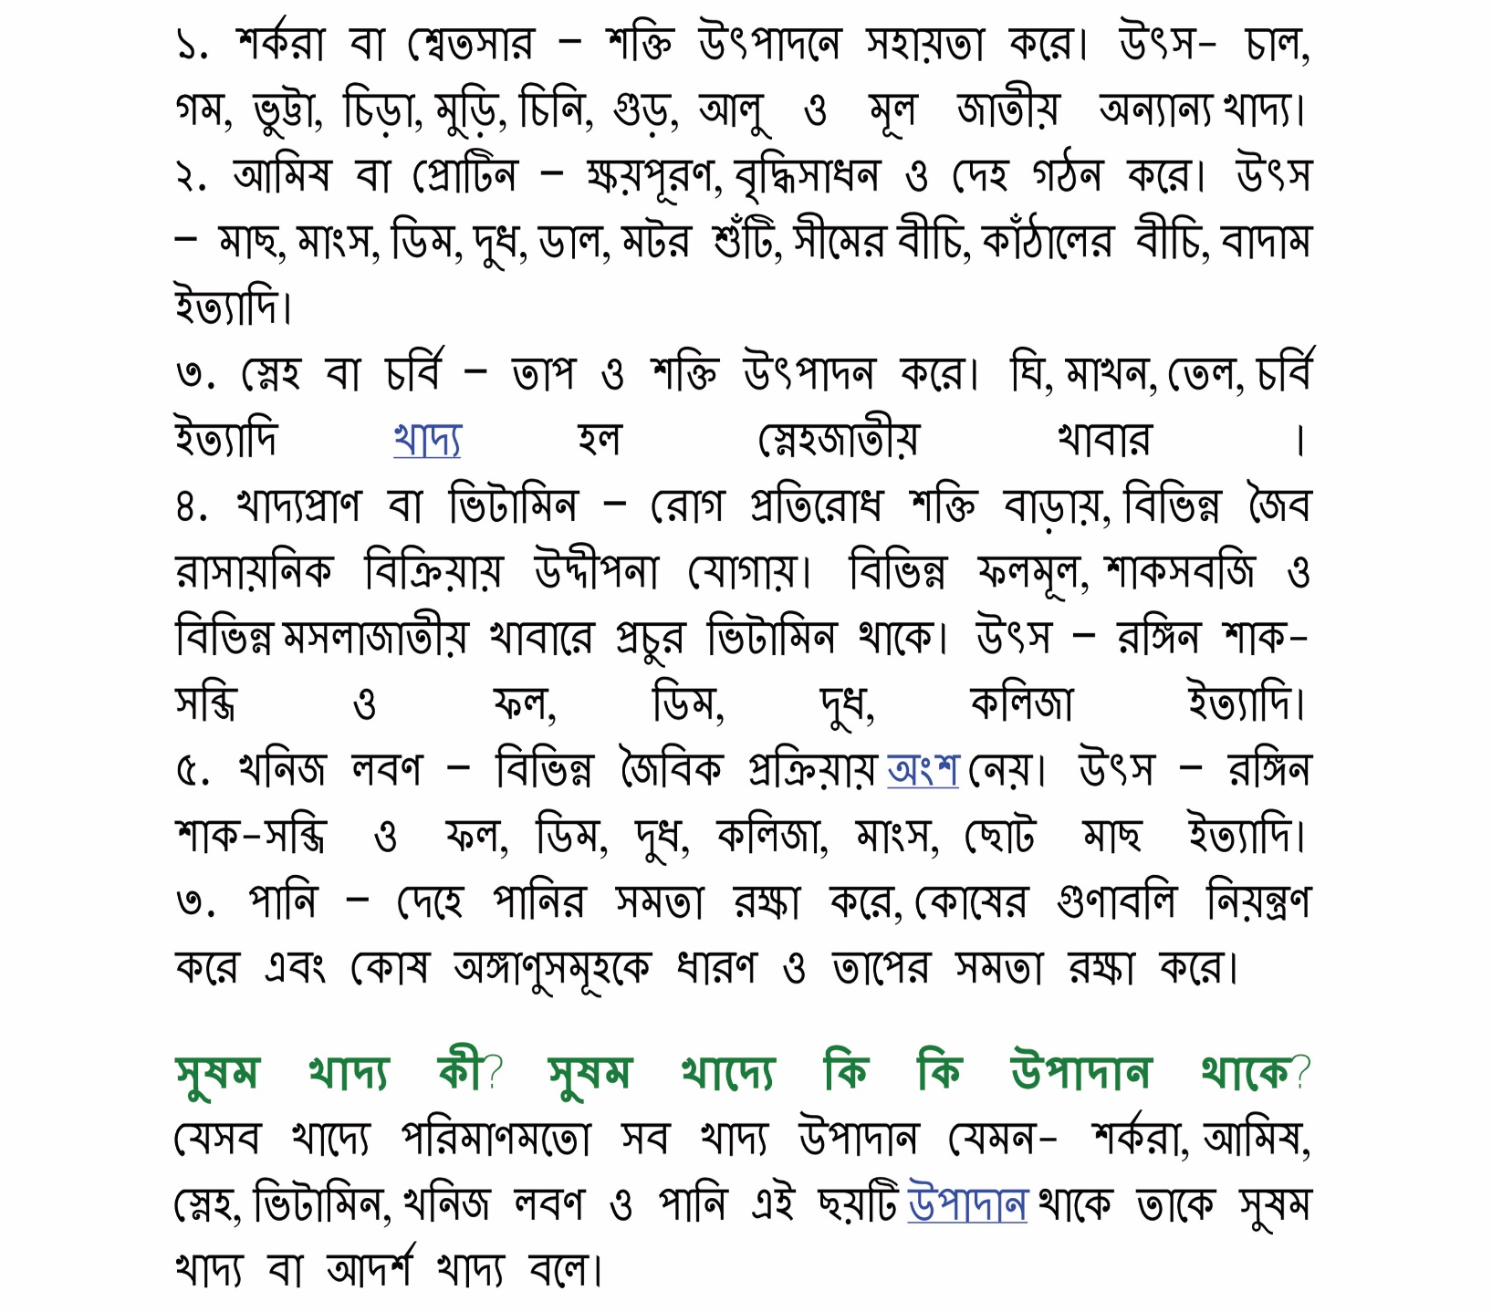
R
Read the text about the food which
Is important for good health, growth
free from dieses.
We should keep them in our
Daily routine of food.

Slide 12
Group work
Group-1
Make a poster paper of healthy food.
Group-2
Make a poster paper of some milk based food.
Group-3
Make a poster paper of our traditional food.
Group-4
Make a poster paper of some fresh vegetables.
Please present your poster paper.

Slide 13
Evaluation
What is our main food?
Why we have to eat the right food?
How we can make traditional food?
Write some name of deshi fish.

Slide 14
Thank you all.

