Slide 1
Good morning

Slide 2
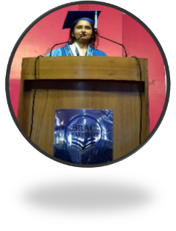
Hemia Afrin.
Assistant teacher,
Digholia (south) Govt. primary school.
Digholia,Khulna.
hemia1922@gmail.com

Slide 3
Class – One Unit - 4
Tittle of lesson- Numbers
Lesson – 1-3
Lesson unit : A. Page- 8
Time- 45 minutes.
04/02/2020

Slide 4
Learning Outcomes
Reading:2.1.1 recognize and read cardinal numbers up to 10.
Writing: 2.1.1 write cardinal numbers up to 10 in figures..

Slide 6
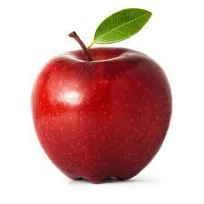
What is this?
apple
1
How many apple?

Slide 7
How many apples?
2

Slide 8
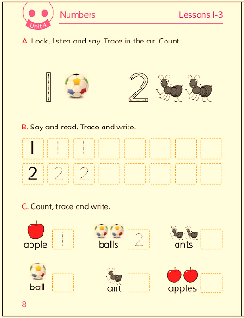
Open your book and look at the lesson
Page no-8 ,Lesson-1-3

Slide 9
Look at the pictures , show and say two balls and one ball.
2
1

Slide 10
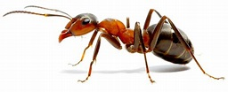
Look at the pictures and show two ants and one ant.
1
2

Slide 11
Read and write the numbers
1
1
2
2

Slide 12
Pair work
1
2

Slide 13
Thanks to all. Good bye.

