Slide 1
WELCOME

Slide 2
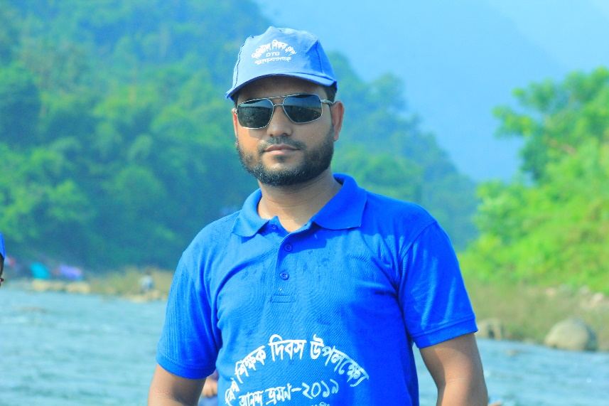
IDENTITY
MD. AL AMIN
Assistant Teacher
Kaitkuna Govt. primary school
Chhatak, sunamgonj
01716184734
Class- Three
Sub: English for today
Unit: 32
Lesson : 1-3
Time : 40 min.
Date: 01.01.2020

Slide 3
Lets enjoy a video

Slide 4
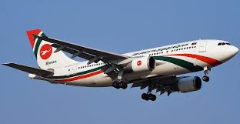
What do you see in the picture?
A Plane
How will you feel if you have a plane journey
?
Wow It will be great
!
.
What do we call the red marks in the sentences?

Slide 5
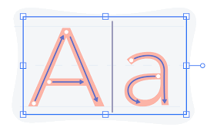
Today’s Lesson
Punctuation
and
Capital Letter

Slide 6
Learning Outcome
Learning outcomes
Students will be able to
Reading: 7.1.1- recognize punctuation marks,
capital letters and read accordingly.

Slide 7
Listen & Say
Good Morning ! Students.
Good Morning ! Teacher.
Can you say when we use Capital letter & Punctuation Marks?

Slide 8
Listen & Say
How are you today?
Fine and you?
Can you say when we use Capital letter & Punctuation Marks?

Slide 9
Let’s know them
Using Capital Letter
We use them mainly for the first letter of sentences, names, days and months as well as for some abbreviations.
We always write the first person pronoun as a capital I.

Slide 10
Let’s know them
Using Capital Letter
Use a capital letter for countries, languages & nationalities, religions:
Bangladesh, China, France
Japanese, English
Islam, Buddhism

Slide 11
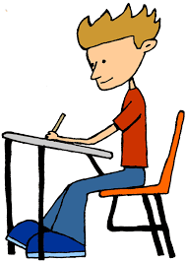
Individual work
When do we use Capital letter in a sentence?

Slide 12
Punctuation Marks
A punctuation mark is a sign used in writing to divide texts into phrases and sentences.

Slide 13
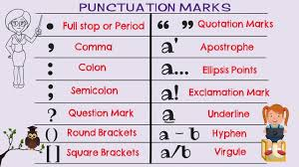
let’s know them

Slide 14
let’s use them
To end a sentence
To separate Item
Full Stop ( . )
Question Mark ( ? )
Exclamation Mark ( ! )
Comma ( , )
Semi colon ( ; )
Notes:
Teacher must write them in the blackboard.

Slide 15
let’s use them
To begin a list
To quote or indicate a title
Colon ( : )
Double quotation mark
( " " )
Notes:
Teacher must write them in the blackboard.

Slide 16
let’s practice
Maliha is Bangladeshi.
She comes from Dhaka.
Dhaka is the capital of Bangladesh.
Notes:
Teacher will say In the name we use Capital, at the end we use full stop.

Slide 17
let’s practice
Maliha lives near the Buriganga river.
.
The river is very big.
In June, July and August, there is a lot rain in Bangladesh.
Notes:
Teacher will say In the name of river we use Capital, to separate words we use comma and at the end we use full stop.

Slide 18
Pair work
Find out the punctuation marks and capital letters.
Maliha is Bangladeshi.
She comes from Dhaka.
Dhaka is the capital of Bangladesh.
In June, July and August, there is a lot rain in Bangladesh.

Slide 19
Evaluation
Read the text again & again and use punctuation marks and capital letters.
maliha is bangladeshi she comes from dhaka dhaka is the capital of bangladesh maliha lives near the buriganga river the river is very big in june july and august there is lot of rain in bangladesh

Slide 20
Checking learning
Correct the sentences:
1. abir is bangladeshi
2. he comes from sylhet
3. sylhet is a nice city in bangladesh
4. in august september and october a lot of
rain in sylhet
5. the jamuna river is very big

Slide 21
