Slide 1
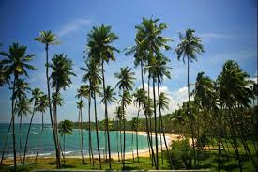

Slide 2
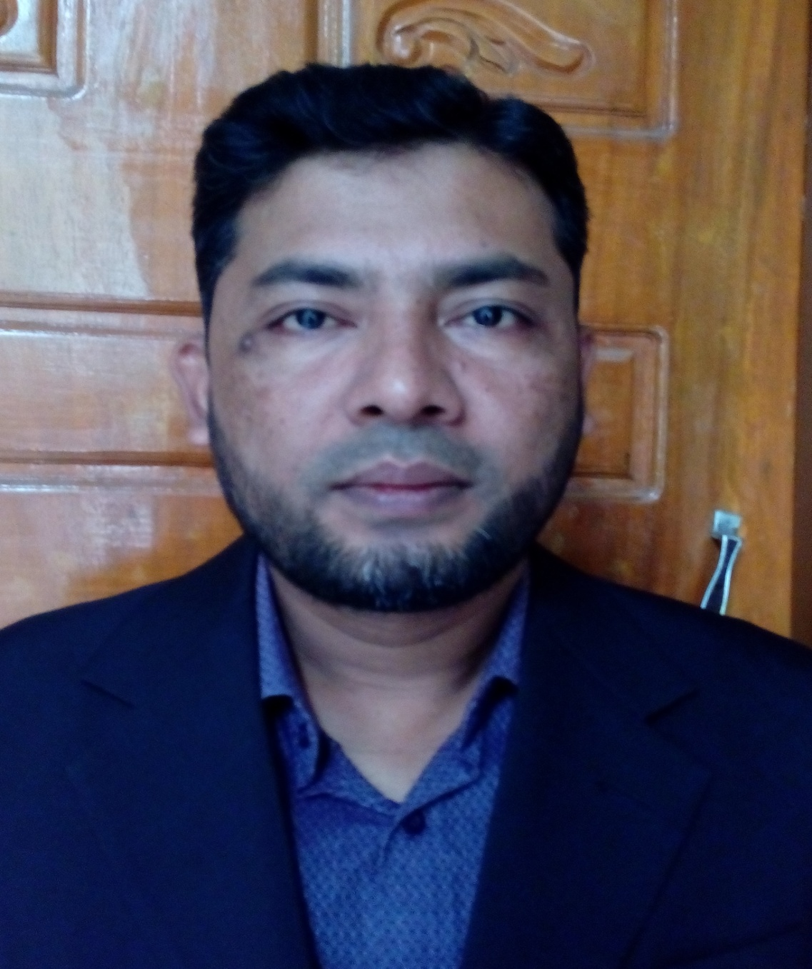
PRESENTED BY
NAME:SHAMSUDDIN.
SENIOR ASST.TEACHER.
VEDURIA SERAJIA FAZIL MADRASAH.
LALMOHAN,BHOLA.

Slide 3
LESSON IDENTITY
CLASS:NINE.
SUBJECT:ENGLISH FOR TODAY.
UNIT:SIX.
LESSON:TWO

Slide 4
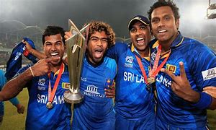

Slide 6
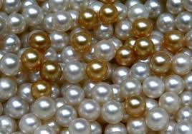
LESSON DECLARATION
SRI LANKA:The pearl of the Indian ocean.

Slide 7
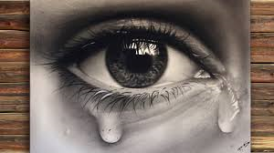
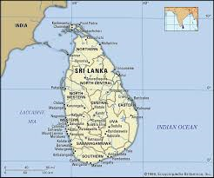
SHAPED LIKE A TEARDROP.

Slide 8
Sri Lanka has different names
Serendip ,ceylon ,teardrop of india

Slide 9
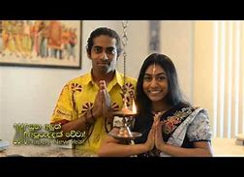
Traditional greeting “Ayubowan’ means “may you have the gift of long life”

Slide 10
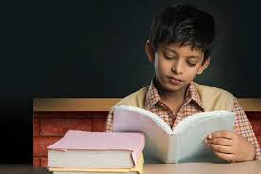
The highest literacy rate in South Asia.

Slide 11
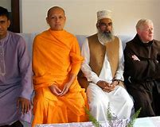
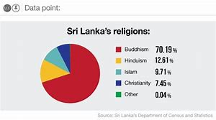
Multi-religious country

Slide 12
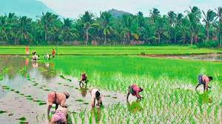
Economy based on agriculture

Slide 13
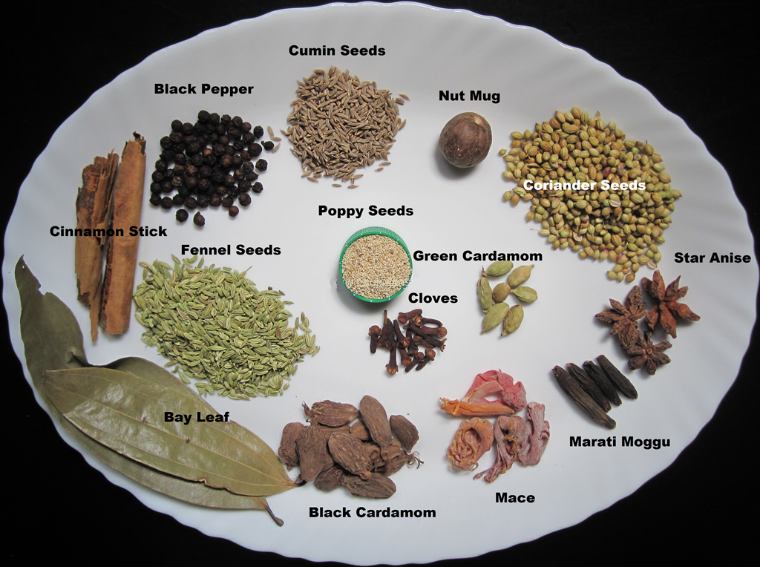
Supplier of a variety of spices

Slide 14
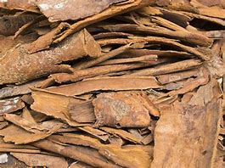
Cinnamon first originated in Sri Lanka

Slide 15
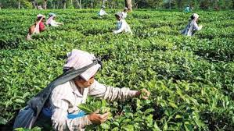
Largest tea exporter of the World.

Slide 16
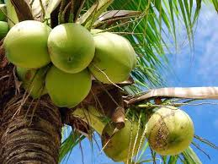
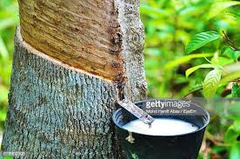
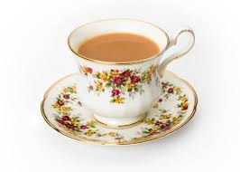
They emphasis on exporting these crops.

Slide 17
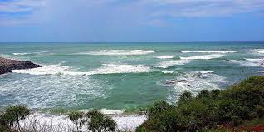
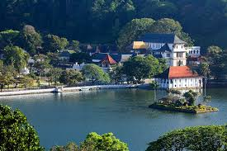
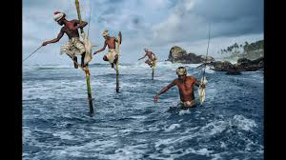
God given blessing of nature

Slide 18
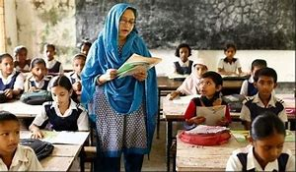
Open at the page 76
Now read the text silently

Slide 19
Sri Lanka | Information
1.Total land are
2.Toatl population
3.The four major ethnic groups are
4.Coastline are
5. The spice which was first originated in Sri Lanka

Slide 20
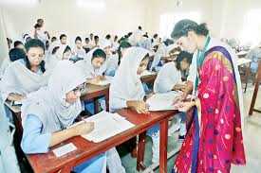
Write Five sentences with your own words about Sri Lanka-

Slide 21
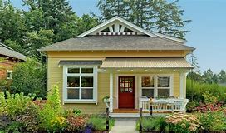
Read through the meaning of the following words-
Abound,adventurous.enrich,excitement,snorkelling,treasure,archaeological,civilization,inhabitants,ancient.

