Slide 1
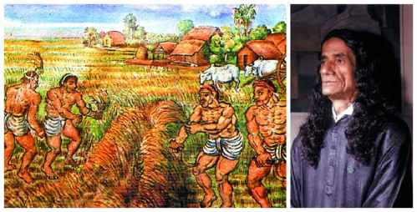

Slide 2
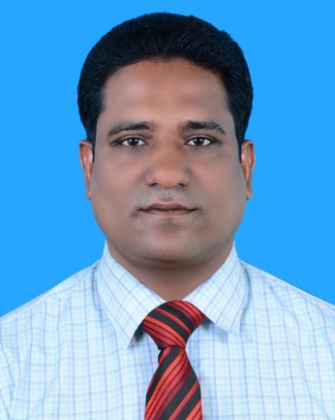
Teachers Introducing
MD.MIZANUR RAHMAN
ASSISTANT TEACHER
DATTAGRAM GOVT. PRIMARY SCHOOL
KULAURA, MOULVIBAZAR.

Slide 3
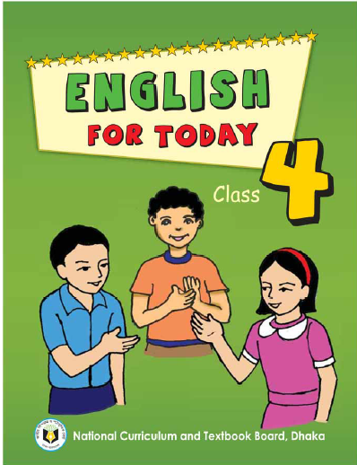
LESSON INTRODUCING
Subject: English
Class: Four
Lesson:1-2 (SM Sultan………..of Bangladesh)
Time: 45 minutes

Slide 4
Learning Outcomes
Students will be able to-
Listening 4:2:1Enjoy and understand simple stories.
Speaking 1.1.1 Repeat after the teacher and say words, phrases and sentences with proper sounds,stress and intonation.
Reading1.4.1 Read words,phrases and sentence in the text with proper pronunciation ,stress and intonation.
Notes:
:

Slide 5
Let’s hear a song
Creating safety environment

Slide 6
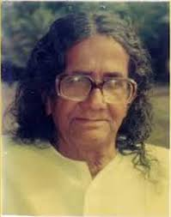
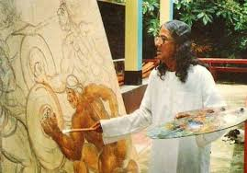
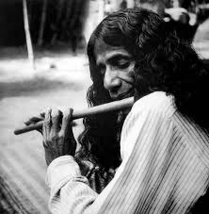
LETS SEE SOME PICTURES
Do you know who is the person?

Slide 7
Today’s lesson
Title Declaration
SM Sultan

Slide 8
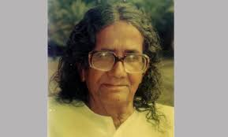
INPUT
SM Sultan is a famous painter of our country.

Slide 9
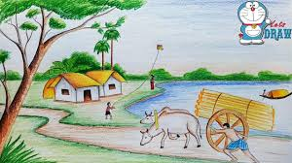
He was born in Narail in 1923.

Slide 10
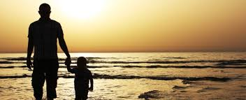
His family didn’t have a lot of money. Sultan went to school for five years, but then he went to work with his father.

Slide 11
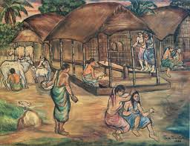
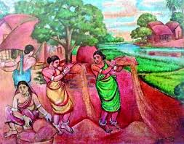
As a child, Sultan loved to draw.

Slide 12
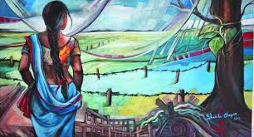
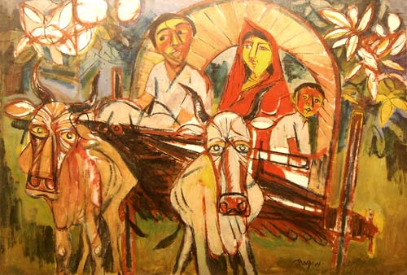
He drew pictures of buildings and other things.

Slide 13
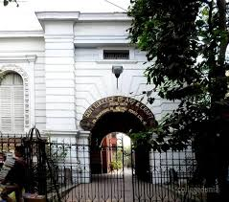
He wanted to study at Calcutta Art College, but his family didn’t have the money.

Slide 14
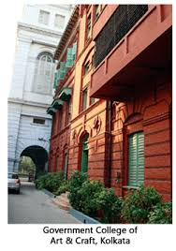
In 1938, he got the money and he went to the Calcutta Art College. He stayed there for three years and then he left.

Slide 15
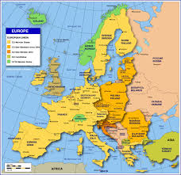
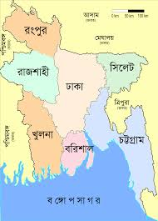
He travelled around Asia and Europe and painted rivers, trees and villages and its people. Then he came back to Bangladesh.

Slide 16
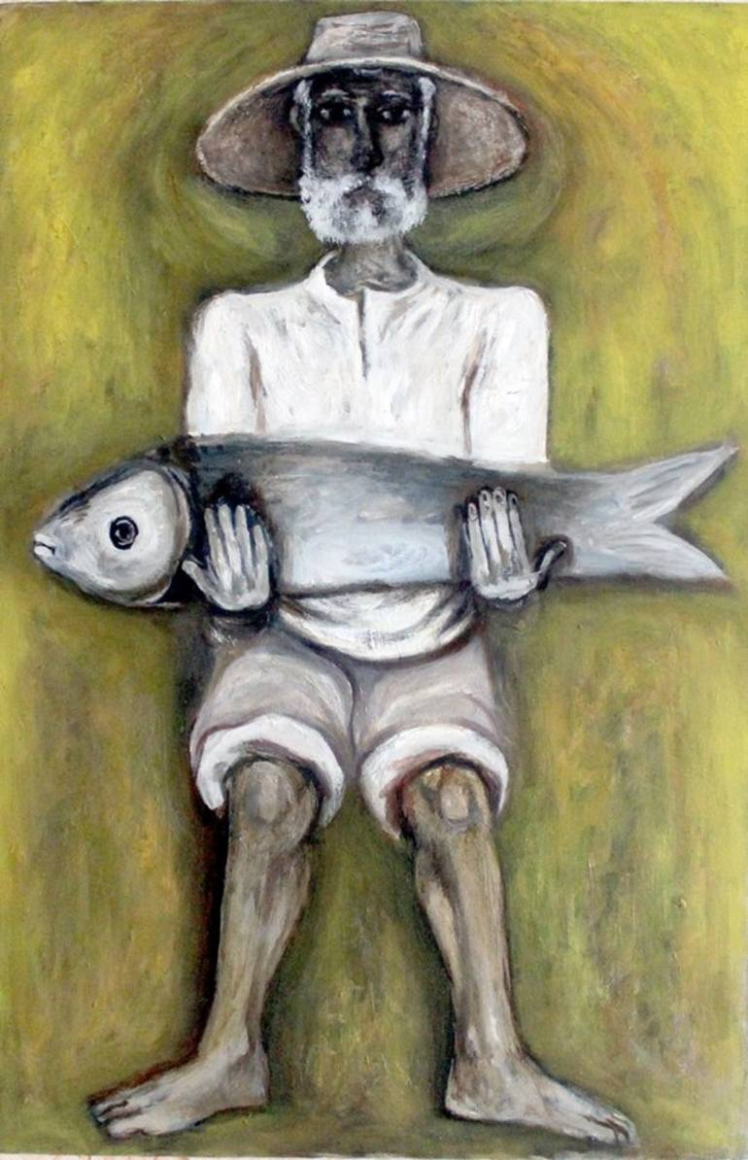
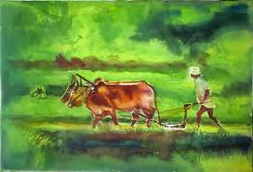
He painted pictures of the farmers and fishermen of Bangladesh.

Slide 17
Open your book & go to page no.68

Slide 18
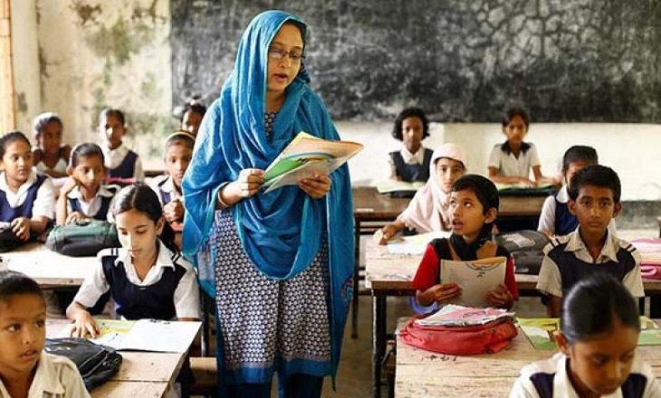
Teacher’s reading

Slide 19
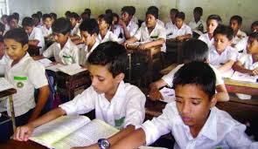
Student’s reading

Slide 20
Find the new words of the text
New words
famous
painter
draw
money
love
stay
travel

Slide 21
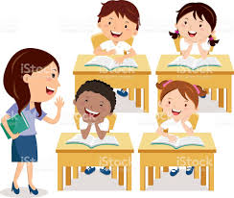
Chain drill

Slide 22
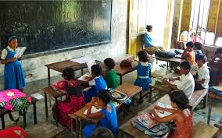
PAIR WORK
PRACT
ICE

Slide 23
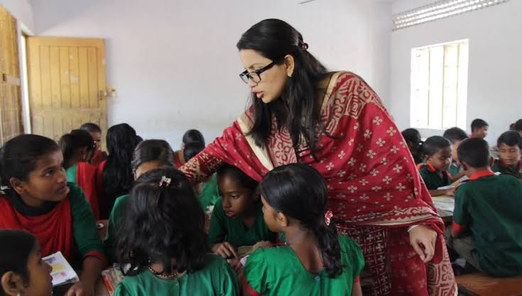
GROUP WORK

Slide 24
Task
01. Who was SM Sultan?
02. Where did SM Sultan born?
03. When did SM Sultan born?
04. What did he like?

Slide 25
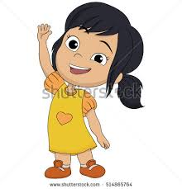
GOOD BYE
Have a good day

