Slide 2
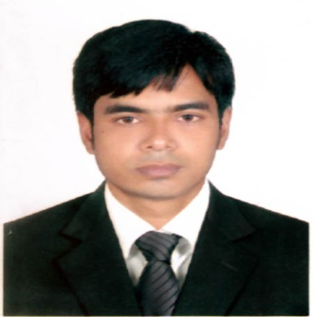
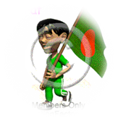
IDENTITY
Teacher
Lesson
Emdadul Haque Milon Assist: Teacher in English
Sonapur Model High School
Dowarabazar,Sunamganj.
English For Today
Class : Six
Unit : one
Lesson : 14

Slide 4
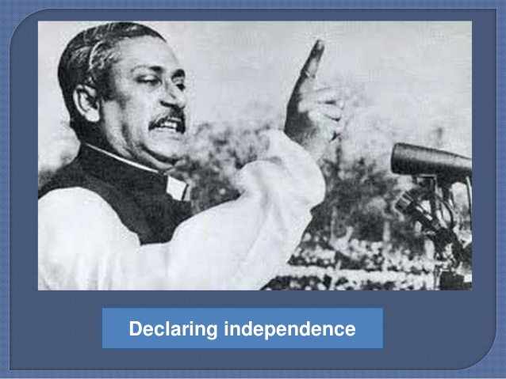
Bangabandhu Sheikh Mujubur Rahman who declared the independence of Bangladesh.

Slide 5
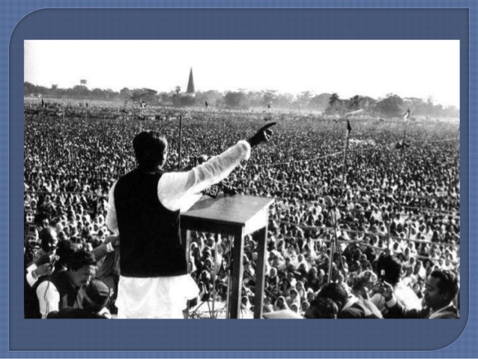

Slide 6
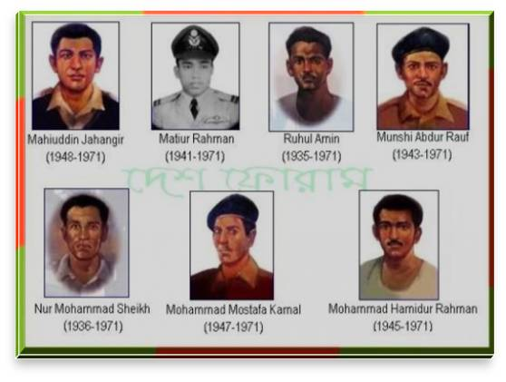
Look at the picture: Do you know them ?
They are freedom fighters (birsarestho) and our pride.

Slide 7
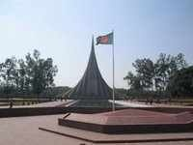
Lesson Declaration
OUR PRIDE

Slide 8
Learning Outcomes
After completing this lesson students will be able to ..
read and understand texts
ask and answer questions
write short paragraph
participate in short dialogues and conversations on familiar topics

Slide 9
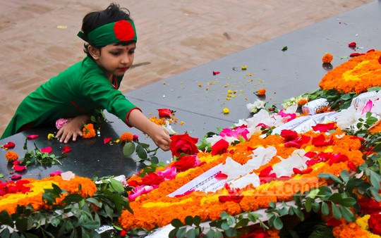
Let`s enjoy video clips
.
What are they doing?

Slide 11
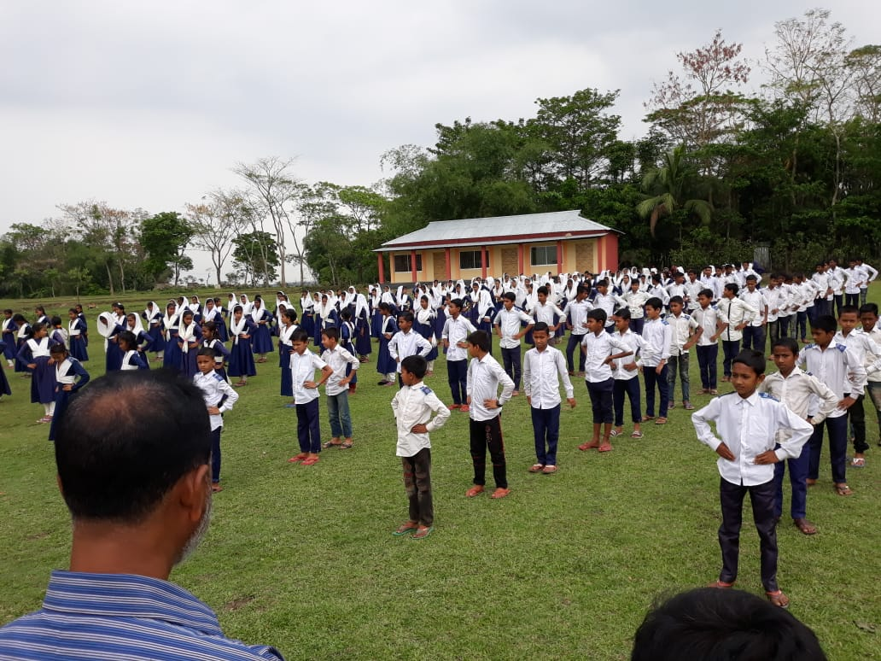
Go to the section – A and listen the passage attentively then go to section A1 and solve the task.
Teacher say about our Pride
Notes:
After completing the reading teacher will give the task slide no 9.

Slide 12
Section – A1, Individual Work
(Match the words with their meanings)
Culumn – A | Culumn - B
unforgettable | Revolution
Independence | Falling on
Celebrate | Sacrificial victim
Swooped | Freedom
Revolt | Memorable
Martyrs | Make famous / party.

Slide 13
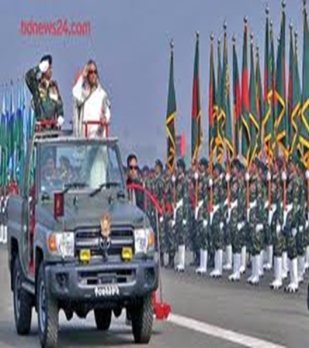
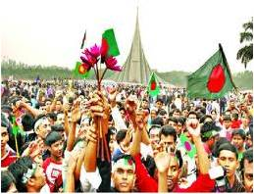
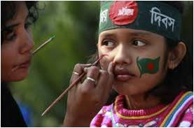
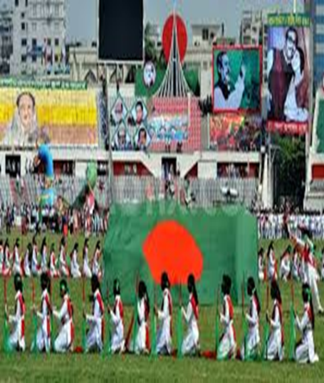
Presentation : Our pride
Now 26 March is our Independence day which we celebrate annually with pride and joy.
Notes:
Teacher can discuss about the above pictures, how we celebrate our independence and victory days.

Slide 14
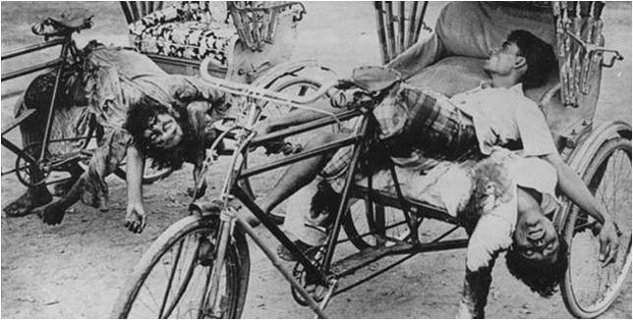
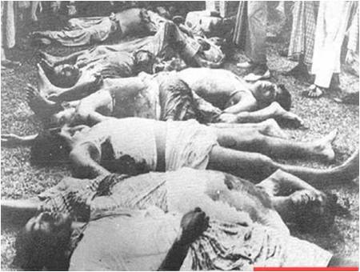
Presentation : Our sorrow and grief
March is also a month of sad memories for us. On the 25th March 1971, in the darkness of the night, the Pakistani army swooped down upon and killed many unarmed men, women and children in Dhaka.

Slide 15
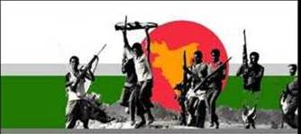
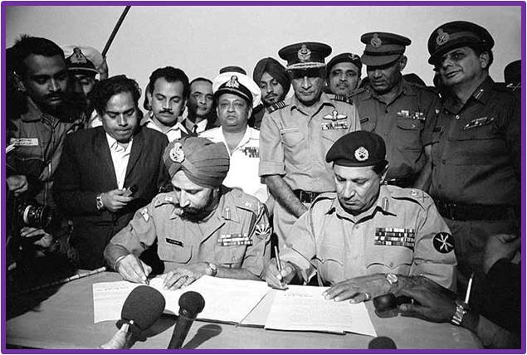
VOCABULARY
Try to make sentence with the following words:
Victory
December 16 is our Victory Day.
Surrender
On 16 December `71 the Pakistani army surrendered unconditionally.

Slide 16
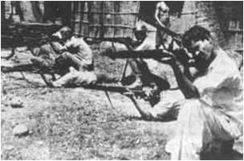
Vocabulary
War
We achieve our freedom after a war.
Martyrs
We should pay our deep respect to the martyrs.

Slide 17
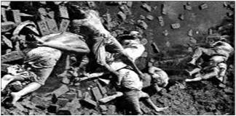
Pair works
Read the text again then
ask and answer with your partner :-
Why 25 march is often called “The dark night” ?

Slide 18
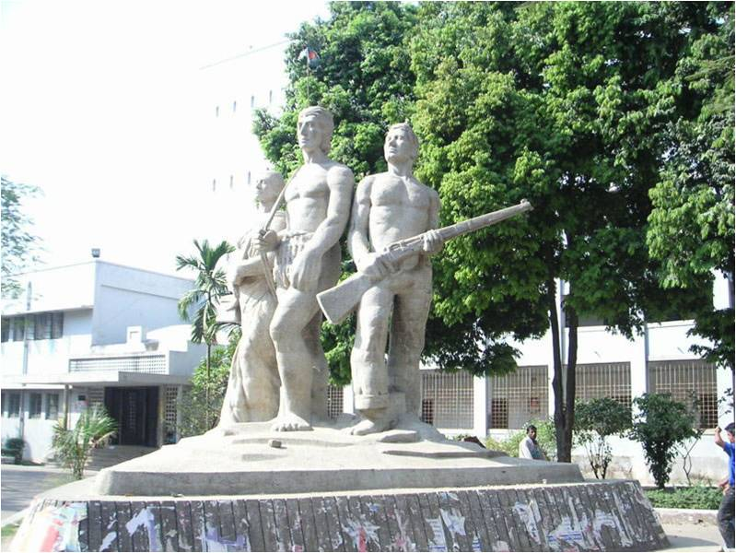
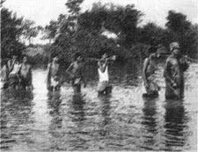
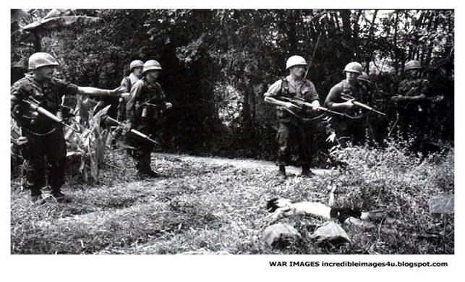
Individual/Pair work
Look at the above pictures and write a few sentences about our liberation war.

Slide 19
Home Work

