Slide 1

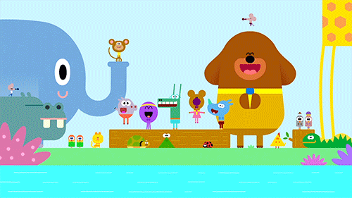

Slide 2

Presented by:
Shahana Akter
Firingee Bazar Government Primary School.
Kotowali, Chittagong.

Slide 3

Lesson Identity
Class: Two
Subject: English
Time: 40 Mintutes

Slide 4


Let’s watch a video
https://youtu.be/fPMjnlTEZwU

Slide 5

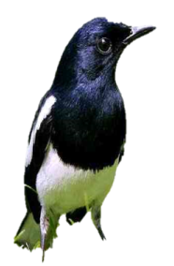


What can you see in the picture?
5
How many apples?
6
How many birds ?
7
How many flowers?

Slide 6
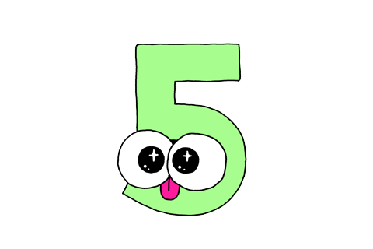


Today our lesson is
Numbers
Lesson- 1 -3
Page- 8

Slide 7

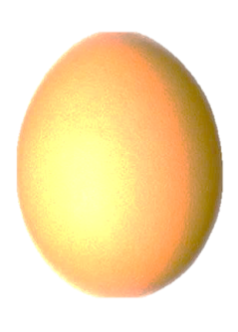


Look and say
5
6
7

Slide 8
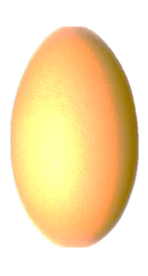
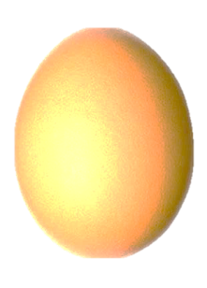
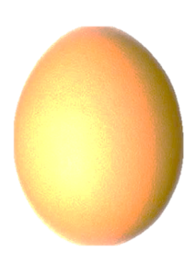
Look, count and say
5
6
7
five
six
seven

Slide 9

Look, count and say

Slide 10
Look, count and say

Slide 11
Look, count and say

Slide 12

Look, listen and say:
5
five

Slide 13

Look, listen and say:
6
six

Slide 14
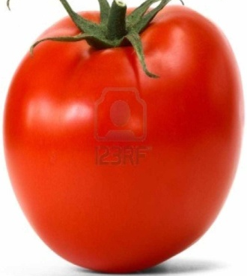

Look, listen and say:
7
seven

Slide 15
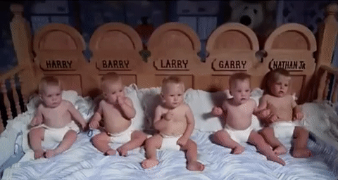
Look-Count-Say
How many babies?
6
5
7
Five

Slide 16
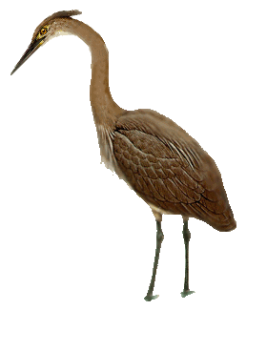
Look-Count-Say
How many birds?
5
6
7
six

Slide 17
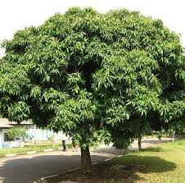

Look-Count-Say
How many mangos?
6
7
5
seven

Slide 18

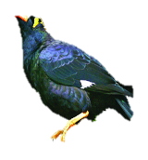
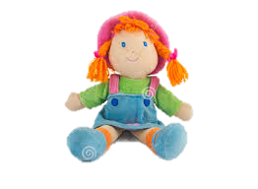

Look, count and say:
Picture
Figure
Word
5
Five
6
Six
7
Seven

Slide 19


Say, Trace & Write:
Practice

Slide 20
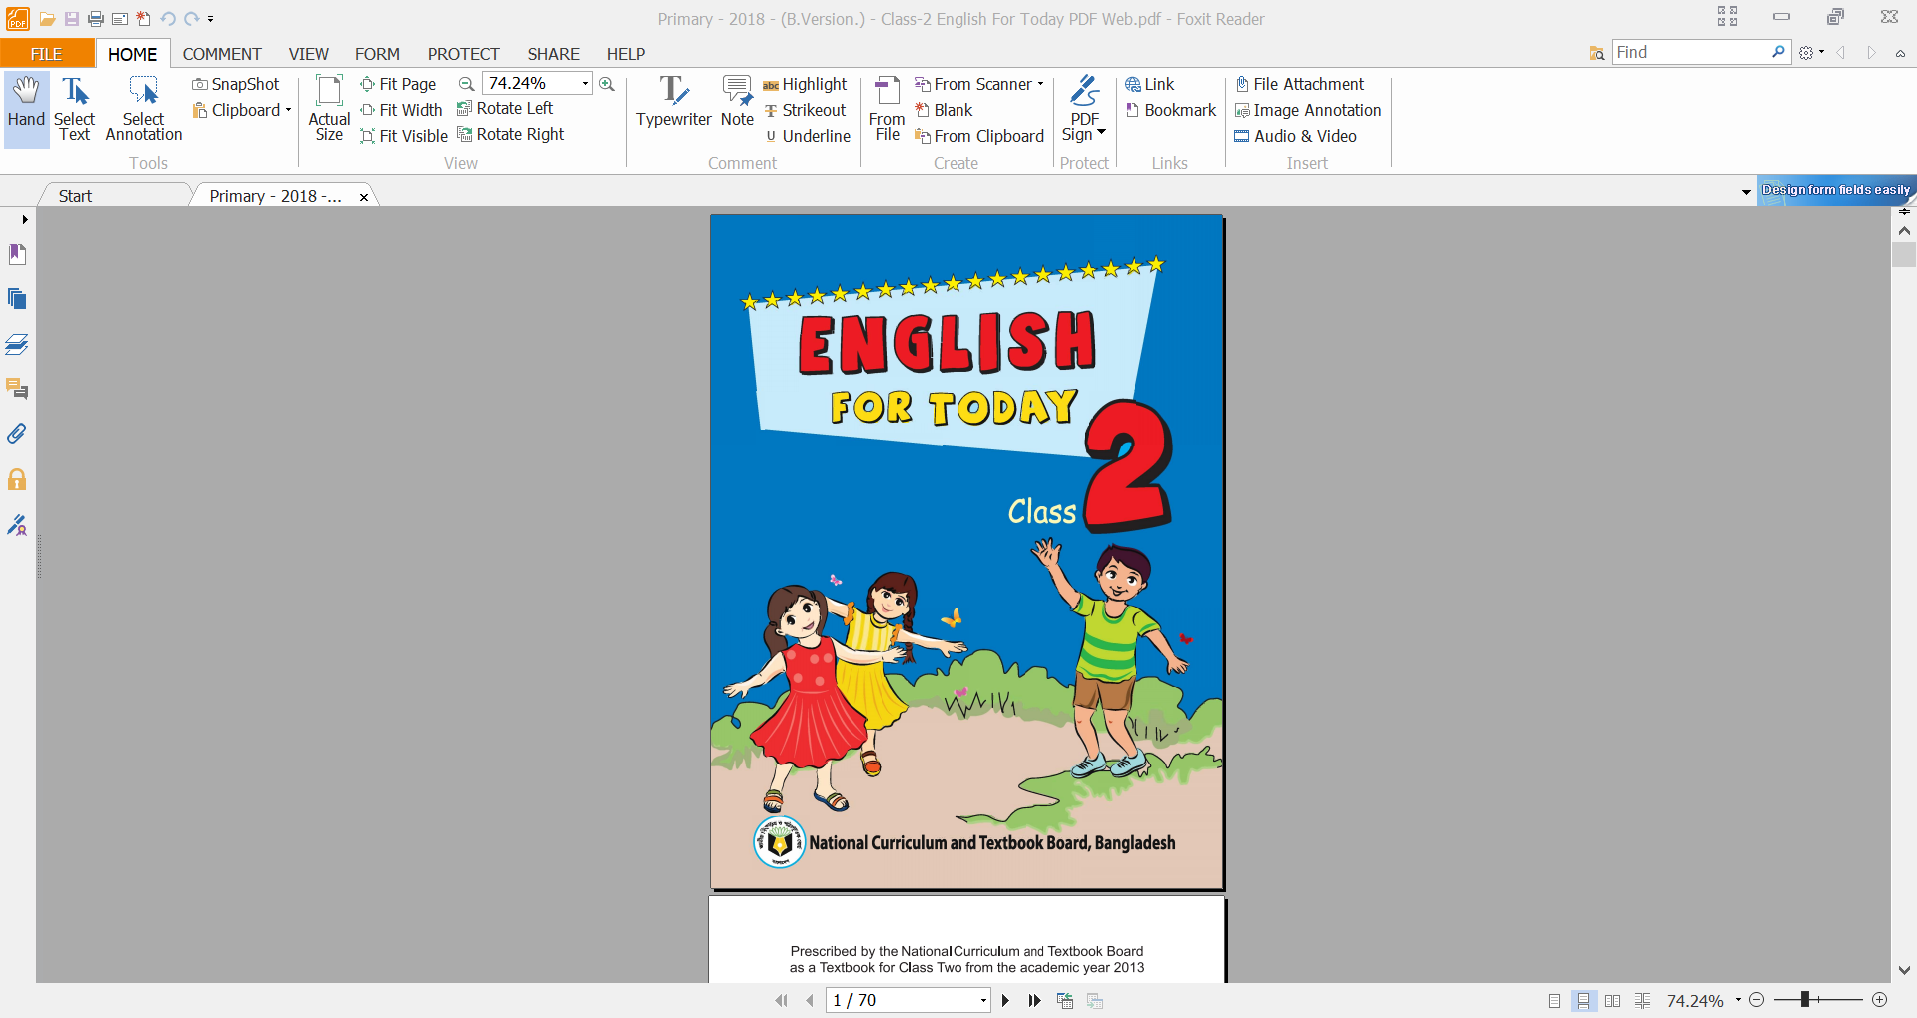
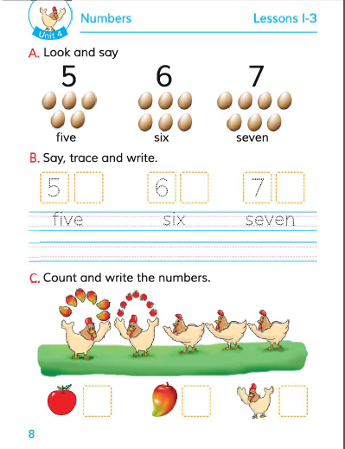
Please open the book At page 8

Slide 21
Say, Trace & Write:
Practice

Slide 22
six
Writing Practice
Say, trace and write.
5
6
7
seven
five

Slide 23
COUNT & WRITE THE NUMBER
SIX
SEVEN
FIVE

Slide 24
Read & Match the numbers with words:
P.W
Number
Word
6
seven
5
six
7
five

Slide 25
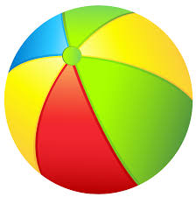
I.W
Count & Write the missing numbers :
5
five
6
six
7
seven

Slide 26




Count & Write the number
5
6
7
Lets see the correct answer

Slide 27

Count & Write the number
5
6
7
Lets see the correct answer

Slide 28
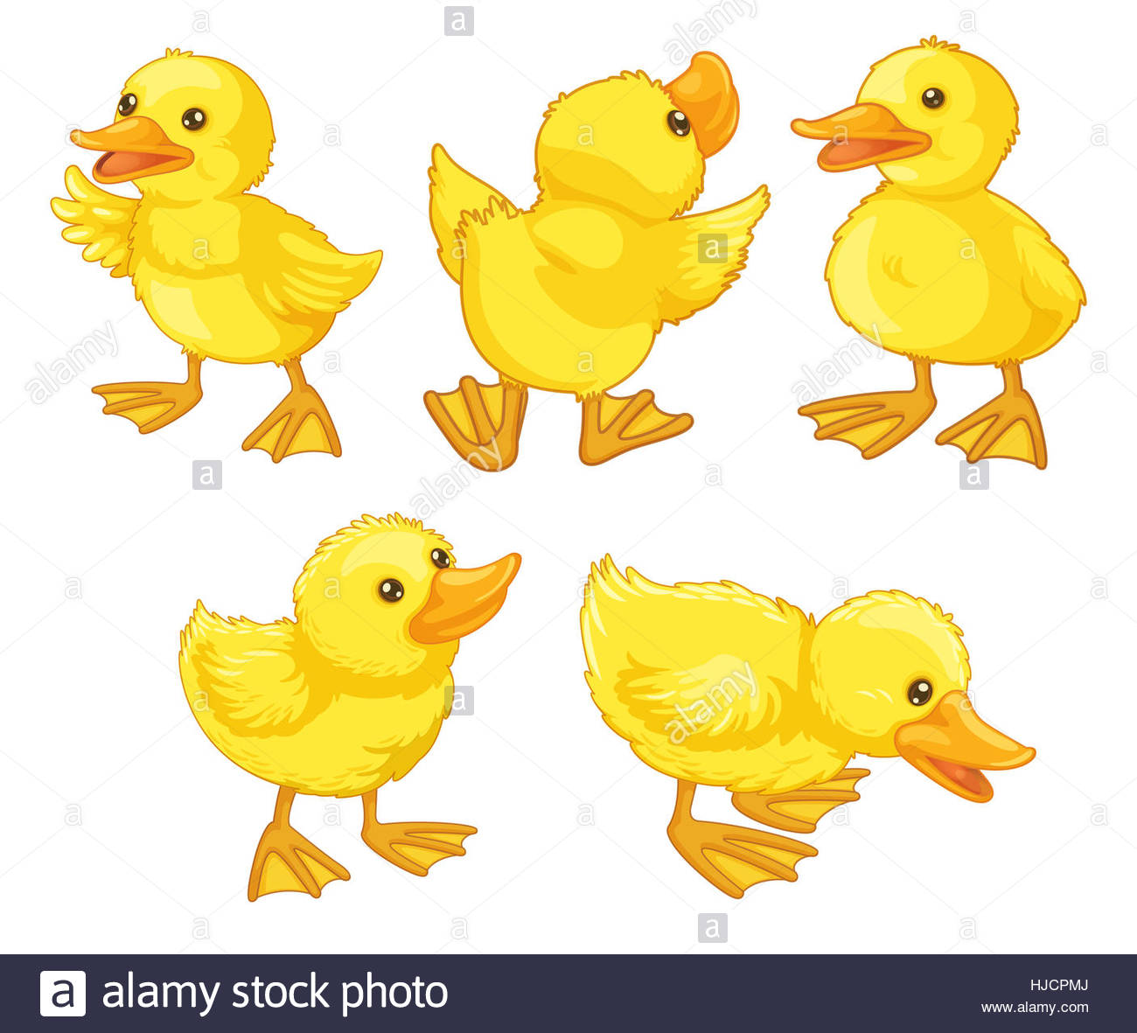
Count & Write the number
5
6
7
Lets see the correct answer

Slide 29
G.W
6
Find the Number & Circle.
7
5
Five
Seven
Six
Five
Seven
Six
Five
Seven
Five
Seven
Five
Six
Seven
Six
Seven
Five

Slide 30



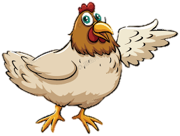
Checking learning
W.C.W
Count and write the numbers:
7
6
5

Slide 31











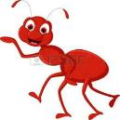

Checking learning
W.C.W
Count and write the numbers:
6
7
5

Slide 32


Slide 33


Slide 34
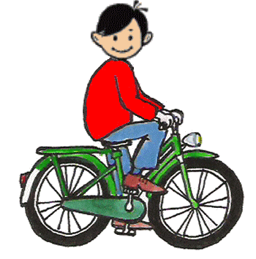
Good Bye

