Slide 1



Welcome to all

Slide 2

Teacher’s introducing
Md.Shanti Mia
( Assistant Teacher)
Nabogram-Gangadharpur Government primary school.
Jhikargacha,Jashore

Slide 3

Lesson Introduching
Class: One Lesson:Unit 15
Sub:English Topic:Number
Time: 45 Minutes

Slide 4

Learning outcomes
By the end of the lesson students able to-
2.2.1 follow simple commands and instructions
2.2.1 recognize and read cardinal numbers upto 10 in figures

Slide 5

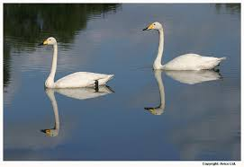
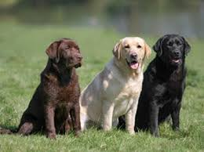
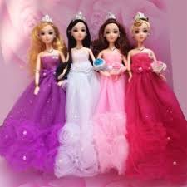
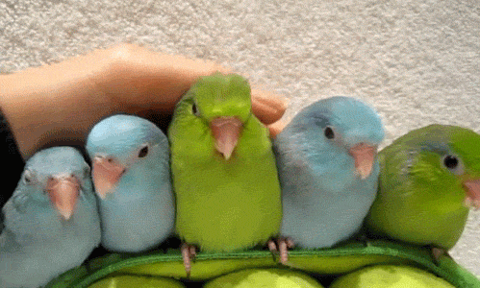

What can you see ?
Can you guess what we are going to learn today?

Slide 6

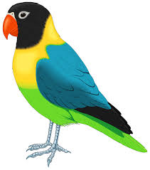
1
How many bird are there ?

Slide 7
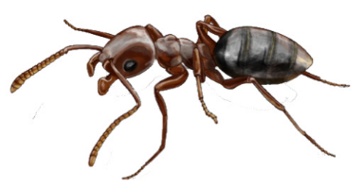
১১১১
2
How many ants are there ?

Slide 8

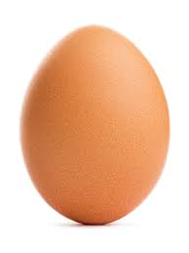
3
How many eggs are there ?

Slide 9

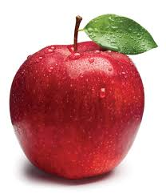
4
How many apples are there ?

Slide 10


5
How many balls are there ?

Slide 11

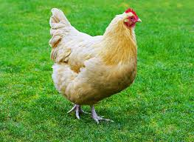
6
How many hens are there ?

Slide 12
Loud reading
1
2
3
4
5
6

Slide 13


Loud reading

Slide 14








Maching. (Pictures with numbers)
2
3
4
5
6

Slide 15

Write on your text book
2
2
3
3
4
4
5
5
6
6

Slide 16



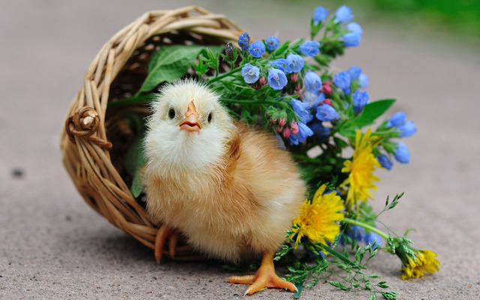

What’s the number missing?
Let’s play a game.
5
4
6
3
2

Slide 17

Point and say.
5 | 2 | 6
3 | 4 | 1

Slide 18

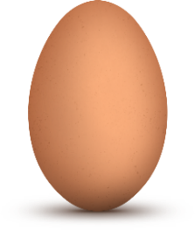

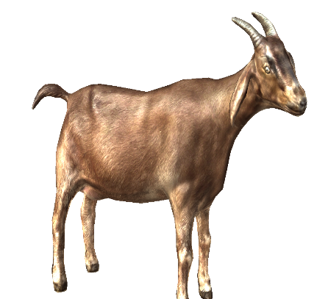

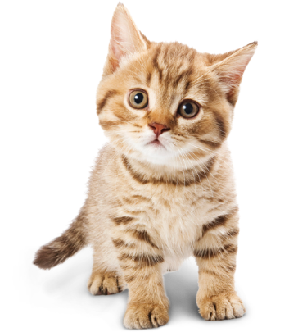
count , trace and write.
4
1
5
goat
eggs
balls
2
3
6
bags
dogs
cats

Slide 19

THANK
YOU EVERYBODY

