Slide 1
welcome

Slide 2
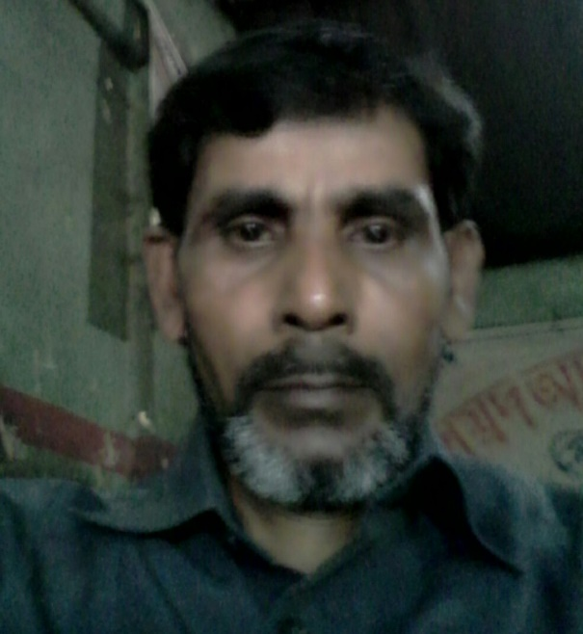
INTRODUCTION
MD ABUL KASHEM
ASSISTANT TEACHER
LAKESHOR DAKHIL MADRASAH
CHHATAK SUNAMGONJ
MOBILE 01786498922
mabulkashem2770@gmail.com

Slide 3
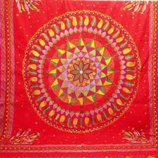
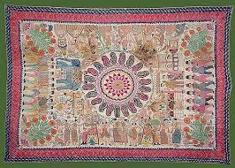
Look at the picture
Nakshikatha

Slide 4
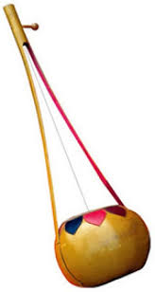
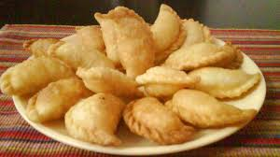
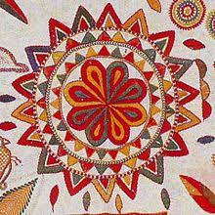
Puli cake
Ek-tara

Slide 5
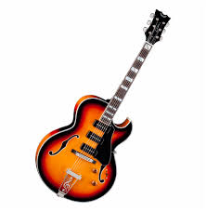
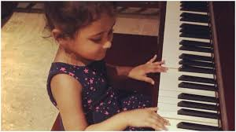
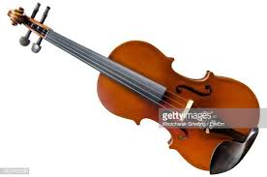
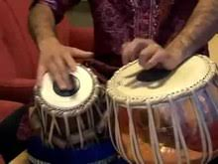
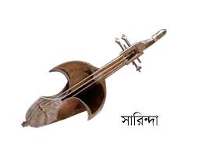
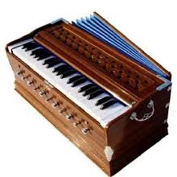
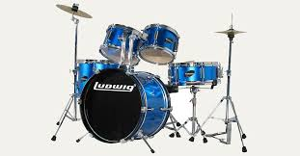
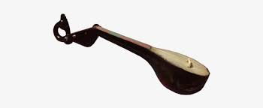
l
Guitar
Piano
Violin
Tabla
Sarinda
Harmonium
Drum
Flute
Ek-tara
Dotara

Slide 6
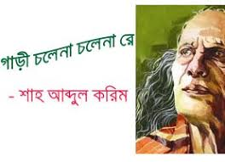
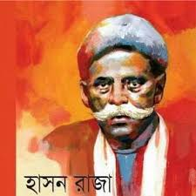
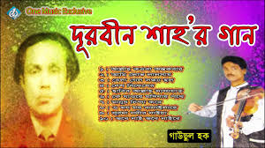
Look at the picture at a glance
Shah Abdul Korim
Hason Raja
Durbin shah

Slide 7
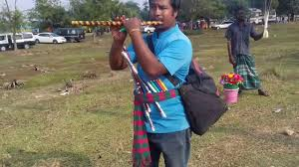
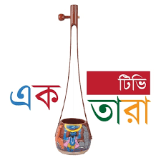
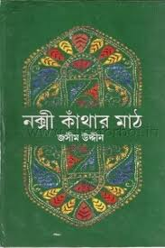
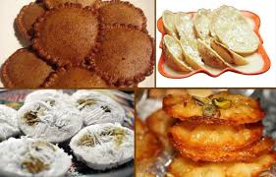
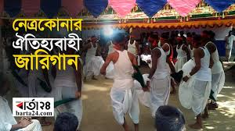
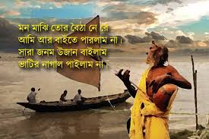
Lesson plan
A glimpse of our culture
Unit- One
Subject- English
Time- 50 Minute
Date- 13/01/2020

Slide 8
Learning outcome
After students have studied this unit, they will able to
Read and understand texts through silent reading
Infer meaning from context
Ask and answer questions
Write answers to questions
Write short composition

Slide 9
Can you play any of these musical instruments ? Tell what you know about him/her.
Bamboo flute
Ek-tara

Slide 10
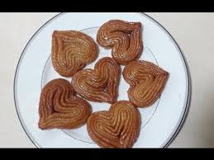
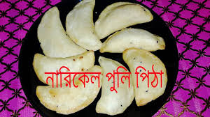
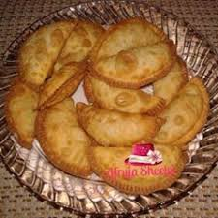
Did you eat these cake ?
Cake

Slide 11
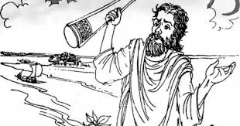
Can you sing a song ?
Ek-tara
Dotara

Slide 12
Do you know anybody who can play any of these instruments ?
Violin
Harmonium
Drum

Slide 13
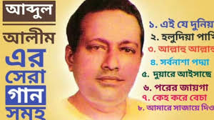
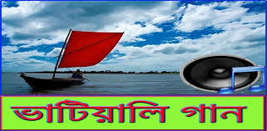
Can you sing any of these songs ?
Polligeeti song
Bhatiali song

Slide 14
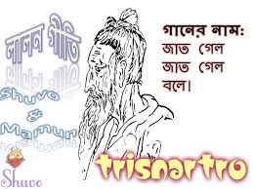
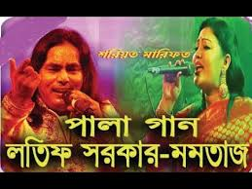
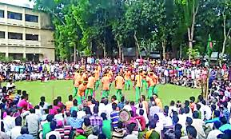
Folk songs are songs sung in the traditional style of a community or country .Here the traditional style includes the themes, words, and tunes of the songs .
Lalongeeti
Palagan
Jarigan

Slide 15
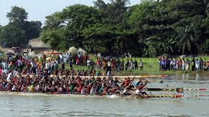
We have a rich history and collection of folk songs in Bangladesh . Of them Palagan, Bhatiali, Bhawaiya, Jari, Sari, Lalongeeti, Gambhira and songs of Hason Raja are very popular .
Jari gaan
Sari gaan
Bhatiali gaan

Slide 16
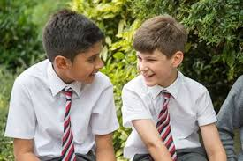
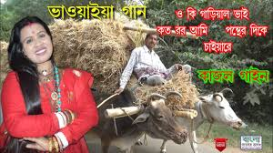
Who usually likes our folk songs ?
Can you name some well known folk songs ?
Do you like folk songs . If you do, who is your favourite folk singer ?
Which song or songs do you like most ?
Pair works

Slide 17
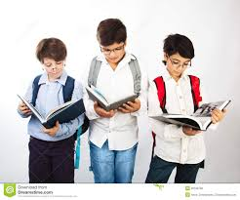
Discuss in groups and write a paragraph on the following question .
Do you want more or less programmes on folk songs on our TV channels ? Why ?/ Why not ?
Group works

Slide 18
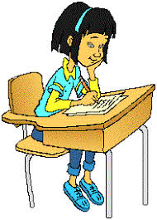
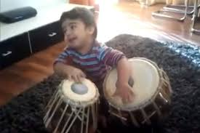
Can you sing a song ?
Can you play any of these musical instruments ?
Do you know play anybody who can play any of these instruments ? Tell what you know about her/him.
Evaluation

Slide 19
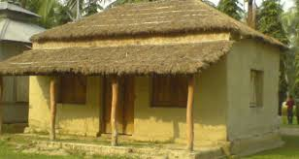
Write a paragraph describing how the Nakshi Kanta is made. Startblike this;
Old or new cloth and coloured thread are needed. First the cloth is folded, then………..
Home works

