Slide 1


Slide 2
GOOD MORNING STUDENT

Slide 3
TEACHERS NAME
MD.ABU ZAFOR SIDDIQUE
H.T
CHAKTABARI GPS

Slide 4


Slide 5
CLASS : THREE
SUBJECT: ENGLISH
TOPIC : OCCUPATIONS
TITLE : LOOK AND SAY

Slide 6
LEARNING OUTSCOMEs
STUDENTS WILL BE ABLE TO:
2.2.1. TO KNOW MENS OCCUPATIONS
2.3.1. TO KNOW WHATS THEIR WORKS.

Slide 7
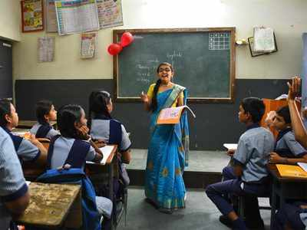
TEACHER

Slide 8

DOCTOR

Slide 9
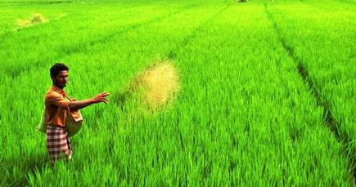
FARMER

Slide 10
EVALUATION
1. WHO GROWS CROPS?
2. WHO TEACH US?
3. WHO TREATMENT US?

Slide 11
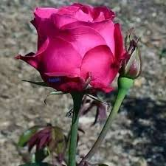

Slide 12
THANK YOU

Slide 13


