Slide 1


Good morning

Slide 2

Teacher name:Ayesha
Assistant teacher
kagjipara G.p.s
Ulipur,Kurigram

Slide 3

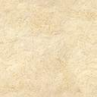
Class :1
Subject :English
Lessons :2
Unit:10(Rhyme)

Slide 4
Larning outcome
4.1 to repeat and recite rhymes the teacher.

Slide 5
Rhyme

Slide 6
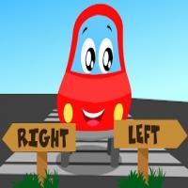


LEFT
RIGHT

Slide 7
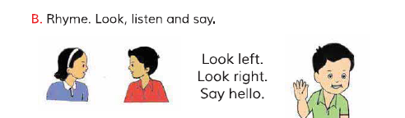

Slide 8
EVALUATION
জোড়ায় জোড়ায় ছড়াটি বলো।
ক্লাসের সবাই ছড়াটি বলো।

Slide 9



