Slide 1
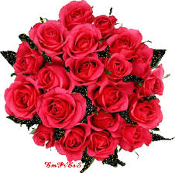

Slide 2
English First Paper
Class-VIII
By
Md. Sulyman Hossain
Asst. Teacher (English)
Alhaj Amena Khatun Bidyapith
Kalukhali,Rajnari

Slide 3
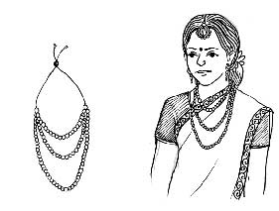
A Look at the pictures and discuss in pairs.
Notes:
Students will discuss this pictures in pairs. Teacher may monitor the discussing.

Slide 4
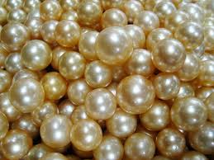
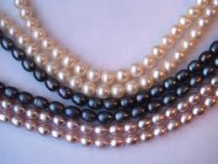
Pearls
Notes:
Students will tell something about the pictures.

Slide 5
Our today’s lesson is
Pearls! Pearls! Pearls!
Unit-7, Lesson-1
Notes:
Lesson declaration. Teacher may skip to the page 15 directly to avoid page No.7-14 clicking right play button (Word meaning).

Slide 6
Learning outcomes
At the end of the lesson, we will be able to-
ask and answer questions
listen for information
read and understand text through silent reading
Notes:
Speaking, listening, reading and writing skills will be focused.

Slide 7
Key Words
Teacher may show the word first and ask meaning of the word to the students. If they can answer, its ok. Then teacher can show the picture. To make them clear completely, teacher can show them a sentence with the word.
To avoid page No 7-14 teacher may use hyperlink
in page 6 to go to the text option directly.
Notes:
This is not for the students. This is for only the teachers.

Slide 8
Mythology
Meaning: Folklore, Tradition, Mythos, Lore
Pearls have been mentioned in religious texts mythologies from the earliest times.
Notes:
Teacher may show the word first, then ask the meaning and at last he may show the meaning and sentence making .

Slide 9
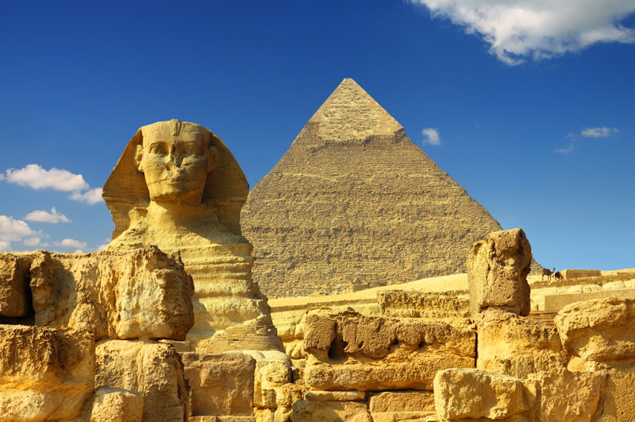
Ancient
Meaning: Olden, Primeval, Age-old, Earliest
In ancient Rome, pearls were considered the greatest sign of wealth and social status.
Notes:
Teacher may show the word first, then ask the meaning and at last he may show the meaning and sentence making .

Slide 10
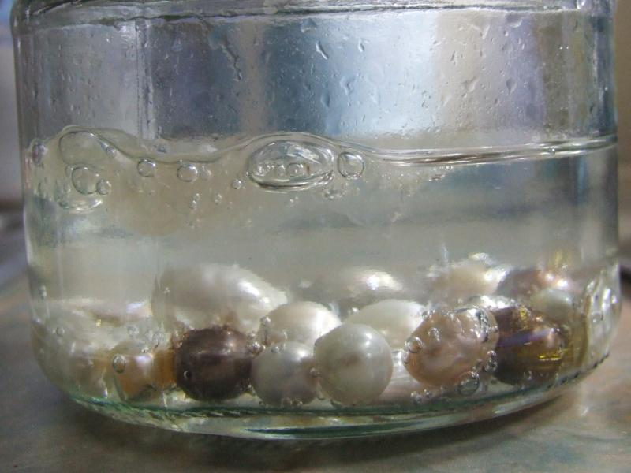
Dissolve
Meaning: Melt, liquefy, thaw
Pearls were dissolved in water in ancient time.
Notes:
Teacher may show the word first, then ask the meaning and at last he may show the meaning and sentence making .

Slide 11
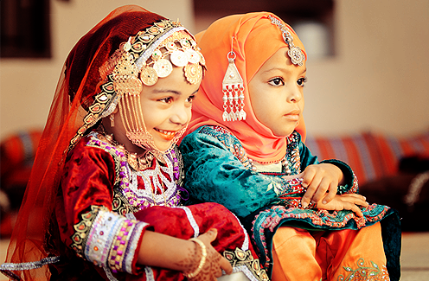
Status
Meaning: Rank, Position, Standing, Grade, Station
Pearls were considered as the sign of status in ancient time.
Notes:
Teacher may show the word first, then ask the meaning and at last he may show the meaning and sentence making .

Slide 12
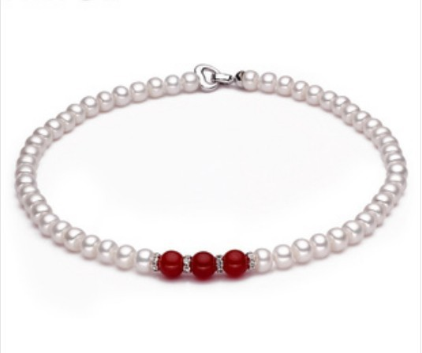
Unparalleled
Meaning: Supreme, unmatched, incomparable, beyond compare
Pearls were thought unparalleled to Rome.
Notes:
Teacher may show the word first, then ask the meaning and at last he may show the meaning and sentence making .

Slide 13
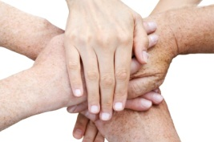
Association
Meaning: Connotation, overtone, suggestion, reminder
The beauty of pearls was associated with love and marriage.
Notes:
Teacher may show the word first, then ask the meaning and at last he may show the meaning and sentence making .

Slide 14
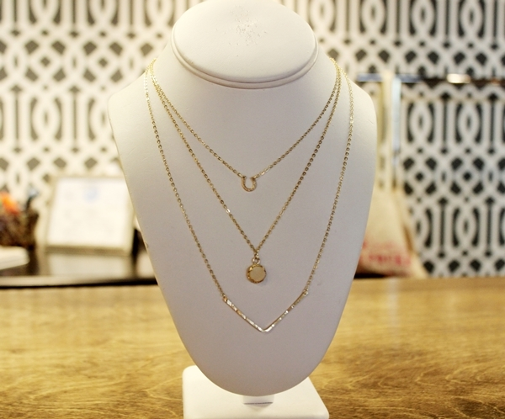
Delicate
Meaning: Subtle, faint, slight, gentle, elusive, soft
It is too delicate for a woman.
Notes:
Teacher may show the word first, then ask the meaning and at last he may show the meaning and sentence making .

Slide 15
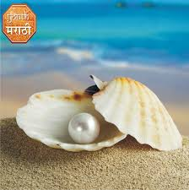
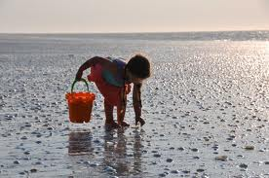
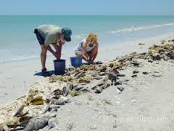
B Read the text and answer the questions that follow.
Thousands of years ago, the first pearl was probably discovered while human beings were searching for food at the sea shore.
Notes:
Teacher may read it loudly as a part of focusing listening skill.

Slide 16
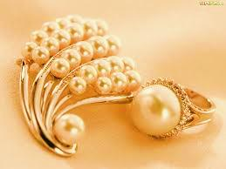
Throughout history the pearl with its shine has been one of the most highly valued gems.
Notes:
Teacher may read it loudly as a part of focusing listening skill.

Slide 17
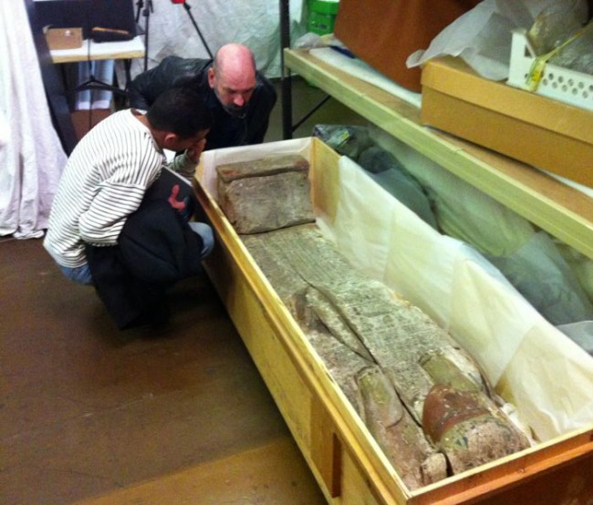
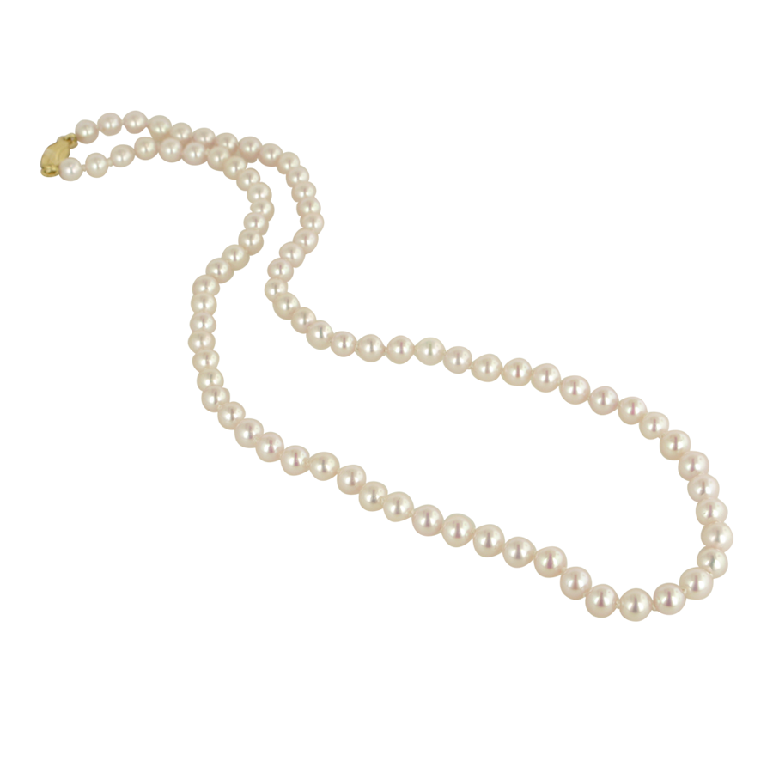
The ancient Egyptians valued pearls so much
that they were buried with them.
Notes:
Teacher may read it loudly as a part of focusing listening skill.

Slide 18
It is said that, the famous queen of Egypt Cleopatra would dissolve a pearl in a glass and drink it as a sign of love and respect for the entire nation.
Notes:
Teacher may read it loudly as a part of focusing listening skill.

Slide 19
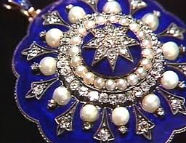
The Greeks thought the pearls as a sign of wealth and social position. The beauty of pearls was associated with love and marriage.
Notes:
Teacher may read it loudly as a part of focusing listening skill.

Slide 20
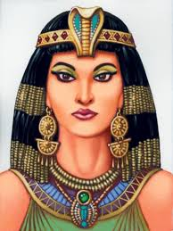
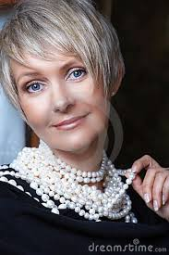
In ancient Rome, pearls were considered the greatest sign of wealth and social status.
Notes:
Teacher may read it loudly as a part of focusing listening skill.

Slide 21
At that time the young women of noble families loved to wear beautiful pearl necklaces
Notes:
Teacher may read it loudly as a part of focusing listening skill.

Slide 22
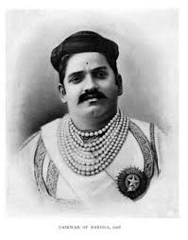
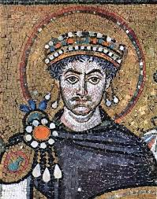
The brave knights used to wear them in the battles for good luck.
Notes:
Teacher may read it loudly as a part of focusing listening skill.

Slide 23
Questions
1 Do you think ‘pearls’ were discovered by accident? Why?
2 Why do you think pearls were valued so much in the past?
3 What good luck the knights thought the pearls would bring them?
Notes:
Students may read it silently to answer the questions. It will focus reading skill.

Slide 24
C Read the text in B again and write the information in the table.
Who | When/Where
The ancient Egyptians | wore | pearls
The Greeks
The ancient Romans
The brave knights
Notes:
Reading and writing skill will be focused by this option.

Slide 25
Thank You
Notes:
Last greeting.

