Slide 1
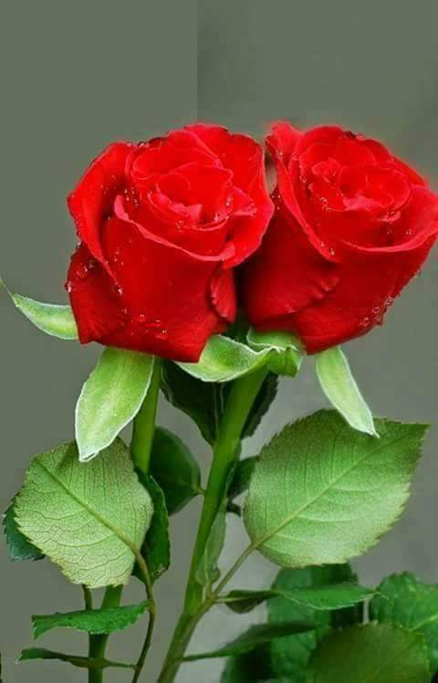
Welcome
to
my class.

Slide 2
Teacher’s introduction
Sarup Das
Head teacher
Azompur Govt. Primary School,
Darsana,Chuadanga

Slide 3
Lesson Introduction
Class-Four
Subject: English
Unit: 8
Lesson: (1-2)
Lesson Title: Traffic Lights

Slide 4
Learning outcomes
Listening :
1.1.1: Recognize sound differences in the context of words.
1.2.1. Recognize which syllable in a word is stressed.
Speaking:
4.1.1 : Repeat poems after the teacher.
4.1.2: Recite poem with understanding.
Reading:
4.1.1: Read aloud poems with proper sounds, stress and intonation.

Slide 5
Let’s sing the “Good morning Song.”

Slide 6
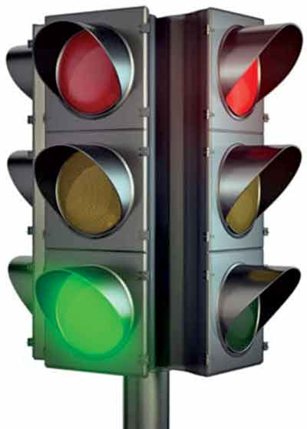
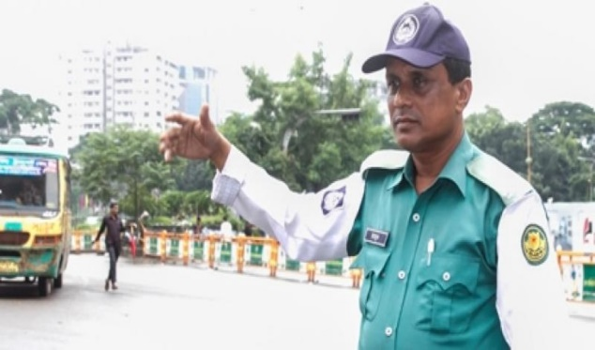
What do you see in the picture?

Slide 7
Our today’s lesson is
Traffic Lights

Slide 8
New Words
Yellow
a traffic slowdown in the passing lane.
Slow Down

Slide 9
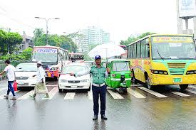
What is this
What is this?

Slide 10
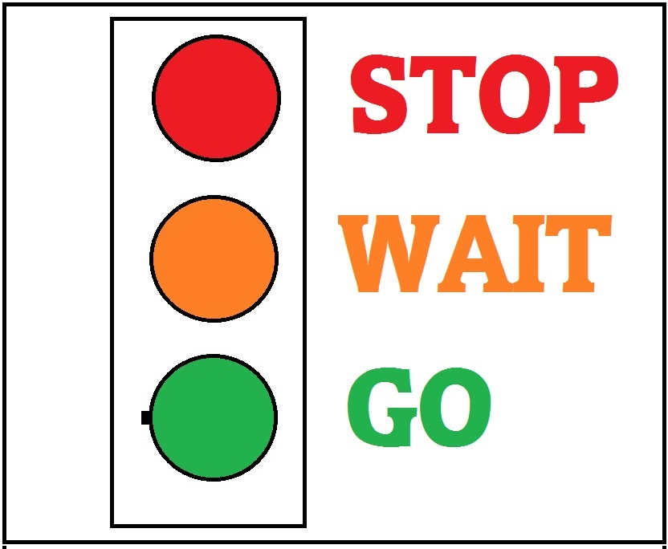
How many colors are there at the traffic light?

Slide 11
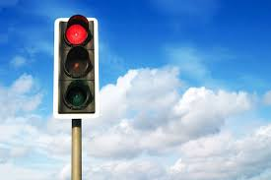
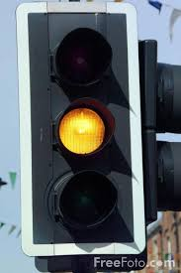
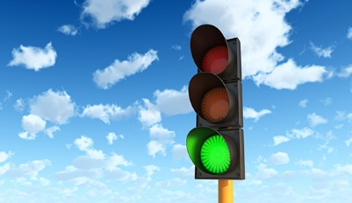
Red light means to stop.
Yellow light means to wait.
Green light means to go.

Slide 12
Let’s listen to the audio
Repeat after the audio for several times.

Slide 13
Now repeat after me with claps.
Recite the rhyme in pairs

Slide 14
Write T for True or F for False.
1. There are three lights on a traffic signal.
2. A red light means slow down.
3. A yellow light means go.
4. A green light means look both ways and go.
5. The red light is between the other light.
6. The green light is under the yellow light.

Slide 15
Answer the following questions
1. What does the red light mean?
2.What does the yellow light mean?
3.What does the green light mean?

Slide 16
Thanks everybody.

