Slide 1
Welcome to English class

Slide 2
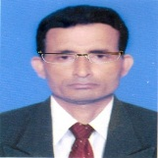
Identity
Manik Chandra Majumder
Senior Teacher (English)
Gazirhat High School
Senbag, Noakhali.
Mobile No: 01717155169
Email: manikmajumder01@gmail.com
Class : Nine-Ten
Subject : English 1st paper
Time : 50 Minutes
Date : 00/00/2018

Slide 3
Read &
Think
Knowledge = To know something about a
particular topic
Skills = Ability to do something practically
Attitudes = Bring about behavioural change

Slide 4
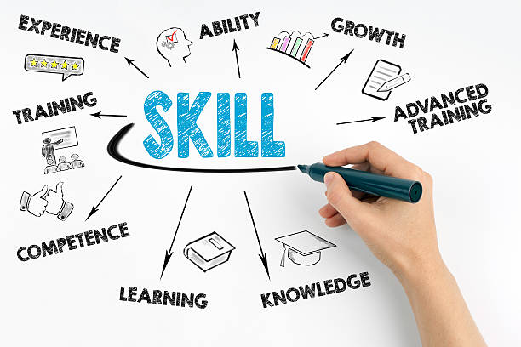
Think about the images.
How can we earn knowledge, skill and attitudes?

Slide 5
Our today’s topic is-------
Unit - 1
Lesson - 2
Knowledge , skills and attitudes

Slide 6
Learning Outcomes
After we have studied this lesson, we will be able to-------
ask and answer questions,
listen and understand others,
take part in conversation,
describe something in writing.

Slide 7
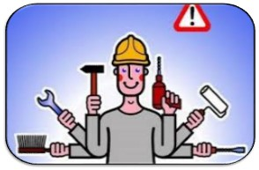
Knowledge
Skills
Attitudes
Behavioural change

Slide 8
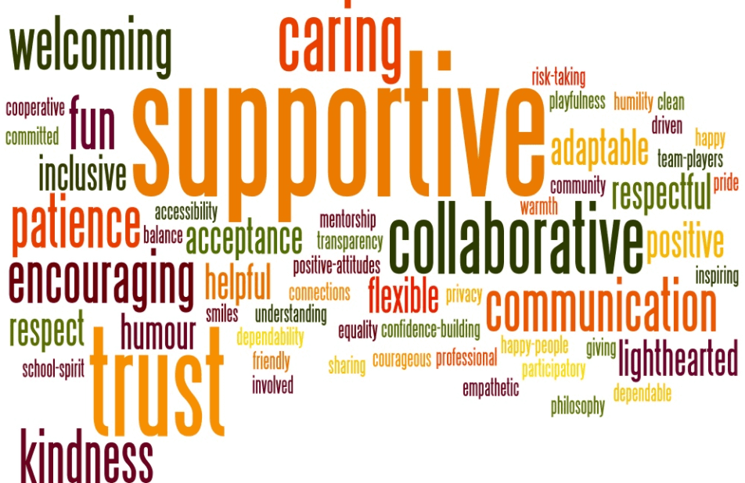
Knowledge, skills and attitudes bring human’s behavioural change that help to make good citizens.

Slide 9
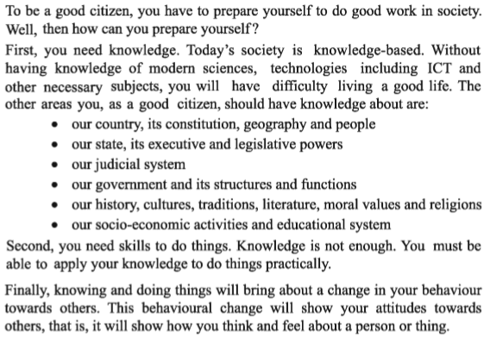
Student will read the text

Slide 10
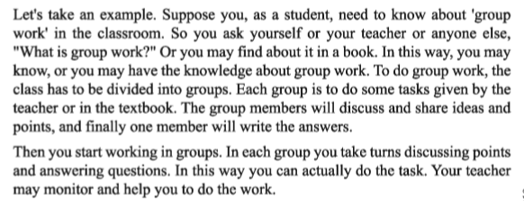

Slide 11
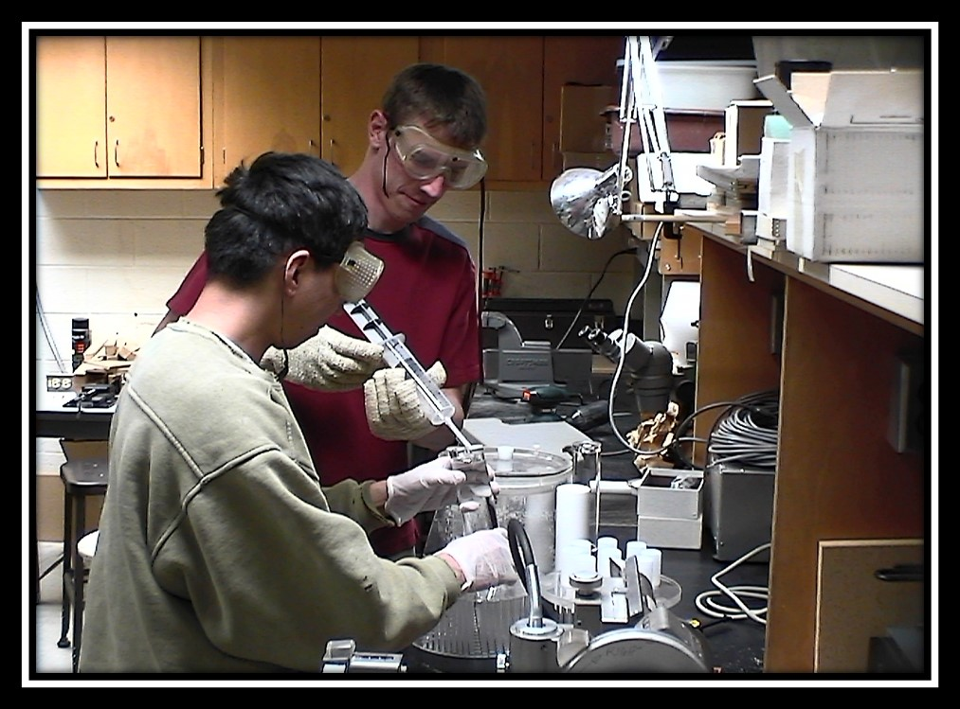
Modern Science

Slide 12
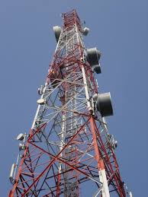
Technology

Slide 13
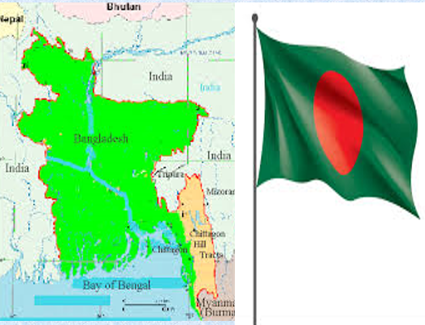
Our country, geographical position

Slide 14
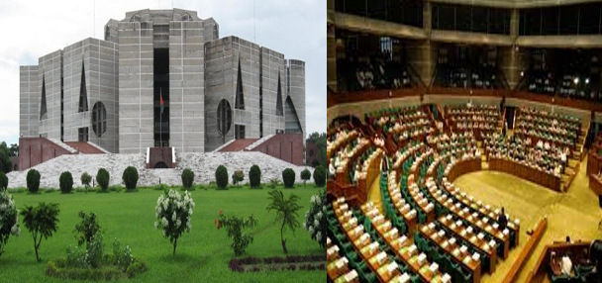
Our constitution
Our legislative power

Slide 15
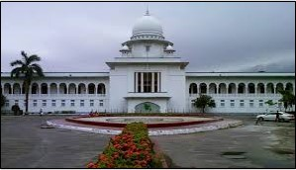
Our judicial system

Slide 16
Individual Work
What do you mean by knowledge?
What is skill?
How can a person reveal attitudes?

Slide 17
Pair Work
First write then exchange your khata with your partner
Suppose, you know how to make a kite. But your friend don’t know how to make it. Now write how you show your behavioural change through knowledge, skills and attitudes.

Slide 18
Group work
Discuss in groups. Write how K S A can be shown in the following topics :
Orsaline | Debate | Email

Slide 19
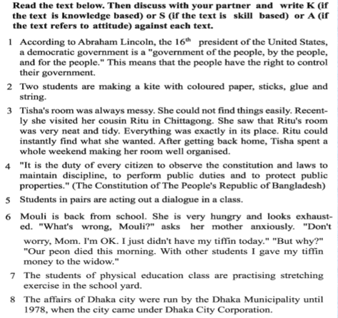
Evaluation

Slide 21
Home Work
Write a paragraph on “How to make Orsaline”.

Slide 22
Thank you all
Good Bye

