Slide 1

WELCOME TO ALL

Slide 2
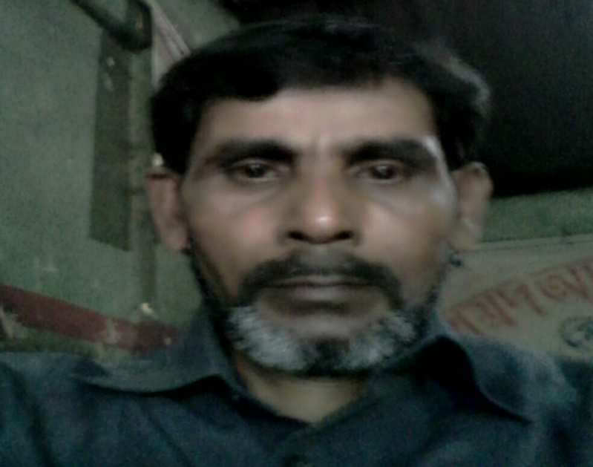
MD ABUL KASHEM
ASSISTANT TEACHER
LAKESHOR DAKHIL MADRASA
CHATAK SUNAMGONJ
MOBILE 01786498922
mabulkashem2770@gmail.com

Slide 3
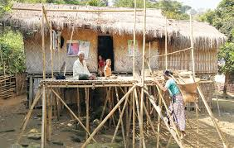
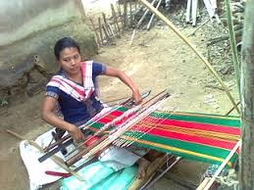
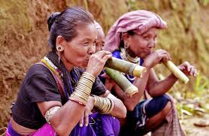
Look at the picture and say .
Santals
Tipperas
Garos

Slide 4
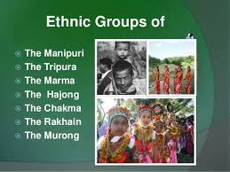
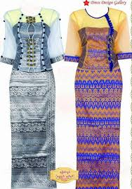
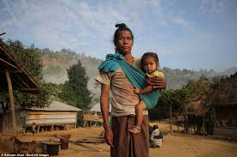
The ethnic people in Bangladesh hold a very important place in the culture of the country . Some of them are the Chakmas, the Marmas, Tipperas, the moorags, Santals, Khasias, Monipuries Hajangs, and Garos.
Ethnic groups
Monipuri dress
Chakmas

Slide 5
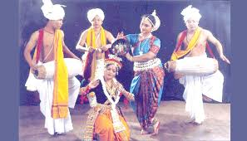
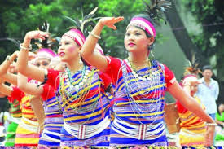
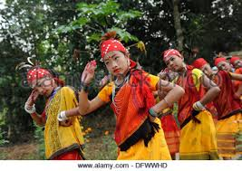
The ethnic people are fond of songs, music, dances, theatre and fairs.
Monipuries dance
Tripperas dance
Garos dance

Slide 6
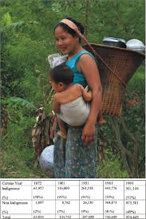
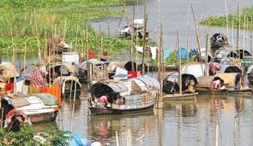
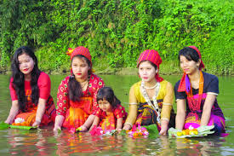
Lesson plan
Our ethnic friends(1, 2)
Lesson:3-4
Unit-One
Time:50 Minutes
Date: 15/01/2020

Slide 7
LEARNING OUTCOME
After finish the lesson they will be able to
Read and understand texts
Recognize the ethnic people of Bangladesh
To explain about the ethnic people of Bangladesh
To description their lifestyle and favourite pastimes

Slide 8
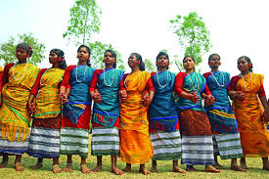
Let us see the picture at a glance and say
Monipuris
Garos
Santals

Slide 9
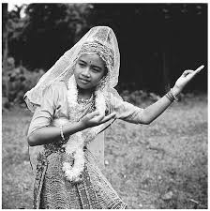
Do you know where the ethnic people live in Bangladesh ? What are they called ?
Bede
Chakmas
Hajangs

Slide 10
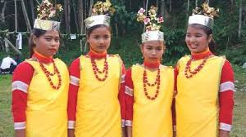
Following the picture and say about them .
Moorangs
Khasias

Slide 11
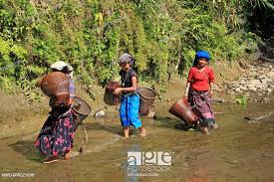
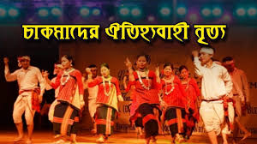
Hunting and fishing are their favourite pastimes . They are fond of songs , music , dances , theatre and fairs .
Fishing
Dance

Slide 12
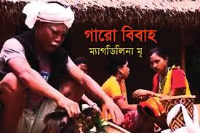
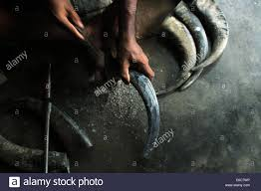
T
Traditional musical instruments used are bugles made from buffalo horns, drums and bamboo flutes .
Garos marriage
Bugles

Slide 13
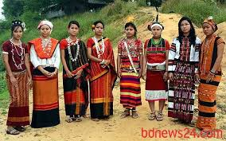
Men wear lungis and women wear thamis or sarongs and angis .
Santals dress
Chakmas dress

Slide 14
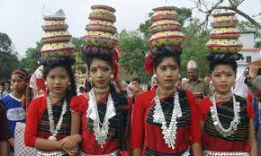
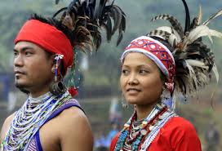
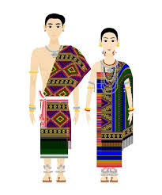
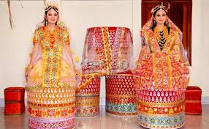
Kkasia
Marma
Hajong
Hajong
Marma
Monipuri

Slide 15
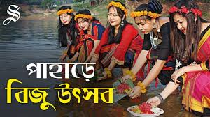
They build their houses on bamboo or wooden platforms called ‘machang’ .Their kitchen utensils are bamboo, wooden, and earthen pots which they make themselves .
Machang
Biju festival

Slide 16
They are fond of songs, music, dances, theatre and fairs .
Monipuries dance
Tipperas dance
Garos dance

Slide 17
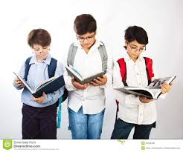
Group work
Imagine you are Sajid and you have a Marma friend called Masing . Now write a dialogue asking and answering questions about dress, food, songs, sports, and pastimes of both of you .

Slide 18
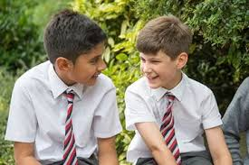
Discuss and answer the following questions in pairs .
Make a list of the things you and you partner eat everyday .
2. Make two lists of food one eaten by the urban and the other by the rural people .
3. Describe a Bangladeshi food that you like best .

Slide 19

Evaluation
What has made Bangladeshi food so special ?
2. Where do we get the fishes from ?
3.Apart from fish, what other foods do we eat with rice ?

Slide 20

THANKYOU TO ALL

