Slide 1
GoodMorning

Slide 2
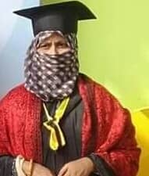
Introduction of the Teacher and Class
Mafuza Akter
Lecturer of English
Kushtia City College,Kushtia
English For Today
Class XI-XII

Slide 3
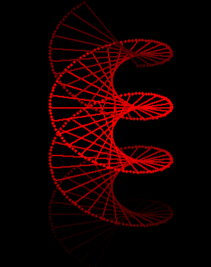
What do you know about the picture?

Slide 4
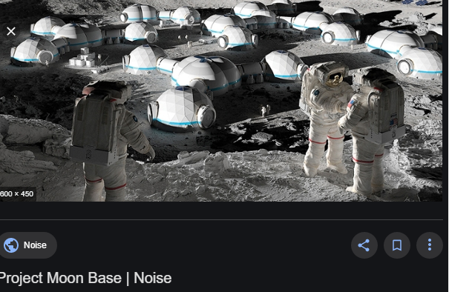
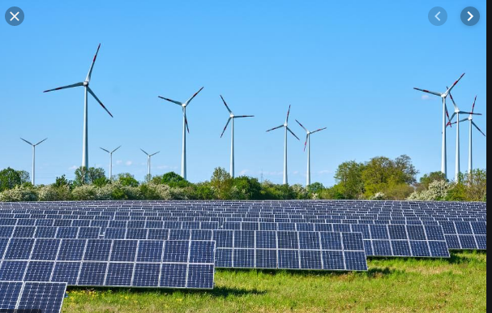
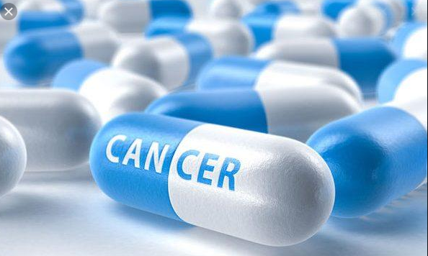
Cure for Cancer
Permanent moon base
Demand for clean energy
DNA Computer

Slide 5
Our Todays lesson
Scientific Beakthroegh we wre waiting for 1
Unit -2,Lesson -3

Slide 6
Learning Outcomes
At the end of the lesson ,Ss will be able to-
Know about DNA Computers activities in modern era.
Can mention the different methods of producing clean energy used at present.
Can explain prevention of Cancer ,the deadliest diseases of modern era.
Practise vocabulary

Slide 7
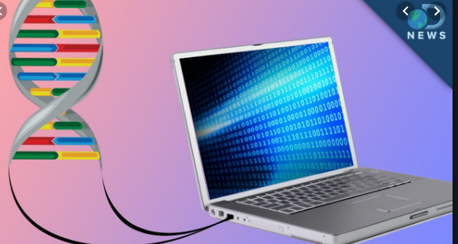
DNA Computer
DNA computing is a branch of computing which uses DNA, biochemistry, and molecular biology hardware, instead of the traditional silicon-based computer technologies. Research and development in this area concerns theory, experiments, and applications of DNA computing

Slide 8
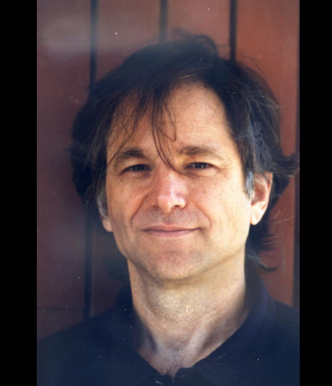
Leonard Adleman (born December 31, 1945) is an American computer scientist. He is one of the creators of the RSA encryption algorithm, for which he received the 2002 Turing Award, often called the Nobel prize of Computer science.^{[1]} He is also known for the creation of the field of DNA computing.
Leonard Adleman

Slide 9
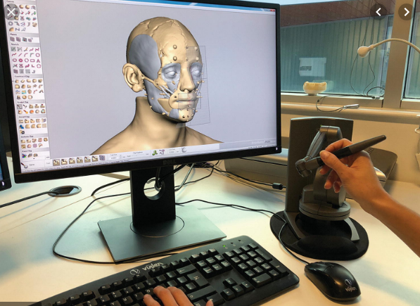
MAYA-II (Molecular Array of YES and ANDNOT logic gates^{[1]}) is a DNA computer, based on DNA Stem Loop Controllers, developed by scientists at Columbia University and the University of New Mexico and created in 2006.
Watch Video now

Slide 10
Single Work
Why are DNA Computers much more powerful than today’s standard computers?

Slide 11
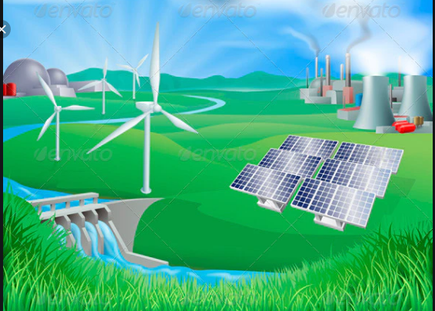
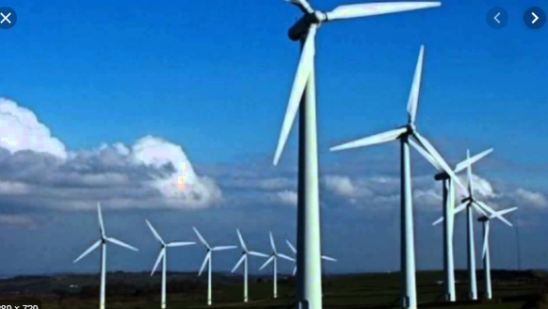
Renewable Energy
There are many forms of renewable energy . Most of these renewable energies depend in one way or another on sunlight. ...
Solar. ...
Wind Power. ...
Hydroelectric energy. ...
Biomass is the term for energy from plants. ...
Hydrogen and fuel cells. ...
Geothermal power. ...
Other forms of energy

Slide 12
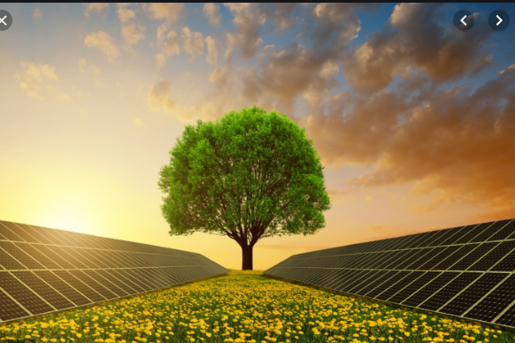
Energy is central to nearly every major challenge and opportunity the world faces today. Be it for jobs, security, climate change, food production or increasing incomes, access to energy for all is essential. Working towards this goal is especially important as it interlinks with other Sustainable Development Goals.
At the current time, there are approximately 3 billion people who lack access to clean-cooking solutions and are exposed to dangerous levels of air pollution. Additionally, slightly less than 1 billion people are functioning without electricity and 50% of them are found in Sub-Saharan Africa alone. Fortunately, progress has been made in the past decade regarding the use of renewable electricity from water, solar and wind power and the ratio of energy used per unit of GDP is also declining.

Slide 13
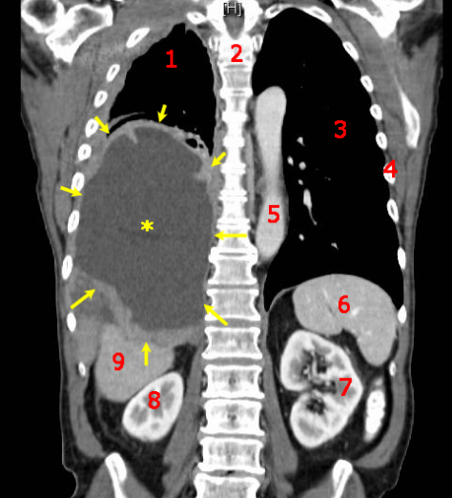
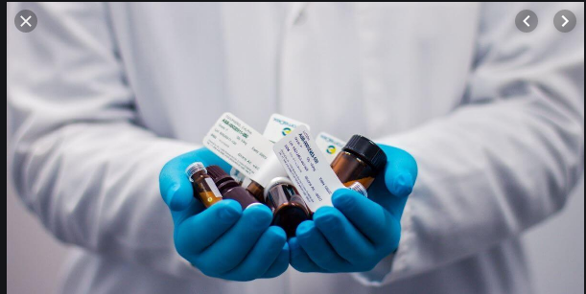
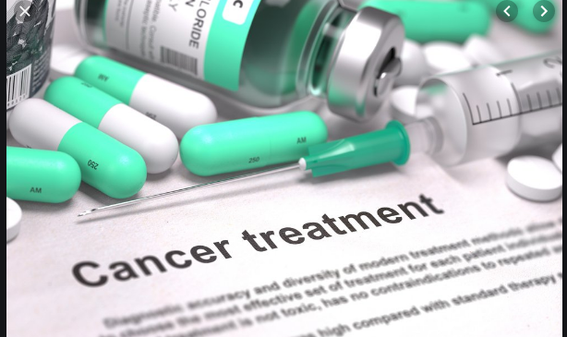
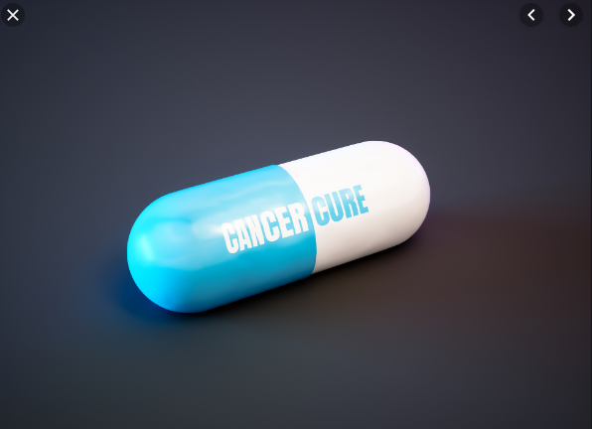
Cancer is a group of diseases involving abnormal cell growth with the potential to invade or spread to other parts of the body.^{[2][8]} These contrast with benign tumors, which do not spread.^{[8]} Possible signs and symptoms include a lump, abnormal bleeding, prolonged cough, unexplained weight loss, and a change in bowel movements.^{[1]} While these symptoms may indicate cancer,

Slide 14
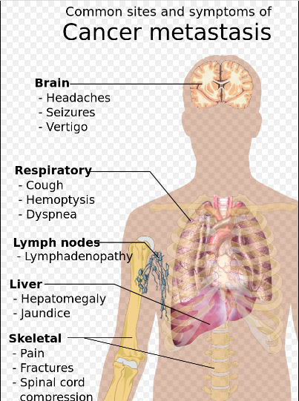
Cancers are a large family of diseases that involve abnormal cell growth with the potential to invade or spread to other parts of the body.^{[2][8]} They form a subset of neoplasms. A neoplasm or tumor is a group of cells that have undergone unregulated growth and will often form a mass or lump, but may be distributed diffusely.^{[24][25]}
All tumor cells show the six hallmarks of cancer. These characteristics are required to produce a malignant tumor. They include:^{[26]}
Cell growth and division absent the proper signals
Continuous growth and division even given contrary signals
Avoidance of programmed cell death
Limitless number of cell divisions
Promoting blood vessel construction
Invasion of tissue and formation of metastases^{[26]}
The progression from normal cells to cells that can form a detectable mass to outright cancer involves multiple steps known as malignant progression

Slide 15
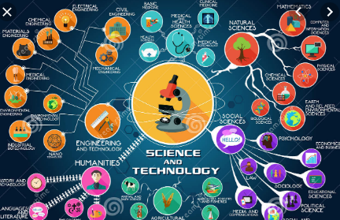
Now Read Text Book

Slide 16
Group Work
Share the following introduction with your friend and give your own views on the opinions expressed in the passage.
Why do you think there is no last word with science?

Slide 17
Home Work
What medical or clinical breakthrough do you think will help the people of our country most.(write Around 300 words)

