Slide 1
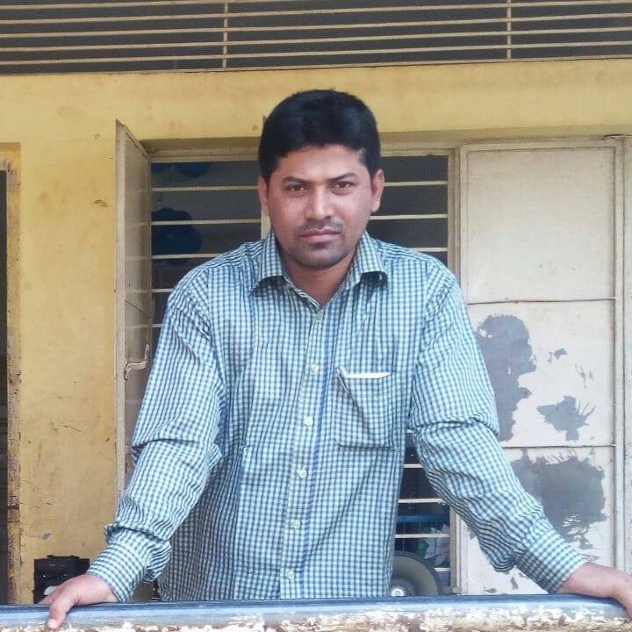
Lesson Contacts:
Class 4
Subject: English For Today
Unit: 40
A Garment Worker’s Day
Lesson: 1-2
Lesson Part: Reshma is a……… Sell them.
Page: 80
Md Shahjahan
Assistant Teacher
Jarulchari GPS
Luxmichari, Khagrachari
Mob: 01816859258

Slide 2
Learning Outcomes:
Students will be able to……
Listening:
1.1.1 Recognize sound differences in the context of words.
1.2.1 Recognize which syllable in a word is stressed.
1.3.1 Recognize which words in a sentence are stressed.
3.4.1 Understand statements make by the teacher and students.
4.2.1 Enjoy and understand simple stories.
Speaking:
1.1.1 repeat after the teacher and say words, phrases and sentences with proper sounds and stress.
Reading:
1.5.1 To read words, sentences phrases in the text with proper pronunciation, stress and intonation.
1.7.1 Read short paragraphs, dialogues and simple letters.
5.1.1 Read silently with understanding paragraphs, stories and other text materials.

Slide 3
Welcome

Slide 4
Would you like to enjoy a song?
Ok lets enjoy.
Greeting song Hello Hello , Hello my friend will play by speaker..

Slide 5
Today we are going to start a new lesson.
The name of the new lesson is………
‘A garment worker’s day’

Slide 6
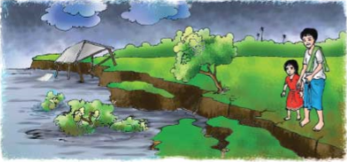
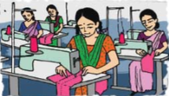
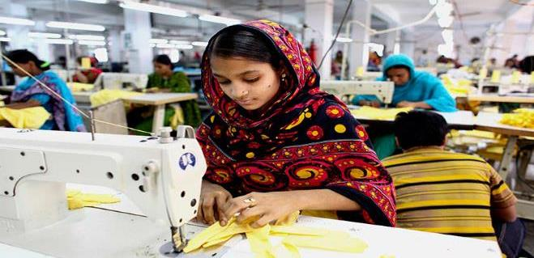
What are you seeing in the picture? Think about it.
Discussion about pictures..

Slide 7
Now we are going to play a game..
Here are some words..
Younger
Garment worker
Accident
Erosion
Driver
Factory
River
You have to write 4 words among them.
Then I will remove the words at random.
If you have written one of the words then circle it out.
When anyone has circled off all his words then shout “BINGO” and he/she will be the winner. Ok lets start.

Slide 8
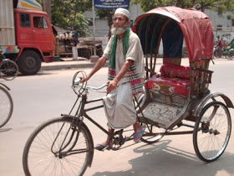
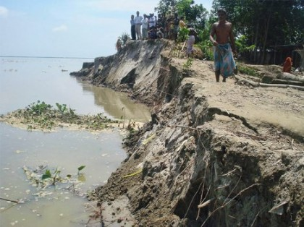
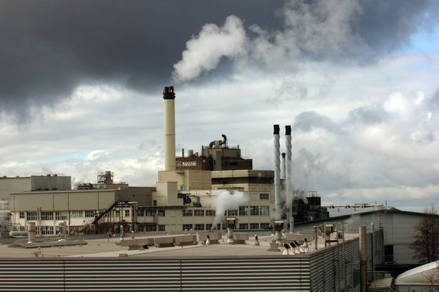
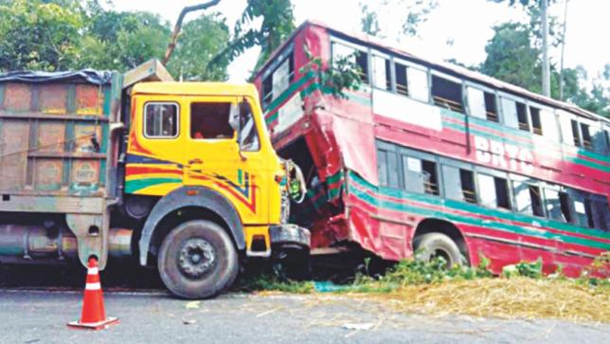
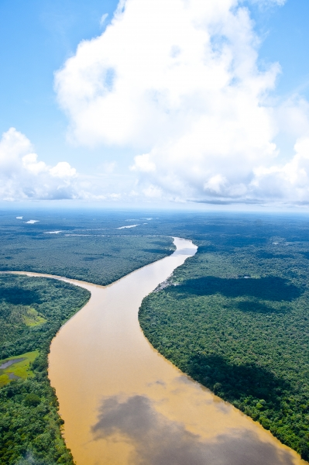
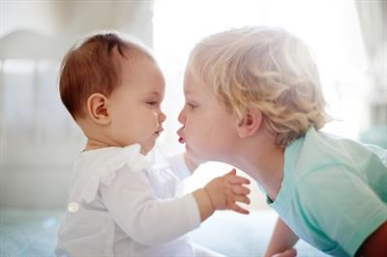
Younger
Garment worker
Accident
River
Factory
Driver
Erosion

Slide 9
Now we are going to read a passage named.
‘A garment worker’s day’

Slide 10
‘A garment worker’s day’
Teacher’s reading 2 to 3 times
Reshma is a garment worker in Dhaka.
She’s 18 years old.
Her family came to Dhaka from a village eight years ago.
There was a river erosion in her village.
They lost their home.
So the family came to Dhaka.
Reshma’s father
worked as a rickshaw driver, but he died in an accident.
Reshma’s uncle Ratan helped the family.
He found a small house for them at Kalyanpur.
He took Reshma to a
Garment factory in Mirpur.
She works their now.
Her younger brother Babul goes to school.
He is in class 5.
Her mother stitches “Nakshi Kathas” at home and sells them.

Slide 11
Explaining in Bangla
I’m telling the gist of the text in Bangla.
Look at the text and listen to me.
রেশমা একজন গার্মেন্ট শ্রমিক। তার বয়স ১৮ বছর। নদী ভাঙনে বসতভিটা হারিয়ে ৮ বছর আগে তারা ঢাকায় এসেছিলো। তার বাবা সড়ক দূর্ঘটনায় মারা গিয়েছিলেন। তার রতন চাচা তাদের সাহায্য করেছিলো। তিনি তাকে মিরপুরের একটি গার্মেন্টে চাকরী দিয়েছিলেন। তার ছোট ভাই বাবুল পঞ্চম শ্রেণিতে পড়ে। তার মা নকশি কাঁথা বানিয়ে বিক্রি করেন।

Slide 12
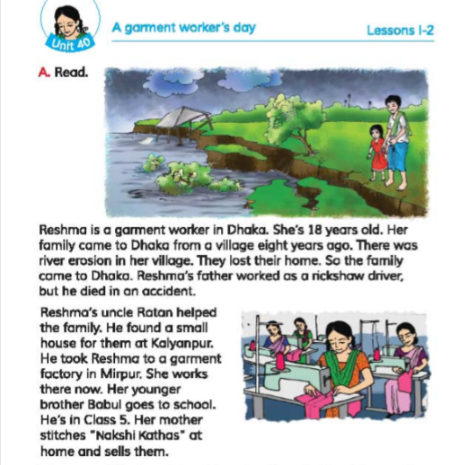
Now divide into 4/5/6 groups
Students group reading
Now read in groups. One student read by turn and others will listen.

Slide 13
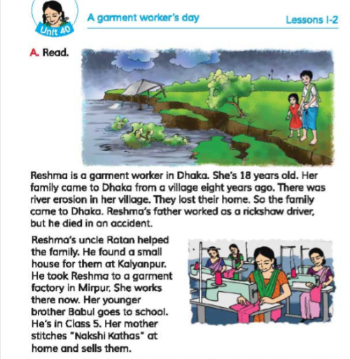
SS` pair and individual reading
Now make pair. One will read and other will help.

Slide 14
√
Choose the correct answer…..
Task
1.What does Reshma do?
a) She goes to school.
b) She’s a farmer.
c) She’s a garment worker.
d) She doesn’t have a job.
2. Who is Babul?
a) Reshma’s father.
b) Reshma’s brother.
c) Reshma’s uncle.
d) Reshma’s friend.
3. Where is the fectory?
a) in Mirpur.
b) in Kalyanpur.
c) five kilometres away.
d) near Babul’s primary school.

Slide 15
Home work…..
Answer the questions.
1/ Who is Reshma?
2/ How old is she?
3/ Why did Reshma’s family came to Dhaka?
4/ What was Reshma’s father’s occupation?

Slide 16
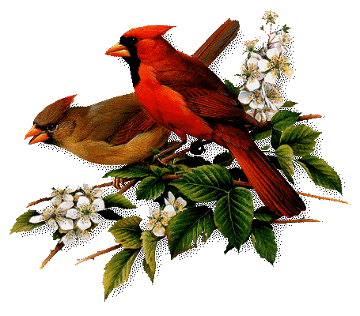
Good bye
Good bye

