Slide 1
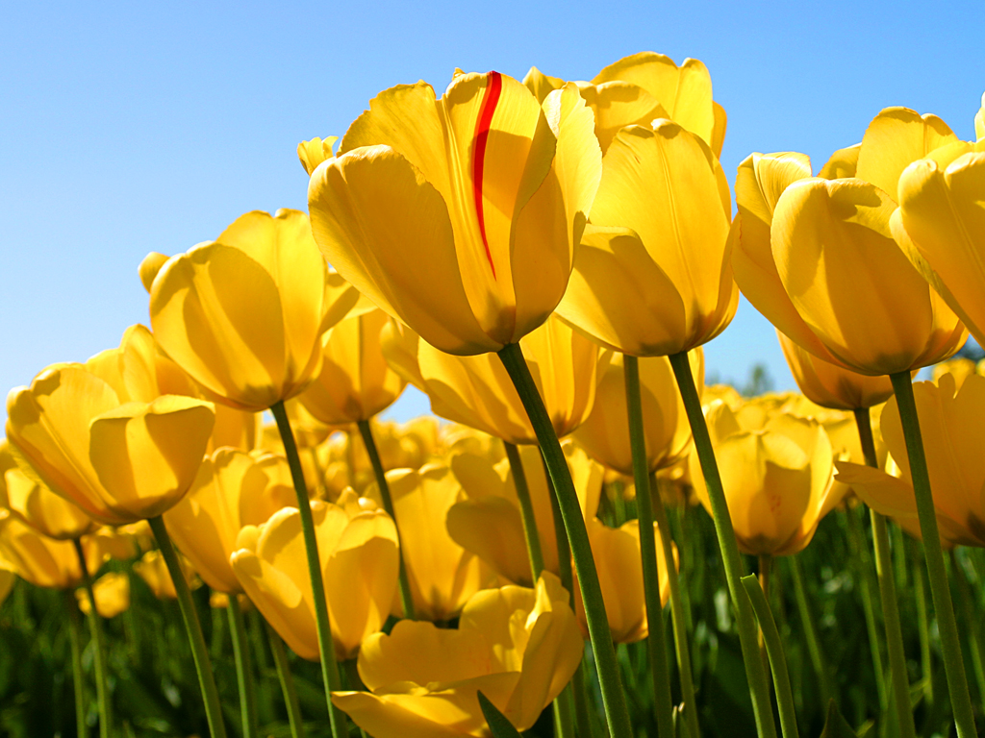
WELCOME

Slide 2
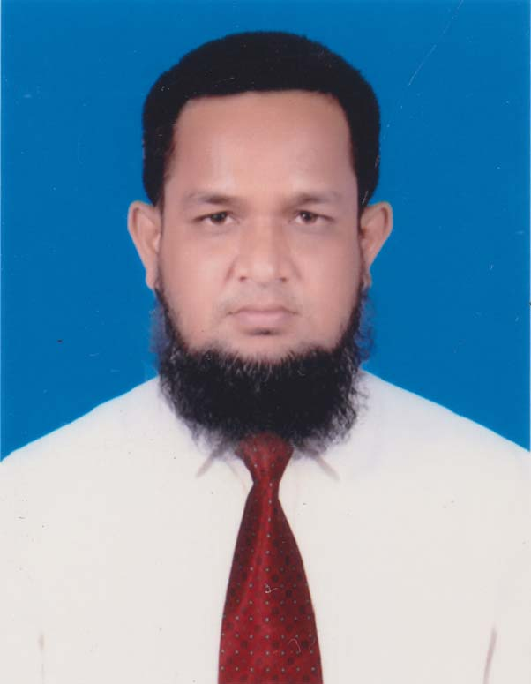
IDENTITY
MD.ABDUR ROUF
Lecturer in English
Khalna Islamia Fazil(Degree) Madrasah
PATNITALA, NAOGAON
Cell. 01767650169
E-mail: rouf301285@gmail.com

Slide 3
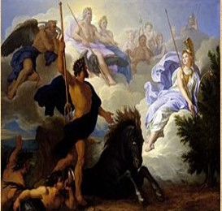
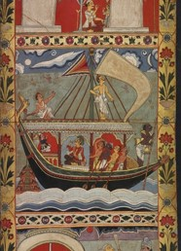
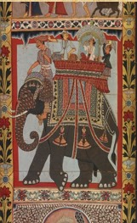
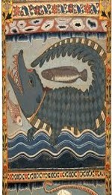
Let us see some pictures
Legend and Painting

Slide 4
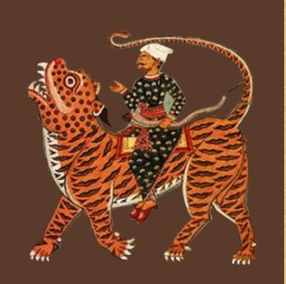
Our today’s Lesson is -
The Legend of Gazi
Unit:14, Myths And Literature ,
Lesson:03 ,The Legend of Gazi

Slide 5
Learning Outcomes
At the end of the lesson, the students will be able to -
Tell the meaning of some new words,
Tell the definition of Myth and Legend,
Describe the miraculous activities of Gazi Pir

Slide 6
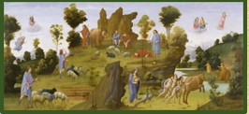
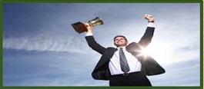
Vocabulary
Myth
Exaggerated
Miracle
Success

Slide 7
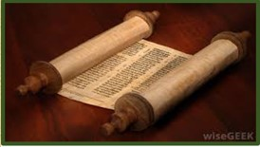
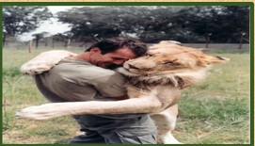
Scroll
Volume
Docile
Obedient

Slide 8
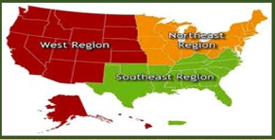
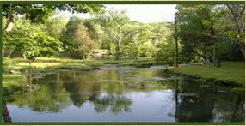
Region
Territory
Creek
Ditch

Slide 9
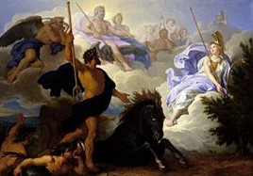
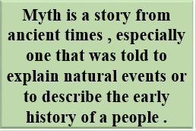
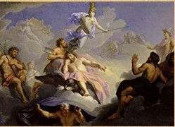
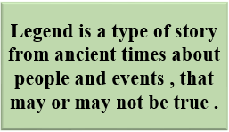
We can know about Gazi Pir from Myth and Legend.
What is Myth?
What is Legend

Slide 10
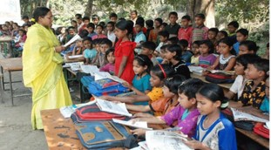
Verbal test
What do you know about “Myth and Legend”?

Slide 11
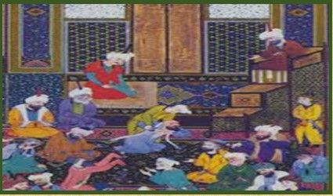
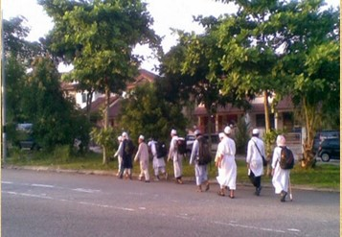
Who is Gazi Pir?

Slide 12
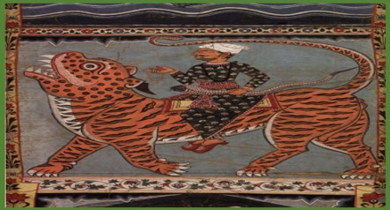
Let’s see the picture.
What indicates this picture?

Slide 13
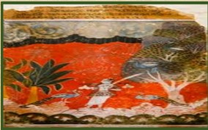
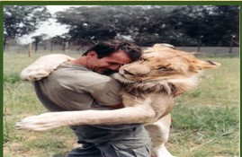

Slide 14
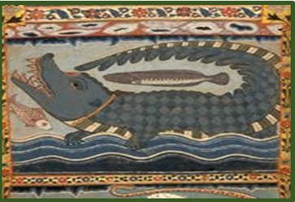
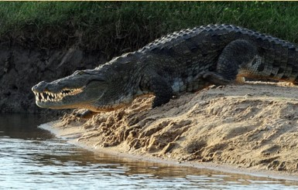

Slide 15
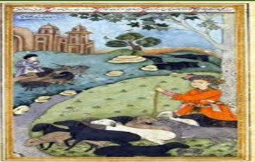
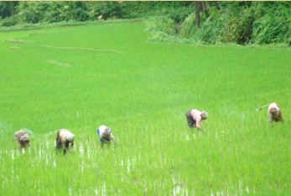

Slide 16
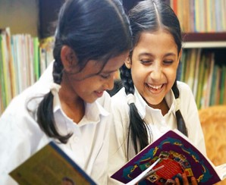
Pair work
Describe Gazi Pir’s Miraculous activities.

Slide 17
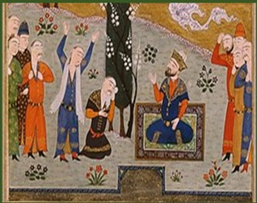
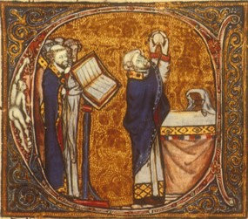

Slide 18
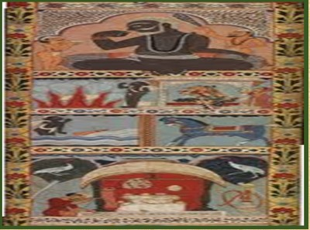
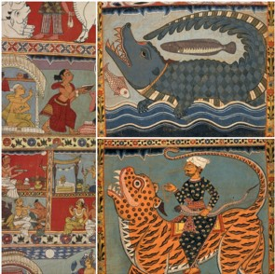

Slide 19
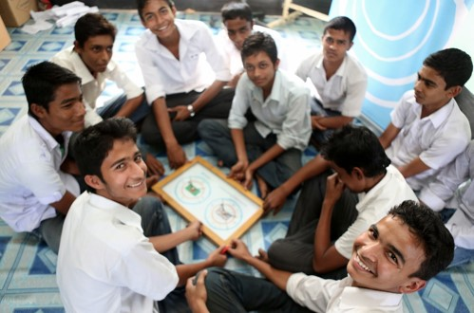
Group Work
Group: One
According to some myth and legend,
what kind of extraordinary power did Gazi have?
Group: Two
Why did people seek help from Gazi Pir?

Slide 20
Evaluation
1. Why was Gazi admired in parts of rural Bangladesh?
2.Have you seen Paat or Scroll painting and describe in brief?

Slide 21
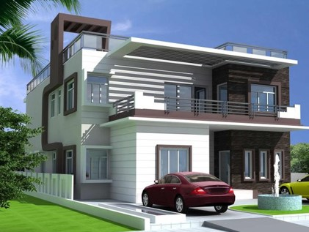
Home Work
Write a paragraph on “The Legend of Gazi Pir.”

Slide 22
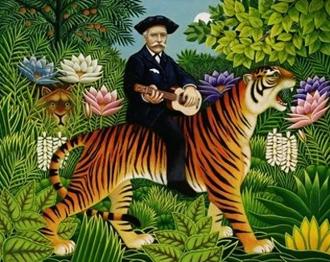
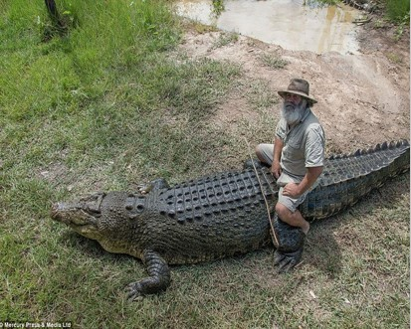
THANKS

